Slide 1



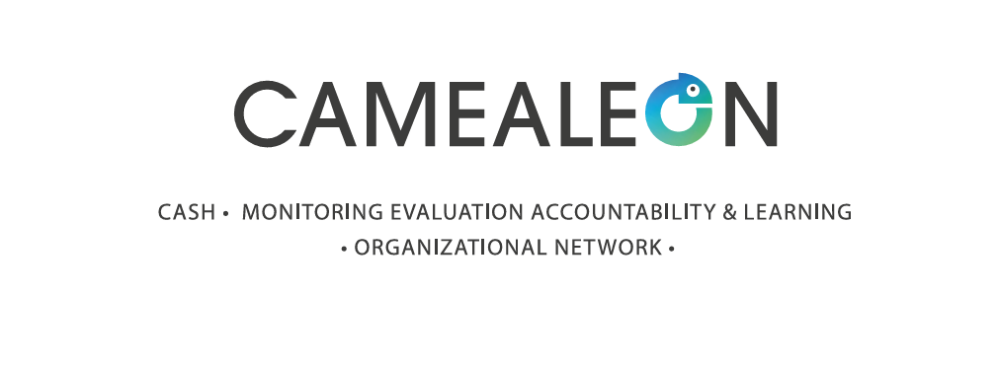
TRANSPARENCY AND ACCOUNTABILITY FROM THE BOTTOM-UP: LESSON FROM SOCIAL ASSISTANCE AND HUMANITARIAN CVA IN LEBANON
Policy Paper by Cory Rodgers and Cynthia Saghir
16th of September 2025

Slide 2



Disclaimer:
This publication was co-funded by the European Union and the Norwegian Ministry of Foreign Affairs. Its contents are the sole responsibility of CAMEALEON and do not necessarily reflect the views of the European Union and the Norwegian Ministry of Foreign Affairs (NMFA).

Slide 3
About:
The Cash Monitoring Evaluation Accountability and Learning Organizational Network (CAMEALEON) is a research and learning initiative in support of humanitarian and social assistance affected populations in Lebanon.
In its third phase, CAMEALEON produces research on the relevance, effectiveness and accountability of cash and voucher assistance and social assistance programs and supports dissemination through learning events, multi-media material and knowledge-sharing activities.

Slide 4


AIM OF THIS POLICY PAPER
Understand how transparency and accountability are perceived by recipients and non-recipients of social assistance and humanitarian CVA.
Provide policy recommendations to enhance transparency and accountability to affected populations and build trust and faith in institutions in Lebanon.

Slide 5
METHODOLOGY
This Policy Paper draws on three of CAMEALEON’s studies conducted between March 2024 and August 2025:
Study: | “Perceptions” | “Disability” | “Bottom Poor”
Research Focus: | Perceptions and popular narratives about CVA, and their impact on social cohesion | Experiences of people with disabilities accessing and using CVA | Experiences of highly vulnerable households accessing social safety nets
Sample (Method) | Over 300 social media posts and 13 traditional media articles 125 Lebanese and Syrian participants across three regions of Lebanon (FDGs and IDIs) 18 media professional and humanitarian practitioners (KIIs) | 61 Lebanese, Syrian and Palestinian people living with disabilities in different parts of Lebanon (IDIs) Practitioners working at 7 aid organizations that serve people with disabilities (KIIs) | NRC Lebanon’s MSNA data 74 vulnerable Lebanese people in different part of Lebanon (IDIs and FGDs) 12 experts and stakeholders in humanitarian CVA and SP (KIIs)
Status | Complete | Write-Up Ongoing | Data Collection Ongoing

Slide 6
LANDSCAPE OF CASH ASSISTANCE IN LEBANON
Humanitarian CVA | National Disability Allowance (NDA) | Social Assistance
Multipurpose Cash Assistance (MPCA) through UNHCR and WFP, and smaller organizations, like Oxfam, NRC, Mercy Corps and local NGOs to all nationalities. Sectoral cash, such as cash for protection and cash for rent or shelter. | The NDA is a universal social grant launched by MoSA, UNICEF and ILO in April 2023 that supports people with disabilities (PWDs). The social grants benefits 26,000 Syrian, Palestinian, Lebanese and migrant PWDs between the ages of 0 and 60. | The AMAN programme is a shock-responsive social safety net established by the Government of Lebanon with the support of the World Bank in 2022. It benefits 160,000 of the poorest and most vulnerable Lebanese households through a hybrid PMT and categorical targeting model and a social registry.

Slide 7
Perception and Experiences from the “Bottom-Up”
Interruptions and Uncertainty about Access to Assistance | Uneven Eligibility Criteria
Many CVA recipients expressed frustration about the lack of reliable medium- to long-term assistance programs. Interruptions are a strategic and often necessary measure for CVA or social assistance providers facing budget shortfalls, but only minimal information is provided to recipients and non-recipients SMS systems are sent to recipients to inform them of changes to their assistance, the decision-making behind these discontinuation or delays in payments are largely opaque. | There is a widespread perception that the distribution of assistance is biased toward certain groups, specifically towards Syrians. Narratives are spread through various kinds of media on nationality-based eligibility criteria and contribute to misperceptions leading to increased between communities and discrimination towards Syrians They also generate distrust in humanitarian agencies and encourage politicians to create a more hostile environment for displaced Syrians.

Slide 8
Perception and Experiences from the “Bottom-Up”
Opaque Targeting Methods | Unresponsive Communication
In our studies, we found widespread scepticism about the targeting mechanisms used for distributing assistance and being selected as being “luck based.” Applicants receive SMS-based notification of their acceptance or rejection from a program, but they are not given information about the reasons that they were rejected. Participants of our studies expressed doubt in the vulnerable criteria used in programmes, where the perceptions that targeting is inaccurate or biased can erode trust in system of assistance overall. | There was the widespread frustration among study participants about communication barriers when trying to reach providers. Some participants face challenges in accessing their assistance and described frustrations trying to reach someone on a non-responsive line for call centres or lengthy delays in response to their questions. Limited communication can also affect people’s understanding of eligibility criteria and targeting mechanisms, where some people would not know they were eligible for a certain program.

Slide 9
CONCLUSIONS AND RECOMMENDATIONS
Focusing on Lifecycle Universal Grants | Universal Social Protection System for All | Enhance Outreach and Communication
Like the NSPS, this paper reaffirms the need for more life-cycle universal social grants, in complementarity with SSN financed through progressive taxation. Universal programs “can to be an effective policy tool to promote solidarity, while at the same time strengthening the social contract.” | The social protection system should cover all nationalities, as is already the case with the National Disability Allowance. Parallel systems of aid for different nationalities can foster resentment between communities. If national systems include refugees, they can receive funds allocated to refugee protection and use this to cover overhead costs and reduce inter-community tensions. | Implementors and donors need to make significant investments in: Outreach and communication to ensure that enrolment details are widely disseminated; Call centres are responsive, well-staffed and trained; and Actively countering misinformation through community engagement and communication strategies.

Slide 10
Q&A

Slide 11
