Slide 1



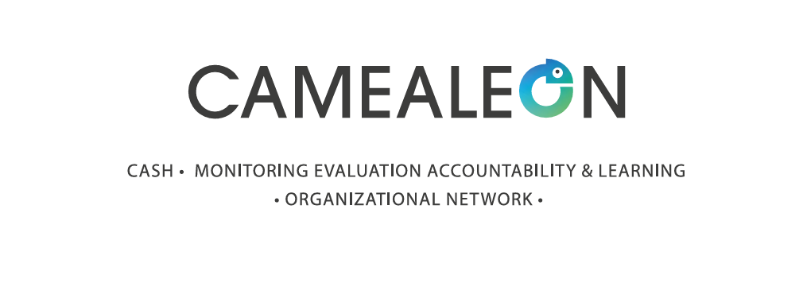
CAMEALEON 2023-2026: ENHANCING THE LINK BETWEEN SOCIAL PROTECTION AND HUMANITARIAN CVA IN LEBANON
25th of September 2025

Slide 2



Disclaimer:
This project was co-funded by the European Union and the Norwegian Ministry of Foreign Affairs. Its contents are the sole responsibility of CAMEALEON and do not necessarily reflect the views of the European Union and the Norwegian Ministry of Foreign Affairs (NMFA).

Slide 3
About:
The Cash Monitoring Evaluation Accountability and Learning Organizational Network (CAMEALEON) is a research and learning initiative in support of humanitarian and social assistance affected populations in Lebanon.
In its third phase, CAMEALEON produces research on the relevance, effectiveness and accountability of cash and voucher assistance and social assistance programmes and supports dissemination through learning events, multi-media material and knowledge-sharing activities.

Slide 4


CAMEALEON PILLARS
To increase evidence on the effectiveness of large-scale assistance response in Lebanon
To increase evidence on the accountability systems of the large-scale social assistance response in Lebanon
To improve learning on the large-scale social assistance response in Lebanon

Slide 5
LANDSCAPE OF CASH ASSISTANCE IN LEBANON
Humanitarian CVA | National Disability Allowance (NDA) | Social Assistance
Multipurpose Cash Assistance (MPCA) through UNHCR and WFP, and smaller organizations, like Oxfam, NRC, Mercy Corps and local NGOs to all nationalities. Sectoral cash, such as cash for protection and cash for rent or shelter. | The NDA is a universal social grant launched by MoSA, UNICEF and ILO in April 2023 that supports people with disabilities (PWDs). The social grants benefits 26,000 Syrian, Palestinian, Lebanese and migrant PWDs between the ages of 0 and 60. | The AMAN programme is a shock-responsive social safety net established by the Government of Lebanon with the support of the World Bank in 2022. It benefits 160,000 of the poorest and most vulnerable Lebanese households through a hybrid PMT and categorical targeting model and a social registry.

Slide 6
Perceptions and Experiences from the Bottom-Up
Study: | “Perceptions” | “Disability”
Research Focus: | Perceptions and popular narratives about CVA, and their impact on social cohesion | Experiences of people with disabilities accessing and using CVA
Sample (Method) | Over 300 social media posts and 13 traditional media articles 125 Lebanese and Syrian participants across three regions of Lebanon (FDGs and IDIs) 18 media professional and humanitarian practitioners (KIIs) | 61 Lebanese, Syrian and Palestinian people living with disabilities in different parts of Lebanon (IDIs) Practitioners working at 7 aid organizations that serve people with disabilities (KIIs)

Slide 7
Perceptions and Experiences from the Bottom-Up
Study: | “Bottom-Poor” | “Older Persons”
Research Focus: | Experiences of highly vulnerable households accessing social safety nets | Experiences of the most vulnerable Older Lebanese Persons in relation to CVA and social protection schemes
Sample (Method) | NRC Lebanon’s MSNA data 74 vulnerable Lebanese people in different part of Lebanon (IDIs and FGDs) 12 experts and stakeholders in humanitarian CVA and SP (KIIs) | 32 IDIs and 8 FGDs and IDIs with older persons aged 60+ and their caregivers throughout Lebanon KIIs with experts, stakeholders and practitioners

Slide 8
CONCLUSIONS AND RECOMMENDATIONS
Focusing on Lifecycle Universal Grants | Inclusive Social Protection System for All | Invest in Effective Communication
Like the NSPS, this paper reaffirms the need for more life-cycle universal social grants, in complementarity with SSN financed through progressive taxation. Universal programmes “can to be an effective policy tool to promote solidarity, while at the same time strengthening the social contract.” | The social protection system should cover all nationalities, as is already the case with the National Disability Allowance. Parallel systems of aid for different nationalities can foster resentment between communities. If national systems include refugees, they can receive funds allocated to refugee protection and use this to cover overhead costs and reduce inter-community tensions. | Implementors and donors need to make significant investments in: Outreach and communication to ensure that enrolment details are widely disseminated; Call centres are responsive, well-staffed and trained; and Actively countering misinformation through community engagement and communication strategies.

Slide 9
Upcoming Research
Leaner Cash Coordination | The Role of Civil Society | Adaptive Capacities
CWG & BA WG merger Evidence-informed process of consensus building and actionable recommendations for coordination with a renewed CWG. Draw lessons from global practices to inform better coordination options in Lebanon October 2025 Identify anticipated coordination bottlenecks, gaps, and challenges after the CWG and BAWG merger | Initial response to the September 2024 conflict Role of non-formal actor’s actions before gov/ formal humanitarian assistance How these early efforts interacted with the formal response. Working with the Asfari Institue - AUB Jan 2026 | Learning brief Embedded across qual research Household and community strategies and approaches that have emerged in response to multiple overlapping crises. Identify areas for further research & linkages to local responses. Dec 2025
Notes:
Role of civil soc – framing of diminishing international assistance, looking from a localization perspective at civsoc responses and linkages with government responses – opportunities for leverage points etc.

Slide 10
2025 Foresight Policy Paper
Forward-looking analysis of trends, gaps, and opportunities related to CVA and Social Protection in Lebanon.
Synthesize insights across multiple studies to inform future program and policy decisions.
Dedicated dissemination event Feb 2026.

Slide 11
Q&A

Slide 12
