Slide 1


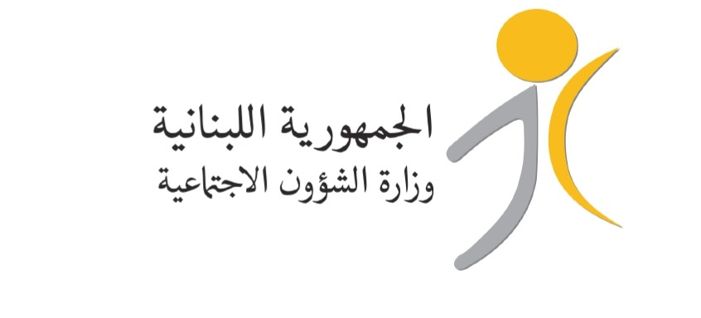
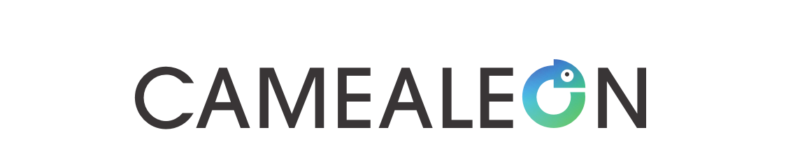




Navigating Social Assistance in Lebanon:
Experiences and insights of the Bottom Poor

Slide 2
Disclaimer
This publication was co-founded by the European Union and the Norwegian Ministry of Foreign Affairs (NMFA). Its contents are the sole responsibility of UrbanAxis, and do not necessarily reflect the views of the European Union or the NMFA.

Slide 3
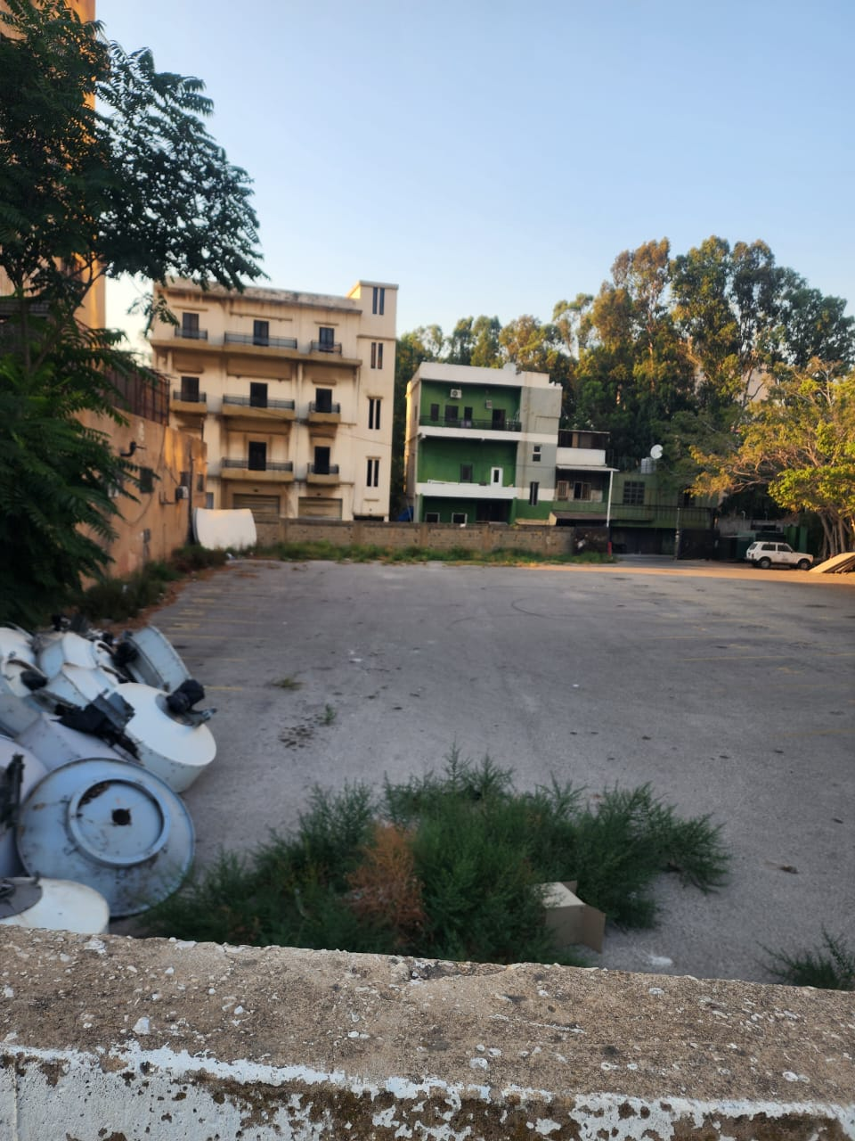

LITERATURE
Notes:
Background:
Since 2019, Lebanon has been grappling with a series of compounding crises; including economic collapse, the COVID-19 pandemic, the Beirut port explosion, and the 2024 Israeli war, that have severely strained its already fragile social protection system. These overlapping shocks have deepened poverty, widened social and economic inequalities, and exposed critical gaps in service delivery. Most recently the government introduced the National Social Protection Strategy (NSPS) as a long-term reform framework. The strategy adopts a pillar-based approach encompassing social assistance, social insurance, welfare, economic inclusion, and equitable access to basic services (Al Shami, 2023).
Lebanon’s social protection system has historically been fragmented and exclusionary, shaped by decades of political instability, economic volatility, and limited institutional capacity. While contributory schemes such as the National Social Security Fund (NSSF) founded in 1963, once provided coverage for formally employed workers, the absence of a comprehensive national social policy framework has left large segments of the population without access to social protection.
Despite its importance, social assistance in Lebanon has never been prioritised in terms of linking it to reliable and sustainable financial sources. In 2019, the Lebanese pound lost more than 98% of its value (World Bank, 2024) and in the absence of meaningful reforms to increase the state’s revenue, such as implementing progressive taxation, has hindered the creation of a cohesive national social policy framework. Lebanon’s current social assistance system is a patchwork of fragmented services managed by various ministries, public bodies, humanitarian actors and local service providers (Te Lintelo, Khayat and Lakshman, 2025). This fragmented provision of social assistance is marked with high levels of exclusion, opaque eligibility criteria, low coverage, barriers to entry, among others, leaving out poor and vulnerable groups with minimal or no social security.
In 2014 and 2021 respectively, the Government of Lebanon, in partnership with international donors, launched programmes such as the National Poverty Targeting Programme (NPTP) and Emergency Social Safety Net (ESSN), both emergency programmes based on loans from the World Bank. These programmes aimed to provide targeted support to the most vulnerable households in Lebanon. While the NPTP and ESSN serve as essential social safety nets, their structural weaknesses render them inadequate in addressing Lebanon’s escalating poverty crisis. The main issue is these programmes were conceived as short-term crisis response measures, rather than as long-term service provision programmes. As a result, they heavily depend on external funding, coupled with fragmented service delivery and political interference, limits their effectiveness and sustainability (Bastagli et al. 2019). Currently, the NSPS offers a long-term vision for reform through a pillar-based approach for a holistic social protection framework (Al Shami, 2023).
This recent development, coupled with the adoption of the pension law, represents a potential turning point in Lebanon’s social protection landscape (Bechara, 2024). The establishment of a pension system for private sector workers, after nearly two decades of deliberations, signals a shift toward more structured and sustainable social protection policies (United Nations, 2023). Additionally, the establishment of the National Disability Allowance (NDA) in April 2023 marked a significant development in Lebanon’s social protection framework. The NDA is a rights-based, universal social assistance mechanism designed to support individuals with disabilities, ensuring they receive essential aid. This represents a crucial step towards a more inclusive and equitable social assistance system, reflecting a broader commitment to universal, rights-based protection (Ministry of Social Affairs, 2023).
While recognising these efforts, there remains a limited understanding of how the poorest Lebanese households, referred to in this study as the “bottom poor”, experience and perceive these programmes. Existing research has focused primarily on policy design and macro-level outcomes, often overlooking the voices of those most affected by exclusion, intermittent support, and opaque targeting mechanisms.

Slide 4
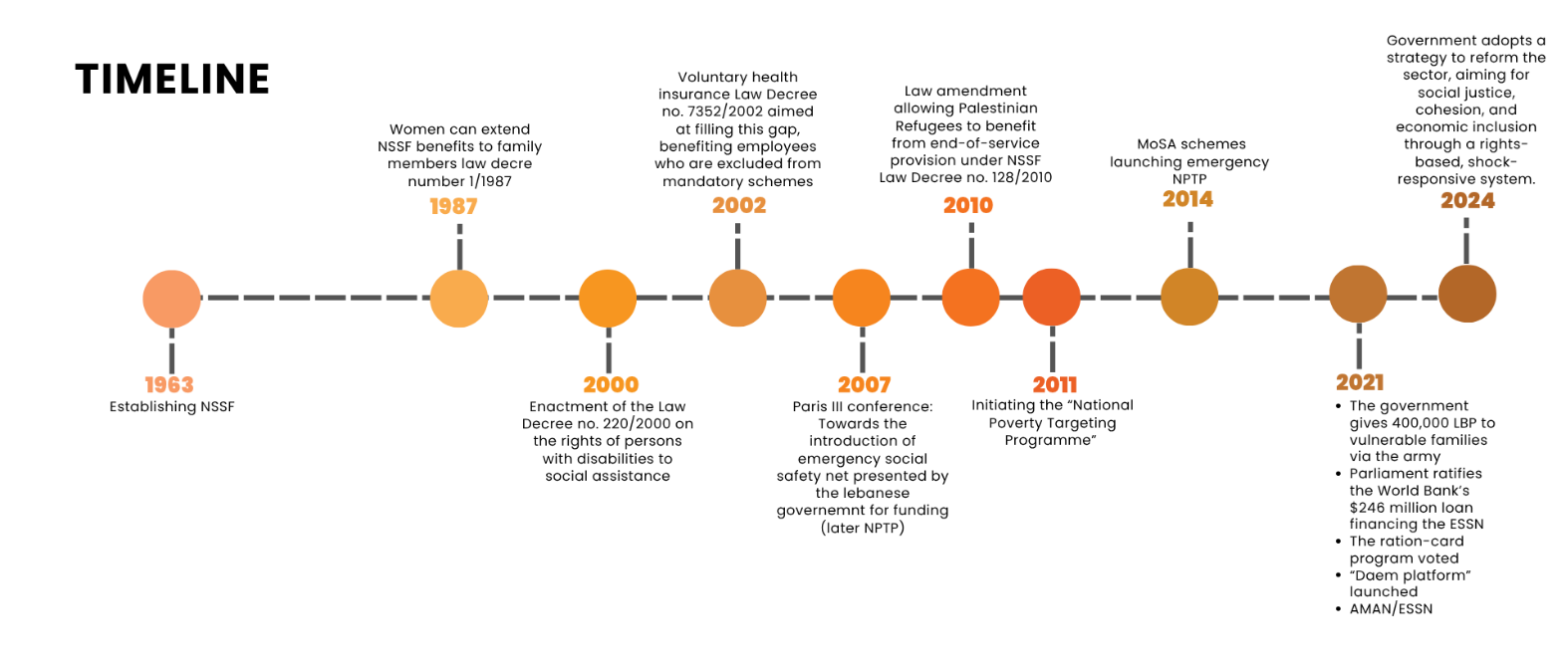
SOCIAL ASSISTANCE IN LEBANON: A LITERATURE REVIEW
Fragmented Social Protection System
Opacity of Targeting in Social Assistance Programmes
Barriers to Accessing Aid
Emotional and Psychological Impact of Accessing Aid
Aid Inequity, Spatial Disparity and Social Cohesion
Role of Networks in Accessing Aid
Gender-Based Barriers to Aid Access in Lebanon
Notes:
The literature on social assistance in Lebanon reveals a system that is fragmented, opaque, and deeply inequitable. Despite decades of policy evolution, from the establishment of the NSSF in 1963 to the recent push for reform in 2024, still - the core issues remain unresolved. This timeline shows incremental changes, but none have addressed structural weaknesses.”
Key Points to Emphasise:
Fragmentation: Social protection is scattered across multiple schemes with no unified framework, creating inefficiencies and gaps in coverage.
Opacity in Targeting: Targeting mechanisms lack transparency, leading to mistrust and exclusion of vulnerable groups.
Barriers to Access: Physical, bureaucratic, and informational barriers prevent equitable access to aid.
Emotional and Psychological Impact: Literature highlights how uncertainty and stigma in accessing aid exacerbate stress and vulnerability.
Aid Inequity and Spatial Disparity: Assistance is unevenly distributed, reinforcing social and regional inequalities.
Role of Networks: Access often depends on personal or political connections, undermining fairness.
Gender-Based Barriers: Women face unique challenges in navigating aid systems, from documentation to mobility constraints.
Taken together, these findings argue for a paradigm shift: Lebanon’s social assistance cannot remain reactive and fragmented. Instead, it needs a rights-based, lifecycle approach that prioritizes transparency, equity, and resilience. Without addressing these systemic flaws, reforms risk perpetuating exclusion rather than alleviating poverty.

Slide 5
RESEARCH QUESTIONS
What are the perspectives and experiences of the bottom poor Lebanese people on enrolling,
being part of and/or being excluded from social assistance programmes (NPTP and ESSN)?
What are their perspectives and experiences regarding key design (such as targeting, regularity, transfer type/size and mode of delivery) and implementation aspects (registration, claiming, receiving) of these social assistance programmes?
What lessons can be drawn from the perspectives and experiences of the bottom poor for improving the inclusiveness and effectiveness of social assistance programmes?
Notes:
This report seeks to move beyond analyses of policy design, coverage, and fiscal sustainability by providing valuable insights into how the poorest Lebanese households themselves experience and perceive social assistance programmes, particularly in terms of exclusion, programme opacity, intermittent support, and inequitable access.
This research employs a mixed-methods approach, combining quantitative and qualitative techniques to thoroughly assess social assistance programmes in Lebanon, particularly the National Poverty Targeting Programme and the Emergency Social Safety Net. By merging statistical analysis with insights into lived experiences, the study aims to provide a comprehensive understanding of programme accessibility, effectiveness, and challenges.

Slide 6
METHODOLOGY
Mixed Methods: Quantitative and Qualitative

Slide 7
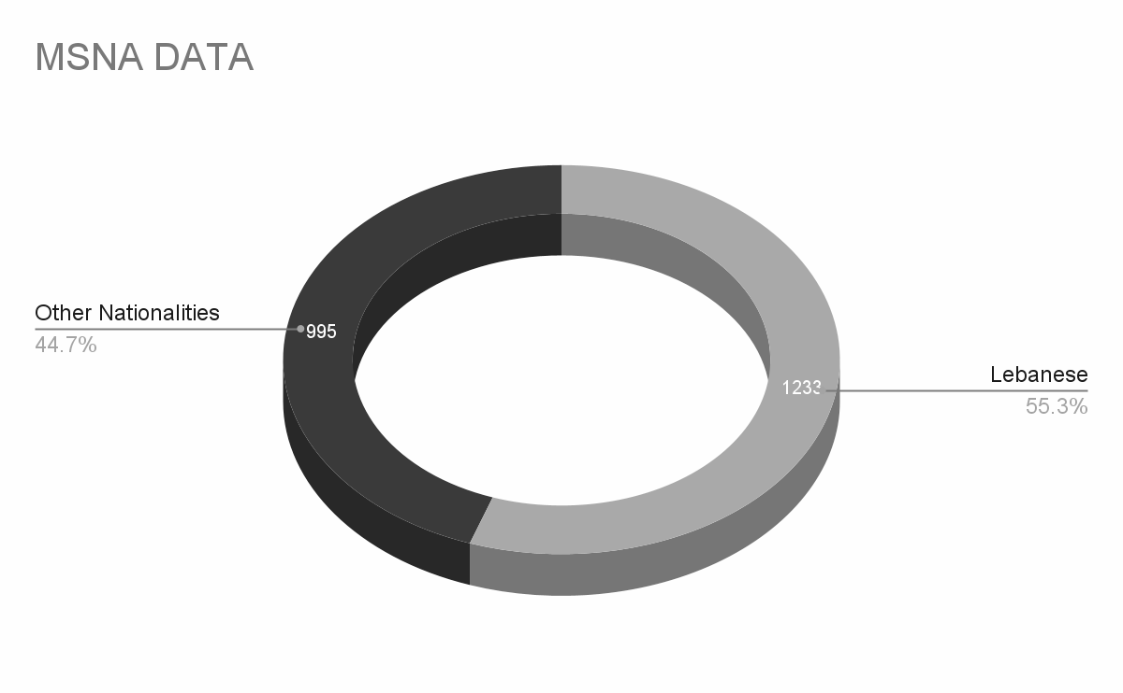
METHODOLOGY - QUANTITATIVE
MSNA Dataset: 2,228 survey entries with 1,233 Lebanese.
Vulnerability Scoring: Calculated for 783 Lebanese households using a validated multidimensional vulnerability score (VS) in STATA 18.
Validation: VS showed strong correlation with income and expenditure levels.
Classification: Households divided into five vulnerability quintiles; the most vulnerable (5th quintile) included 157 individuals.
Notes:
Methodological inspiration was drawn from global indices such as the Social Vulnerability Index, the Multi-Dimensional Poverty Index, and the Household Economy Approach (Cutter et al, 2003; Alkire and Foster; 2011; Save the Children, 2008).
Variables were weighted to prioritise dimensions most strongly associated with survival and resilience, notably food security, healthcare, and income stability. Statistical modelling and poverty scoring techniques were then applied to identify households experiencing the highest degrees of deprivation and VS. The bottom quintile (N= 157 households, out of the 783) was identified as the target population for qualitative sampling.
The study's quantitative phase involved analyzing a dataset of 2,228 entries to pinpoint the most vulnerable households using a multidimensional vulnerability score. Of the 2,228 survey participants, 1,233 were Lebanese, and vulnerability scores were successfully calculated for 783 of them. This group was then categorized into five vulnerability quintiles based on their scores, with the most vulnerable segment (the top quintile) consisting of 157 individuals. The subsequent qualitative research sampling strategy was informed by examining key features of this highly vulnerable group, including their geographic distribution, assistance status, and the gender and age of the household head.
The quantitative analysis using STATA 18 identified the most vulnerable households based on a validated multidimensional vulnerability score (VS). The validation exercise confirmed that the VS correlates strongly with income and expenditure levels, allowing for identification of the bottom quintile (5th quintile, N = 157)

Slide 8



METHODOLOGY - QUALITATIVE
In Depth Interviews
49
Key Informant Interviews
11
Focus Group Discussions
6
Notes:
The subsequent qualitative fieldwork focused primarily on households in the lowest quintiles to examine lived experiences of vulnerability and to unpack how assistance programmes are perceived by those most in need. Purposive and stratified sampling were employed to ensure the inclusion of households across key variables identified during the quantitative stage. The data was also expanded geographically to include diverse districts across Lebanon; from urban centres like Beirut and Metn, to rural and conflict-affected areas such as Muhammara in the North, Zahle in the Bekaa Valley, Bikfaya in Mount Lebanon, and Southern districts near the border; allowing for a nuanced understanding of how location intersects with aid access, vulnerability, and social dynamics.
Qualitative participants were identified through a combination of stratified purposive sampling and snowball sampling. Sampling criteria included:
Aid status (recipients and non-recipients): To capture experiences of accessing aid and perspectives of those excluded from receiving aid.
Gender: The sample was overrepresented by women due to fieldwork conducted during the day. Women acted as primary narrators of household experiences, given men’s preoccupation with work.
Age and disability: Older persons and persons with disabilities were not directly interviewed due to ethical considerations; however, some of their experiences were reflected through the accounts of their caregivers.
Geography: Participants were selected across urban and peri-urban sites in Beirut, the Bekaa, and the South
Three complementary data collection tools were deployed during the qualitative phase:
In-depth Interviews (IDIs): Forty-nine interviews capturing personal accounts of navigating social assistance systems.
Focus Group Discussions (FGDs): Six sessions exploring collective perceptions, shared frustrations, and perceived inequalities.
Key Informant Interviews (KIIs): Eleven interviews with aid practitioners, public officials, and NGO representatives to understand programme inception, design and delivery and situate household narratives within the broader operational and policy context.
Ethical protocols for the study included obtaining informed consent, ensuring anonymisation, and guaranteeing voluntary participation. Older persons (above 60) and persons with disabilities were excluded from this study to protect vulnerable groups, as their participation would require additional ethical safeguards and specialised consent procedures. Fieldwork was challenged by contextual factors such as municipal elections and regional conflict, which affected both trust and access to participants. The qualitative sample was selected purposively, which may introduce sampling bias and limit the generalisability of findings. Self-reported data may be affected by recall bias and social desirability bias, especially when participants are asked about social assistance. Additionally, some participants were hesitant to share information due to concerns about losing aid or having experienced fatigue from repeated interactions with aid organisations. Data saturation indicated that similar narratives were being repeated, suggesting the possibility of targeting the same populations and highlighting the need for alternative approaches to capture more diverse perspectives. Finally, potential gaps and inconsistencies in the pre-existing MSNA dataset could have limited the analysis.
The qualitative data analysis used the most vulnerable from all the quantiles in the MSNA data and expanded on these where there was ability to do so. The qualitative data was coded and then grouped under themes and subthemes to generate overarching themes. we will go through the most prominent today.

Slide 9
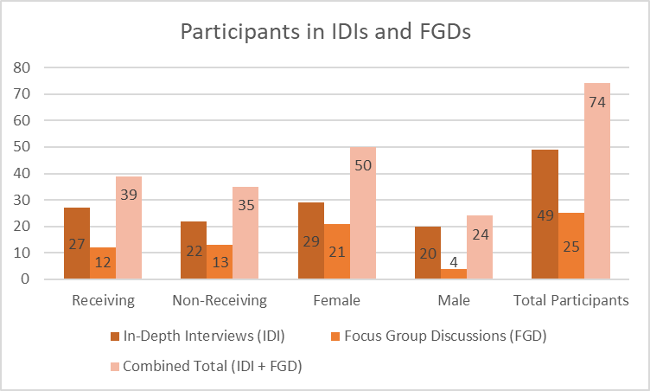
METHODOLOGY - QUALITATIVE

Slide 10
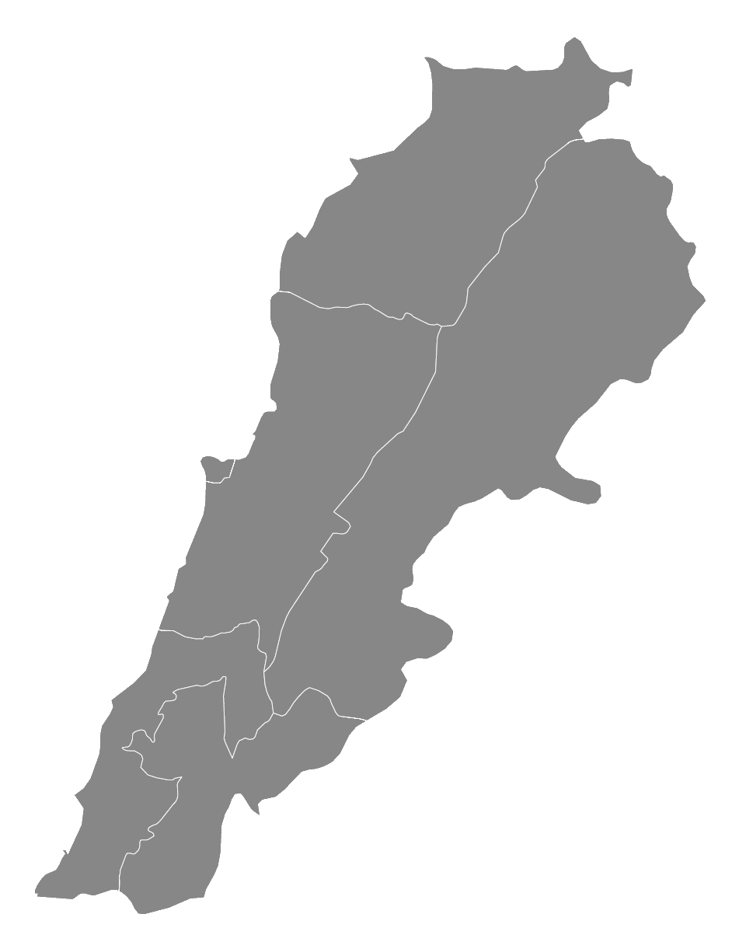
METHODOLOGY-AREAS COVERED
Muhammara
IDIs: 10
Sir El Donieh
IDIs: 8
Bourj Hammoud
Karantina
IDIs: 10
FGDs: 2
Bikfaya - Metn
IDIs: 6
Qob Elias
IDIs: 6
FGDs: 2
Saida
FGDs: 2
Bissarieh
IDIs: 5
Ain Baal
IDIs: 4
Notes:
Data saturation has been reached at the milestone of 30 IDIs and 4 FGDs.

Slide 11
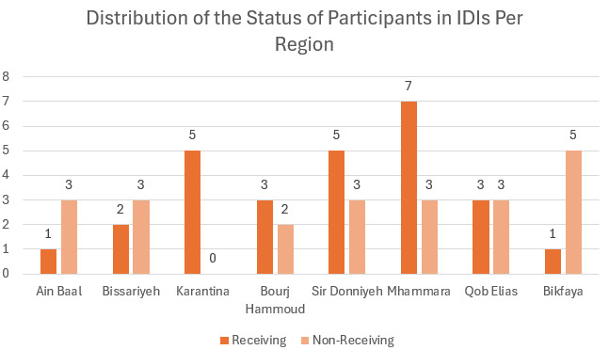
IDIs SAMPLE DISTRIBUTION

Slide 12
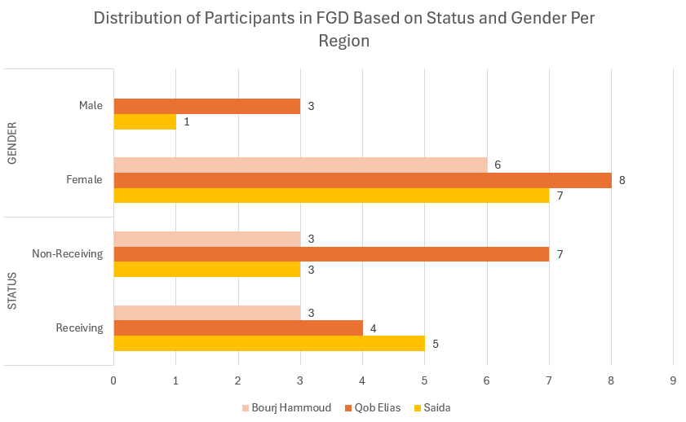
FGDs SAMPLE DISTRIBUTION

Slide 13
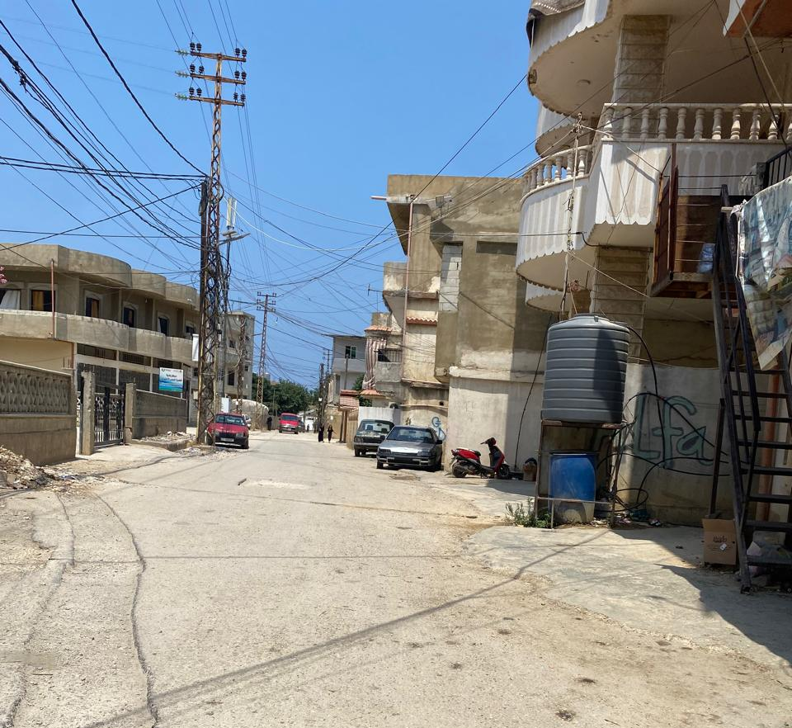
FINDINGS BY THEMATICS
Muhammara (Akkar)

Slide 14
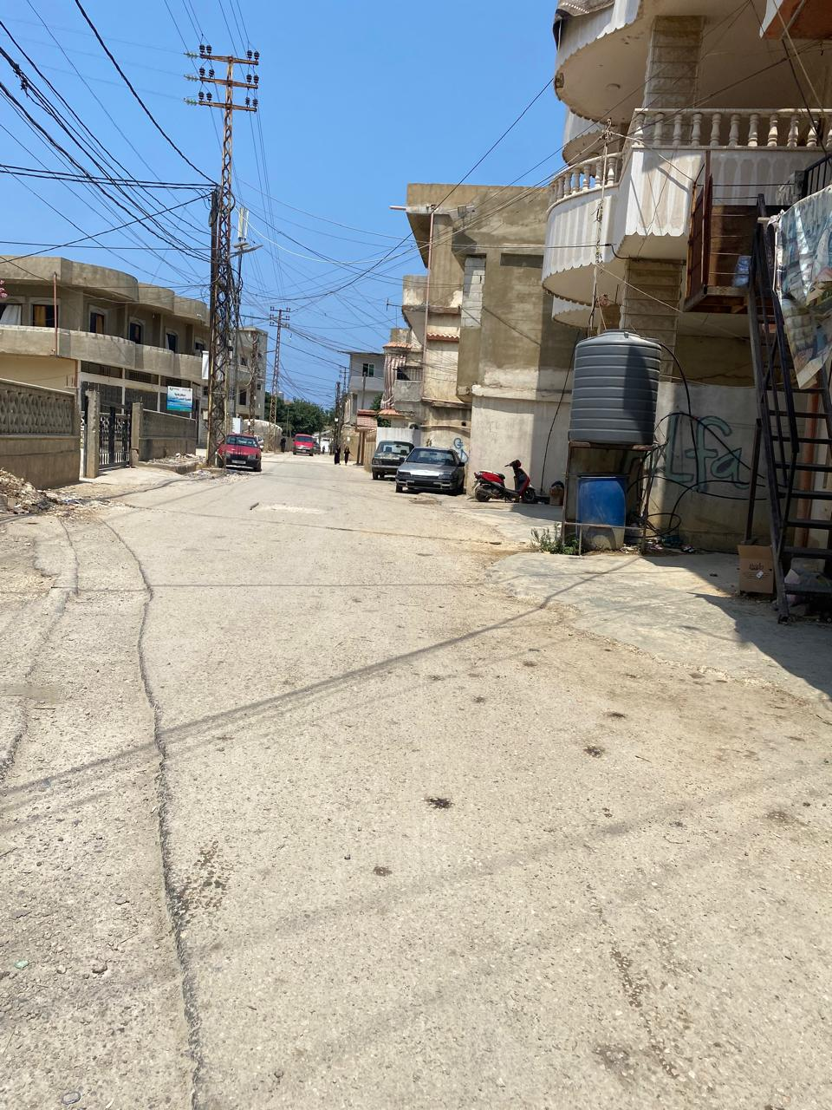
FINDINGS-The Effect of Multiple Crises on Receiving Social Assistance
Disrupted Social Assistance
Social Assistance and Resilience
Perceived Ineffectiveness
in Social Assistance During Crisis
Notes:
Disrupted Social Assistance
Participants described how assistance was interrupted or discontinued during crises namely the financial crisis of 2019, COVID-19, the August 4th explosion in 2020, and the Israeli war in Lebanon (2024) depriving them from financial support amid volatile economic and security conditions. Assistance disruption or discontinuation during times of crises increased perceptions of economic uncertainty and instability.
Interviewees who receive assistance reported different experiences regarding compensation for the months in which assistance was suspended/interrupted: while some were compensated others were not. Multiple participants who received assistance were displaced during the 2024 war from South Lebanon. They expressed the reality and perils of aid suspension that have been compounded by displacement during that time. Participants experienced gaps without any explanation as one male participant in Bikfaya (Mount Lebanon) noted "During the war there was a 5 month wait... no one made up for it.” One female participant from the South who was displaced and her aid discontinued suffers two types of cancer expressed her dependency on assistance for her treatment costs: “I have breast cancer, and get treated for it, but was also recently diagnosed with cervical cancer, which I am not treating because we’re 8 at home, lost a daughter in the war […]and were cut off from aid. This amount that we received even if for a short while, used to help us cover my medical costs.”
Interruptions of social assistance during times of crisis exacerbates economic precarity of vulnerable households; forcing them to endure prolonged periods without support while having to deal with their compounded vulnerabilities.
Social Assistance and Resilience
The successive shocks experienced in Lebanon profoundly altered participants’ economic realities and perceptions of social assistance as a main lifeline. Interviewees who receive assistance had planned their expenditure based on the availability of cash assistance. According to a man who benefits from AMAN in Sir el Donniyeh (North Lebanon): “The amount went to rent, medication, and mostly for heating, diesel or wood, because the generator subscription is too expensive. For example, if my salary is not enough, I take the amount that we get from the aid to cover the rest of the rent and then whatever is left from the aid, it goes to medication and if we have an extra amount left, I put it on the side for heating.”
The crisis triggered an exponential increase in living costs and a reduction in available aid, exacerbating an already dire situation for low-income households. As a result, households developed complex coping mechanisms, such as borrowing, reducing essential expenditures, or relying on informal networks to secure additional income.
Coping measures also entailed removing some nutritional elements from household diets, a practice that was common among recipients and non-recipients of MoSA assistance. A non-recipient female participant in Bteghrine (Matn District) explains: “A lot of things we don’t get anymore: meat, chicken we get some but much less now.” Moreover, participants shared accounts on how they tend to prioritise medication over food or other medication as well as have ration modest quantities of food over long periods of time. A female participant for Qob Elias benefits from AMAN and whose husband lost his job due to a severe back injury exemplifies these cases: I can't stop the medication, especially the medication for my blood pressure and diabetes. I try to reduce other medications or food […] Now, I buy on a day-to-day basis. […] What I do is that I buy meat and divide it per meal, especially since my fridge is not working. An interviewed expert corroborates this practice whereby some “have to cut on medicines rather than taking the recommended one pill per day. They take it every two days to make it last longer” (KII). These practices exemplify the abject poverty and precarity of households’ situations.
Perceived Ineffectiveness in Social Assistance During Crisis
There is a widespread view that state institutions are unable to provide reliable support consistently. During emergencies and shocks, people are led to rely on humanitarian aid, which is often seen as unpredictable and temporary. Yet, despite these challenges, it is often perceived as properly managed and distributed.
Despite their confusion about the roles of MoSA, humanitarian organisations, and local NGOs, participants believe that it is the responsibility of the Lebanese Government to provide social protection. They see the government as not fully fulfilling its obligations and therefore relying on NGOs and international organisations to address gaps in social assistance for needs that fall outside its scope. According to a non-recipient male participant from Muhammara: “MoSA should be responsible, and especially the government, but it’s not doing its job fully. The NGOs are taking over. For example, the house, if they (INGO) didn’t renovate it, it would have been worse."
Participants perceive that MoSA does not respond appropriately in times of crisis due to budget constraints, logistical limitations, and weak local coordination. One non-recipient female participant from South Lebanon complains about the lack of reliability and organisation of assistance provision, which has worsened during the war: “I have been trying for years to get assistance and have not been able to keep up with anything anymore. Everything is chaotic, and the MoSA office in Tyre was bombed, which made everything much more difficult because we no longer know who to call.” Others perceived that international organisations and local NGOs were more responsive. One displaced non-recipient woman in South Lebanon noted," We believe the assistance from NGOs and foreign organisations is better than government aid because they are more present among us. The government does not work in the same way, and we rarely see them in our area.” Some even went as far as to say NGOs could take over government responsibilities in social assistance. According to a non-recipient divorced woman in Qob Elias: “since the funding is coming from outside, foreign aid, and the government doesn't have funds, so for now it’s better for the organisations to take over the responsibility of helping because the government is unable to do it.”

Slide 15
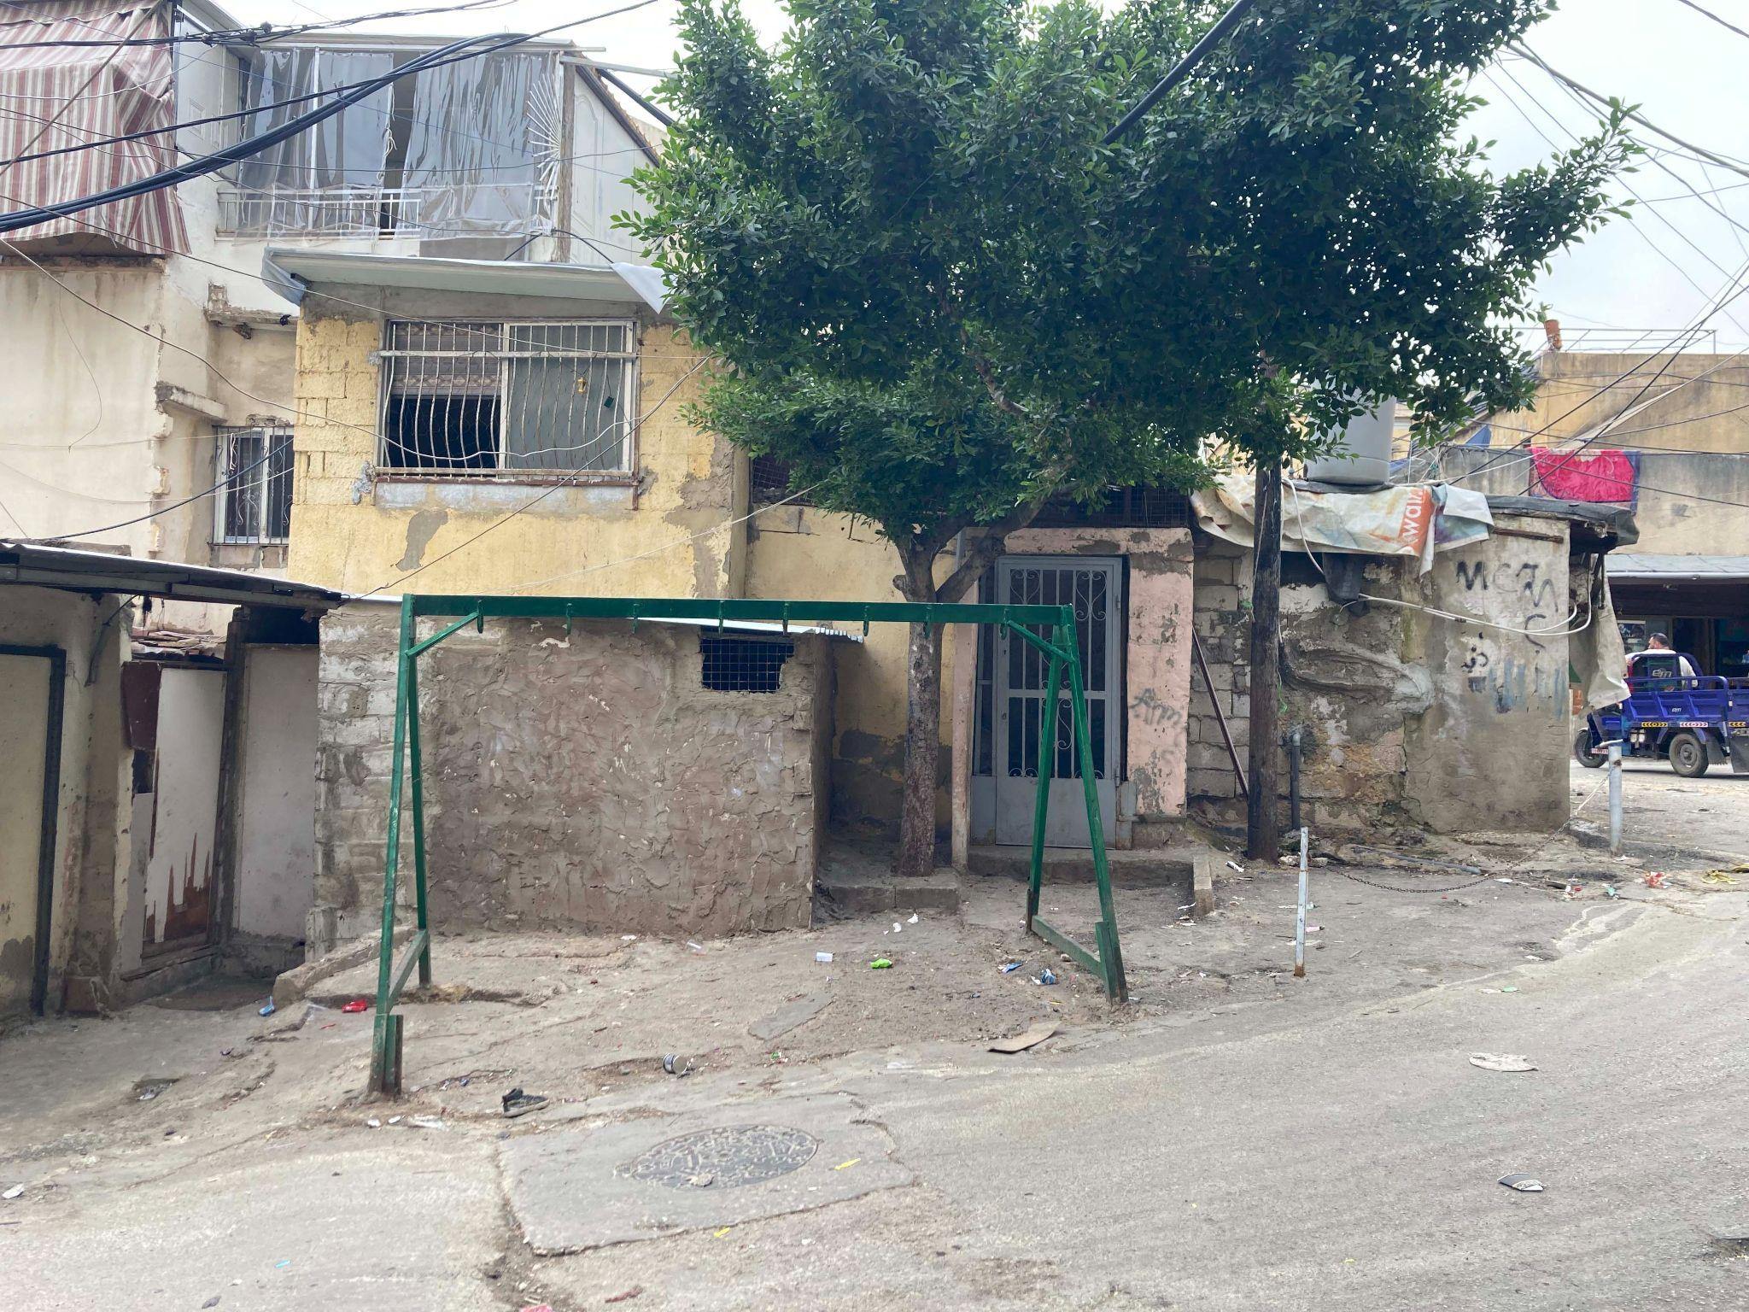
FINDINGS-Outreach Targeting and Design Opacity
Ineffective Outreach to Communities in Need
The Perceived Role of Political Networks and Local Authorities in Accessing
Lack of Clarity and Trust in Targeting and Design
Notes:
Ineffective Outreach to Communities in Need
Respondents criticised the lack of systematic outreach to the poorest communities. They described institutional channels for accessing information about social assistance programmes as limited and inconsistent. One non-recipient female participant form Muhammara stated: “We never got anything from MoSA. Apparently, they opened offices again but we never went there to apply. We never got a link on the phone. My father wanted to send someone to the MoSA office because he couldn’t go. But I have younger siblings so I had to stay home and my brother is working so no one could go.” Her statement highlights geographic inequities in outreach and discouragement among vulnerable households to pursue access to assistance. On the other hand, accessing institutional websites and platforms was also problematic, requiring digital literacy and smartphone access, resources not available to all. Respondents criticised the lack of systematic outreach to the poorest communities.
Mass media channels, such as television and news outlets, were more successful in raising general awareness but failed to provide actionable information. Participants recalled hearing about aid programmes on TV and social media yet this did not translate into meaningful engagement or access such as this non-recipient male participant in Sir el Donniyeh: “We heard about the aid programme on TV and on social media. We never received anything and no one contacted us.”
Participants frequently relied on peer-to-peer information sharing to learn about social assistance programmes, often compensating for gaps in formal outreach and accessibility. Many described receiving programme details through family and friend networks, such as one AMAN recipient male participant who noted how his wife’s cousin “forwarded the message to her and she helped us register”, while another non-recipient female in Qob Elias shared, “We had a friend that works with MoSA and she was like why don't you do it”. Neighbour networks also played a key role, with a recipient female participant in Muhammara stating, “My neighbours also told me there is this programme”. A non-recipient female participant from Qob Elias demonstrated how community awareness about the assistance programmes was often driven by informal networks: “My neighbours got links and sent them to each other.”
These networks were especially important and reliable for individuals facing literacy barriers, who relied on family members to help navigate application processes.
The Perceived Role of Political Networks and Local Authorities in Accessing Social Assistance
Political affiliations and local power structures often mediate access to social assistance in Lebanon. Respondents reported that political party representatives shared programme details with their supporters before public dissemination, reinforcing perceptions of favouritism and inequity. As one non-recipient male from South Lebanon and whose application was rejected noted, “People affiliated with certain parties seem to have better chances of getting assistance. It’s frustrating to see others benefit through connections […] There’s a lack of clarity in the entire process. Why were we not eligible? Why no communication?”
Several participants described how political party connections facilitated their inclusion in aid programmes. For instance, a woman in Sir el Donniyeh who was discontinued from assistance programme shared, “At the time, we were politically affiliated with someone, so that's how we got access”. While another woman who benefits from AMAN since 2021 noted how she sought the help of someone connected to MoSA to enrol in the NPTP programmes before (10 years ago), “I registered in Karm El Zaytoun with Professor X in the ministry”, highlighting the role of personal political contacts in navigating the system.
Municipalities are perceived to play a significant role in controlling access to aid, particularly in politically charged environments. Focus group discussions in the South revealed that “Word of mouth from people who are close to the political powers in the municipality” was a common way to learn about programmes. Another recipient male participant in the same focus group added, “People close to the municipality do that to reserve assistance for people who share their political following”, underscoring how local governance is perceived to reinforce partisan distribution practices. One interviewed expert elaborated on the role of local authorities using their leverage impact on SDCs in their localities to influence aid distribution, “The role of municipal members and mayors and makhatirs. They all do play a role in connecting people to services, whether it's services from non-governmental organisations or from SDCs. You find that very often they play a very important role when it comes to linking beneficiaries to or recipients to required services when they know about them.” (KII)
Information itself is often treated as power capital. A woman one of the Qob Elias FGDs (non-recipient participants) described deliberate information hoarding, noting that “People don't want others to know about assistance”. This calculated withholding of information by political actors serves to control access and maintain influence, creating a system where aid is distributed not based on need, but on loyalty and proximity to power.
Experts interviewed for the study noted that political pressure could be more prevalent in the NPTP programme prior to 2019, whereas the ESSN is perceived to be less politicised. Nonetheless, many poor households remain excluded due to perceived influence of local elites, who control access to information and services in their communities.
Lack of Clarity and Trust in Targeting and Design
Participants in this study voiced concerns about the lack of transparency in the design and implementation of social assistance programmes. Many believed that aid distribution was not based on clear or measurable criteria, or that such criteria had not been properly communicated to the public. This ambiguity fostered widespread mistrust and discouragement, with individuals often hesitant to reapply or seek further information. A common sentiment was summed up in the question: “Why them, not me?” especially when participants saw neighbours receiving support while they themselves faced repeated rejections without explanation.
The experience of a non-recipient male participant from Bikfaya exemplifies how eligibility criteria and assessments that have not been clearly communicated undermine trust in social assistance programmes. The interviewee’s wife claims that they were rejected for aid based on the appearance of their home, as she explained, “They came to do a home inspection from MoSA. They saw the condition of the house and they told me that because we have parquet flooring in the house, we are not eligible for the aid.” Participants believed that social workers over-relied on visual cues, rather than verified socio-economic data, which caused emotional distress and a sense of humiliation. Some expressed the home inspection process as arbitrary with some areas never receiving visits as claimed by a recipient female participant from Saida: “Honestly I do not recall, but we applied and waited for inspection, while some other people we knew received assistance without any inspection of their homes, so the procedure was different for every household.” Excluded or discontinued participants also struggled to understand how verification visits and their frequency were linked to checking poverty criteria. This lack of clarity undermines confidence and trust in the system among the bottom poor.

Slide 16
FINDINGS- Barriers to Accessing Aid and Support Channels
Digital and Functional Illiteracy
Physical and financial Barriers to Accessing Aid
Lack of Feedback and Appeals Mechanisms
Notes:
Digital and Functional Illiteracy
Vulnerable individuals struggled with online applications due to illiteracy or lack of digital skills, often relying on others for help. However, participants who could access SDCs in their regions did not encounter challenges related to the usage of the DAEM digital platform used for registration in AMAN programme or applying through the SMS links.
In an increasingly digital world, the prevalence of illiteracy and limited access to, or proficiency with, digital technology can limit accessibility of individuals to programmes that rely on written forms or online platforms for application and distribution. Participants reported difficulties directly caused by their inability to read or write. This requires depending on others for help, whether informal (relatives, neighbours and friends) or formal. For example, a recipient female participant from Sir el Donniyeh remembered, "A female employee at the office of the MOSA helped me in filling the form because I am illiterate". And another non-recipient female participant from the South, who received assistance in accessing the form "I can't read or write, […]so my sister helped me complete the application. This underlies the importance of human intermediaries when official processes are not designed for those with low literacy.
According to expert interviews, relying on technology-based access to assistance programmes alienated poor rural communities and vulnerable social groups in urban settings that face poor internet connectivity, digital illiteracy, and a lack of access to ATMs (or lack of knowledge of using them). One expert highlighted “…everything that has to do with online registration; we knew from Ukraine it would not reach the digitally illiterate. That’s the case in Lebanon too. So we need to make sure we accommodate these online-driven registration platforms to the digitally illiterate. Maybe the poorest, the most vulnerable (the elderly or disabled) will not know how to register on a digital platform. So definitely, we should be thinking around that: using more analogue registration, or more community-based registration.”
Physical and Financial Barriers to Accessing Aid
Accessing social assistance in Lebanon was often hindered by a combination of physical and financial obstacles, particularly for individuals living in remote or underserved areas. One of the most pressing challenges was the cost and logistics of traveling to designated payment points, such as banks or OMT centres. These journeys were not only expensive but also physically demanding, especially for older individuals or those with limited mobility. A female recipient from Sir el Donniyeh shared her experience: “It cost me 300,000 L.L. to travel to the bank in Tripoli. Now, with the transition to OMT, it is easier to withdraw money, and I am treated better at the OMT location.” While the shift to OMT centres improved access for some, it did not fully eliminate the barriers.
Transportation costs remained a significant concern. For many, the financial burden of reaching assistance points outweighed the benefits of the aid itself, especially when assistance was provided through the banking system. A recipient woman from Muhammara explained: “The closest bank branch was in Tripoli or Halba, it was far for us and costly. Now with OMT, we can go by foot.” Similarly, another recipient female FGD participant from Qob Elias described the high cost of travel: “I used to take a taxi to Chtaura to withdraw the money. The taxi fare varied depending on how long I stayed; around 700,000 to 800,000 LBP. Sometimes I had to go more than once a month because there were a lot of people.” These testimonies highlight how logistical and financial constraints can effectively exclude vulnerable individuals from accessing support.
Before the transition from banks to OMT centres, beneficiaries faced additional difficulties with ATM withdrawals. Long queues, depleted machines, and overcrowding were common, often leading to tense and even violent encounters. One recipient male participant from Saida recounted: “At the peak of the crisis, when the queues were extremely long, you can ask my wife, I got into an altercation with another recipient, because he was trying to cut the line.” Such incidents underscore how the process of accessing aid can itself become a source of stress and conflict, further burdening those already in need.
Moreover, the complexity of banking procedures posed challenges for individuals unfamiliar with digital or formal financial systems. The son of a non-recipient female participant from Qob Elias described her reliance on others to withdraw the amount, for some charges.
“Some people used to help the people in need. They used to take all the cards and go to the bank while taking a small amount in return for the service.” These experiences reveal how institutional design and lack of user-friendly systems can create additional layers of exclusion.
While the shift to OMT centres offered some relief, the broader landscape of social assistance remained fraught with physical and financial barriers. These obstacles not only limited access but also depleted the already scarce resources of the most vulnerable, creating a cycle of hardship that undermines the very purpose of social support.
Lack of Feedback and Appeals Mechanisms
Another major source of distress for participants was the absence of communication regarding the status of their applications or the reasons behind the discontinuation of aid. Many described the process as akin to submitting applications “into a void,” with no follow-up, confirmation, or explanation. This lack of feedback left individuals feeling uncertain, excluded, and powerless in the face of an opaque system.
A recipient male from Bikfaya shared his frustration while trying to track his application through MoSA’s hotline: “We used to call every day to find out what was happening, but the operator wouldn’t answer, and we ran out of phone credit.” His experience reflects a broader sentiment among participants who felt that the system was not only inaccessible but also unresponsive to their efforts to engage with it.
This perceived lack of transparency extended to cases where aid was previously received but then suddenly halted without any explanation. Several participants described being left in the dark, unsure whether the support would resume or why it had stopped. One female participant from South Lebanon and who suffers several health issues shared her stress over being discontinued form AMAN: “I don’t know exactly when or why it ended, and I never followed up to ask whether it would resume.” Others echoed similar feelings of confusion and disillusionment.”
In the absence of clear and effective formal appeals mechanisms or feedback loops, individuals were left with no way to contest decisions, seek clarification, or re-engage with the system. This undermined the perceived fairness of the aid process and further eroded trust in institutions meant to provide support.

Slide 17
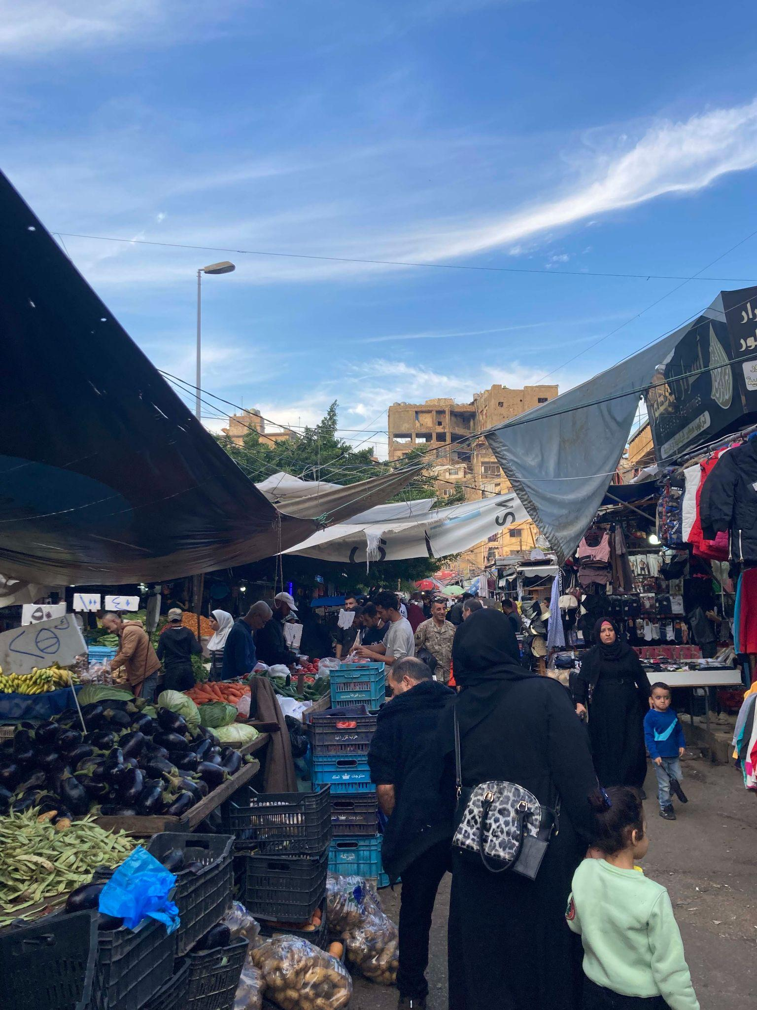
FINDINGS-Perceived Inequity in Aid Distribution
More Comprehensive and Better-Organised Aid for Refugees
Nationally-Led programmes are Less Generous/Accessible in comparison to INGO programmes targeting refugees
Notes:
Perceived Inequity in Aid Distribution
A recurring theme across interviews was the perception of inequity in how aid is distributed, particularly between Lebanese citizens and Syrian refugees. Many participants expressed a belief that non-governmental organisations (NGOs) prioritised other nationalities, especially Syrian refugees, over Lebanese nationals. This perception contributed to feelings of marginalisation and resentment, particularly among those who felt overlooked in their own country.
Lebanese participants frequently compared their situation to that of Syrian refugees, often concluding that refugees received more comprehensive or better-organised assistance. This sentiment was captured in repeated references to feeling like “refugees in their own country.” A recipient male from South Lebanon described his experience following displacement: “After we were displaced and moved to Ain Baal, it (assistance) became especially critical. I was struggling to find stable housing and employment, and we noticed that in some cases, Syrians were benefiting from certain advantages in these areas that we, as nationals, didn’t have access to.”
This perceived disparity extended beyond material aid to the logistical organisation of assistance. A female recipient from South Lebanon observed: “It is clear that they (Syrian refugees) are receiving more attention in terms of aid programmes and accessibility to them. Collection points for money withdrawals are a clear sign of this, with most queues serving Syrians appearing more organised and efficient.” Such comparisons reinforced the belief that Lebanese citizens were being deprioritised in favour of refugee populations.
Other participants echoed similar concerns. One AMAN female recipient form Qob Elias stated: “Sometimes you feel there's preferences; it's going to the Syrians [….] they go after the women who are widows or orphans.” This remark suggests that even within vulnerable groups, there is a perceived hierarchy of needs that places Lebanese citizens at a disadvantage. Some participants question the fundamental priorities of aid programmes. A non-recipient male participant from Sir el Donniyeh asked pointedly: “Who's more rightful to get the help, Syrians (refugees) or Lebanese?” These statements could reflect a broader tension around national belonging, entitlement, and the role of humanitarian aid in a context of protracted crisis.
Participants frequently expressed concerns over what they perceived as unequal treatment between Lebanese citizens and Syrian refugees in the distribution of aid. A dominant narrative was that non-governmental organisations (NGOs) prioritised refugees, while government-led programmes were either less accessible or less generous to Lebanese nationals. This perception was shaped not only by the quantity of aid received but also by its quality and consistency.
Several participants pointed to the wide range of support available to Syrian refugees through multiple NGOs and international agencies. A recipient female participant from Qob Elias described the disparity between her situation and that of her Syrian (refugee) neighbour: “She gets medical care for free; she gives birth for free etc… Everything is covered by the UN. I’ve had two kids since then and have had to worry about my birth and being in very poor hospitals. Even if her husband works or doesn’t, they get money and food supplies from the UN. And her husband works 3–4 jobs all day long. God bless them, but you look at this and you feel like a refugee in your own country.”

Slide 18
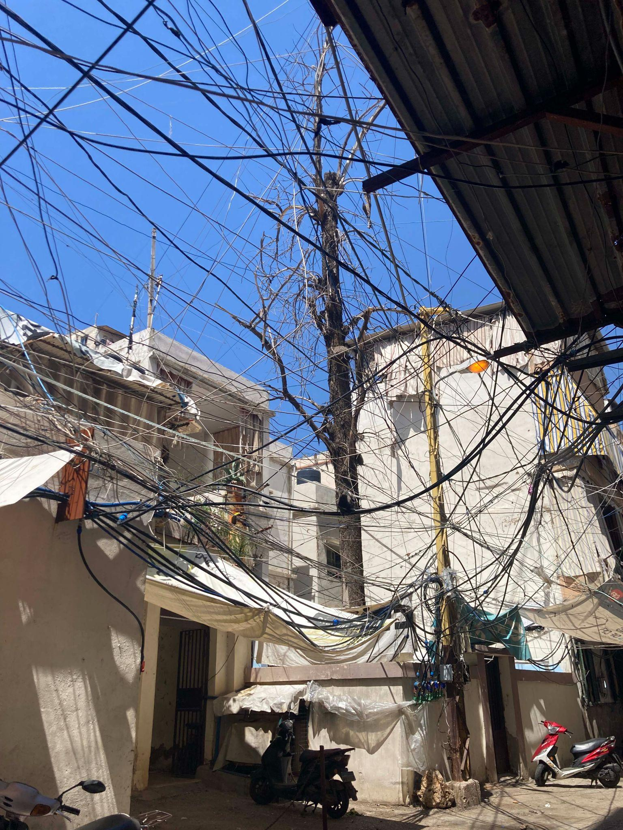
FINDINGS- Emotional and Psychological Toll of Aid Dependency
Stigma, Humiliation and Social Isolation
Anxiety and Uncertainty Pertaining to Unpredictable Aid
Notes:
Stigma, Humiliation and Social Isolation
Participants frequently described feelings of shame and humiliation associated with seeking and receiving social assistance. These emotions were not limited to the act of collecting aid but extended to how individuals perceived themselves within their communities. A non-recipient female participant from Muhammara communicated this sentiment starkly: “I prefer to stand next to a wall and cry rather than ask for help or accept money from someone.” Her feeling is echoed by a recipient female participant from South Lebanon: “You feel quite humiliated and degraded just standing there waiting for $150”
For others, the stigma attached to aid was so profound that it led to social withdrawal and isolation. The visibility of receiving assistance was considered shameful, as it exposed the vulnerability of individuals and households. A recipient woman from Karantina shared: “All the neighbourhood gets the help, but they deny getting the help. I found it shameful. I don’t say anything to anyone, no one knows. I don’t mix with people; I stay at home.” This account illustrates how stigma could silence recipients and push them out of communal life, reinforcing their marginalisation.
Recipients reported being shamed for receiving social assistance, challenging societal expectations around masculinity and self-sufficiency, especially in rural areas. One focus group participant noted “"Someone bullied me for receiving this assistance as if I am not manly enough". These comments were however made particularly by non-recipients.
Anxiety and Uncertainty Pertaining to Unpredictable Aid
The unpredictability surrounding social assistance programmes was a major source of chronic stress and anxiety for many participants. Repeated rejections, sudden interruptions in aid, and the absence of clear communication channels contributed to a persistent sense of emotional and psychological strain. The process of seeking assistance was not only practically challenging but also mentally exhausting, often leaving individuals feeling frustrated and helpless.
Even those currently receiving aid expressed anxiety about the continuity of support, especially when they learn about the discontinuation of benefits around them. One male participant receiving aid in Muhammara described this tension and mixed feelings of gratitude and uncertainty: “As long as we have the card, we are grateful and we leave it to God. I don’t know why other people have stopped getting cards.” The uncertainty surrounding programme rules and eligibility criteria created a climate of fear, particularly among those whose household circumstances had changed. A female participant receiving aid in Karantina, whose husband passed away, shared her concern: “I'm scared that because they stopped for 2 months now, it's probably because they know my husband passed away.” Her words reflect the emotional toll of unclear policies and the fear of losing vital support.

Slide 19
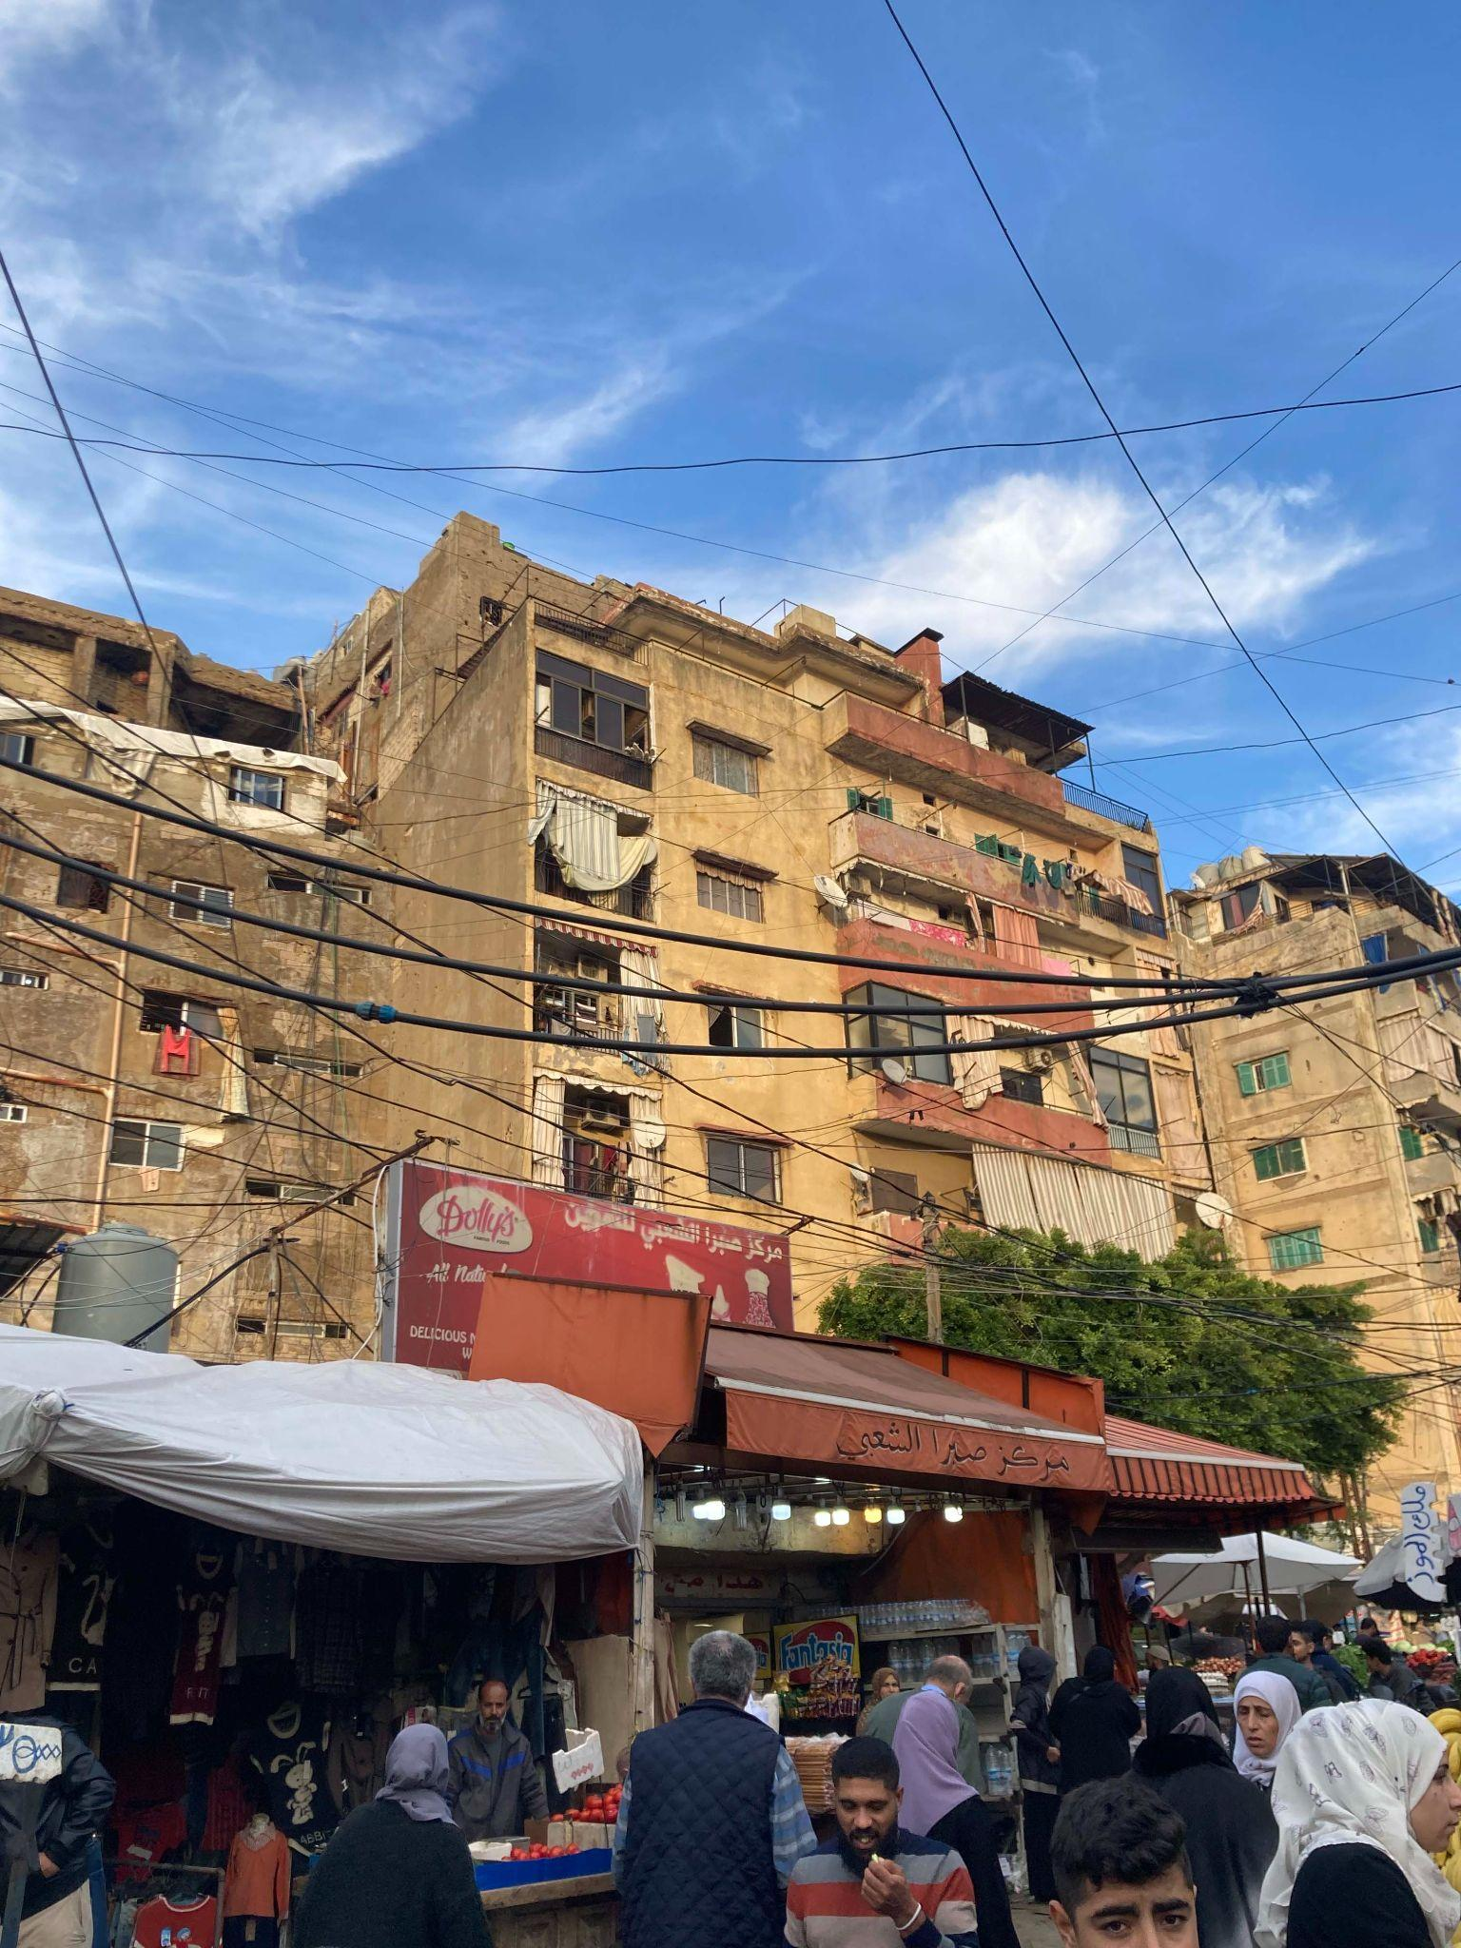
FINDINGS- Gender-Related Perceived Challenges in Receiving Aid
Women’s Economic Empowerment versus Burden
Widowhood Vulnerabilities and Administrative Barriers
Notes:
Women’s Economic Empowerment versus Burden
Several female participants described how receiving aid provided a sense of relief and empowerment, particularly in their role as primary caregivers. In Zahle, women noted that they were more attuned to household needs than men, with one (recipient) stating: “The woman is more important in the house than the man. Women are more aware of household needs.” Another who also receives assistance added: “As a woman, I feel relieved having a source of income. I can cook for my kids.” However, this empowerment was at times limited. Another recipient woman reflected: “It’s freedom […] I get the money and I give them to my kids. I don’t get anything for myself.” She highlighted how aid is often absorbed into family responsibilities, leaving little room for personal benefit.
Historically, women have played a supportive economic role, as noted by a male recipient in the South: “Women have always supported their husbands, they used to work in the field and go to the market.” Yet, in the current crisis, this support has become more burdensome, with women shouldering increased responsibilities without adequate recognition or resources.
Widowhood Vulnerabilities and Administrative Barriers
Widowed women faced distinct challenges in accessing aid, often due to patriarchal administrative systems. One recipient widow from Karantina explained: “I put the application under the name of my late husband because he is the man.” These practices reflect how male-centric registration systems complicate access for widows. The fear of losing aid due to changes in household status such as death was also discussed in section 4.4. This points to a broader issue where the death of a male household head disrupts aid continuity, creating uncertainty and vulnerability.
Widowhood often resulted in complete financial dependency, particularly in the absence of alternative income sources. In many cases, adult children became the financial safety net for widowed mothers A recipient widow from Karantina explains: “For example, I pay electricity, and then my kids add on more to be able to pay the bills.” Some women noted that their independent status contributed to their acceptance into the programme, as this recipient widow from Burj Hammoud noted: “Because I am a widow, I get the help.” While others highlighted that financial hardship intensifies feelings of exclusion and being overlooked by aid mechanisms: “Since my husband died, I’ve been the only one trying”, says a non-recipient widow from Bikfaya.
Women also bore the brunt of intensified care responsibilities. Several participants described being the primary caregivers for ill or elderly family members. Health sacrifices were common among women trying to balance care and financial constraints. One female recipient from Qob Elias stated: “I sacrifice my own medication so I can feed my kids.” While another female recipient for Burj Hammoud explained: “Sometimes the budget doesn’t allow me to buy the medication so I lessen my intake.”
These testimonies reflect the difficult choices women make daily, often prioritising their families’ needs over their own health and well-being.

Slide 20
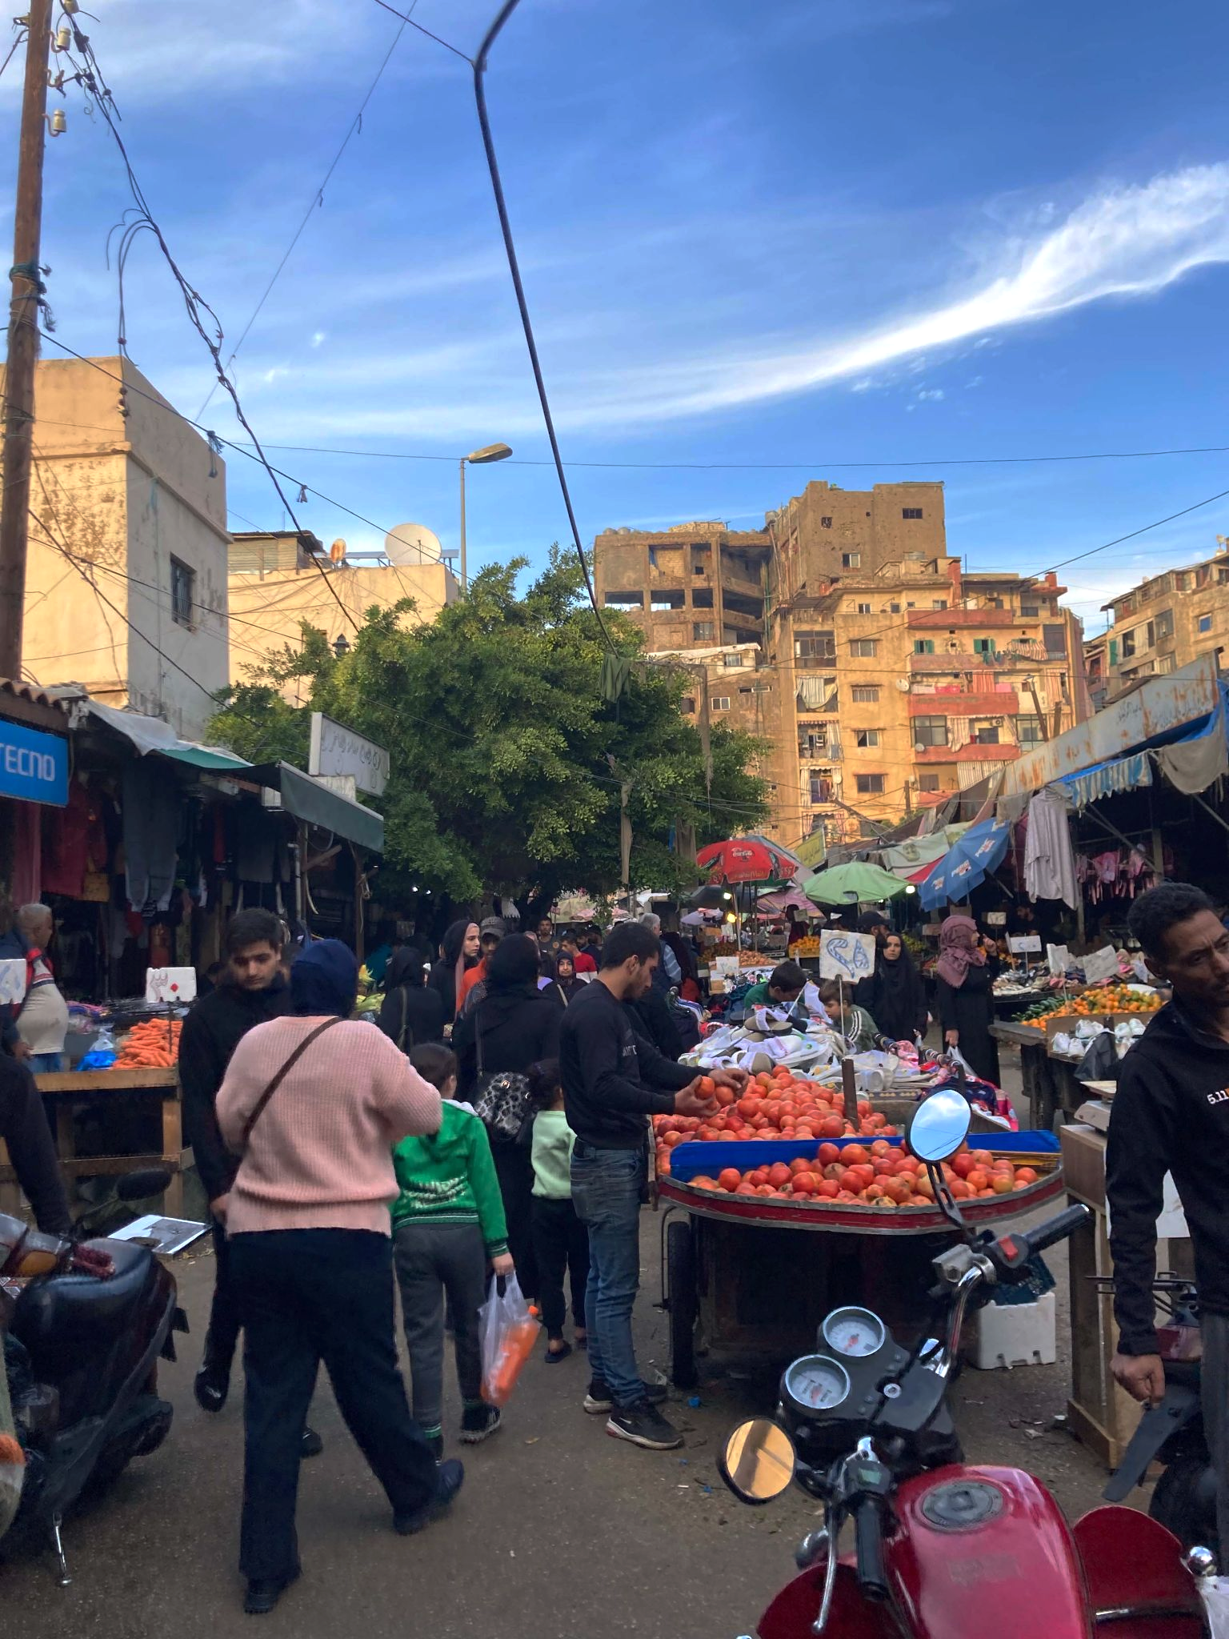
FINDINGS-Barriers to Accessing Aid and Support Channels
Digital and functional illiteracy
Physical and Financial Barriers to Accessing Aid
Lack of feedback and appeals mechanisms
Notes:
Digital and Functional Illiteracy
Vulnerable individuals struggled with online applications due to illiteracy or lack of digital skills, often relying on others for help. However, participants who could access SDCs in their regions did not encounter challenges related to the usage of the DAEM digital platform used for registration in AMAN programme or applying through the SMS links.
In an increasingly digital world, the prevalence of illiteracy and limited access to, or proficiency with, digital technology can limit accessibility of individuals to programmes that rely on written forms or online platforms for application and distribution. Participants reported difficulties directly caused by their inability to read or write. This requires depending on others for help, whether informal (relatives, neighbours and friends) or formal. For example, a recipient female participant from Sir el Donniyeh remembered, "A female employee at the office of the MOSA helped me in filling the form because I am illiterate". And another non-recipient female participant from the South, who received assistance in accessing the form "I can't read or write, […]so my sister helped me complete the application. This underlies the importance of human intermediaries when official processes are not designed for those with low literacy.
According to expert interviews, relying on technology-based access to assistance programmes alienated poor rural communities and vulnerable social groups in urban settings that face poor internet connectivity, digital illiteracy, and a lack of access to ATMs (or lack of knowledge of using them). One expert highlighted “…everything that has to do with online registration; we knew from Ukraine it would not reach the digitally illiterate. That’s the case in Lebanon too. So we need to make sure we accommodate these online-driven registration platforms to the digitally illiterate. Maybe the poorest, the most vulnerable (the elderly or disabled) will not know how to register on a digital platform. So definitely, we should be thinking around that: using more analogue registration, or more community-based registration.”
Physical and Financial Barriers to Accessing Aid
Accessing social assistance in Lebanon was often hindered by a combination of physical and financial obstacles, particularly for individuals living in remote or underserved areas. One of the most pressing challenges was the cost and logistics of traveling to designated payment points, such as banks or OMT centres. These journeys were not only expensive but also physically demanding, especially for older individuals or those with limited mobility. A female recipient from Sir el Donniyeh shared her experience: “It cost me 300,000 L.L. to travel to the bank in Tripoli. Now, with the transition to OMT, it is easier to withdraw money, and I am treated better at the OMT location.” While the shift to OMT centres improved access for some, it did not fully eliminate the barriers.
Transportation costs remained a significant concern. For many, the financial burden of reaching assistance points outweighed the benefits of the aid itself, especially when assistance was provided through the banking system. A recipient woman from Muhammara explained: “The closest bank branch was in Tripoli or Halba, it was far for us and costly. Now with OMT, we can go by foot.” Similarly, another recipient female FGD participant from Qob Elias described the high cost of travel: “I used to take a taxi to Chtaura to withdraw the money. The taxi fare varied depending on how long I stayed; around 700,000 to 800,000 LBP. Sometimes I had to go more than once a month because there were a lot of people.” These testimonies highlight how logistical and financial constraints can effectively exclude vulnerable individuals from accessing support.
Before the transition from banks to OMT centres, beneficiaries faced additional difficulties with ATM withdrawals. Long queues, depleted machines, and overcrowding were common, often leading to tense and even violent encounters. One recipient male participant from Saida recounted: “At the peak of the crisis, when the queues were extremely long, you can ask my wife, I got into an altercation with another recipient, because he was trying to cut the line.” Such incidents underscore how the process of accessing aid can itself become a source of stress and conflict, further burdening those already in need.
Moreover, the complexity of banking procedures posed challenges for individuals unfamiliar with digital or formal financial systems. The son of a non-recipient female participant from Qob Elias described her reliance on others to withdraw the amount, for some charges.
“Some people used to help the people in need. They used to take all the cards and go to the bank while taking a small amount in return for the service.” These experiences reveal how institutional design and lack of user-friendly systems can create additional layers of exclusion.
While the shift to OMT centres offered some relief, the broader landscape of social assistance remained fraught with physical and financial barriers. These obstacles not only limited access but also depleted the already scarce resources of the most vulnerable, creating a cycle of hardship that undermines the very purpose of social support.
Lack of Feedback and Appeals Mechanisms
Another major source of distress for participants was the absence of communication regarding the status of their applications or the reasons behind the discontinuation of aid. Many described the process as akin to submitting applications “into a void,” with no follow-up, confirmation, or explanation. This lack of feedback left individuals feeling uncertain, excluded, and powerless in the face of an opaque system.
A recipient male from Bikfaya shared his frustration while trying to track his application through MoSA’s hotline: “We used to call every day to find out what was happening, but the operator wouldn’t answer, and we ran out of phone credit.” His experience reflects a broader sentiment among participants who felt that the system was not only inaccessible but also unresponsive to their efforts to engage with it.
This perceived lack of transparency extended to cases where aid was previously received but then suddenly halted without any explanation. Several participants described being left in the dark, unsure whether the support would resume or why it had stopped. One female participant from South Lebanon and who suffers several health issues shared her stress over being discontinued form AMAN: “I don’t know exactly when or why it ended, and I never followed up to ask whether it would resume.” Others echoed similar feelings of confusion and disillusionment.”
In the absence of clear and effective formal appeals mechanisms or feedback loops, individuals were left with no way to contest decisions, seek clarification, or re-engage with the system. This undermined the perceived fairness of the aid process and further eroded trust in institutions meant to provide support.

Slide 21
FINDINGS- Intersectionality and Aid Access
REGIONAL VARIATIONS IN AID ACCESS​
Aid access varies widely: Northern Lebanon 70%, Mount Lebanon 17%, Bekaa 67%,
Greater Beirut 80%, South 44%.​
SOCIAL AND STRUCTURAL BARRIERS​
Barriers include transportation, health gaps, discrimination, and program invisibility across regions.​
GENDER AND SOCIAL IDENTITY IMPACTS​
Women face care burdens, documentation issues, and shifting gender roles impacting aid receipt.​
VULNERABLE GROUPS’ EXPERIENCES​
Older adults, female-headed households, and isolated families face exclusion from aid due to multiple factors.​
Northern Lebanon
Greater Beirut
Bekaa
Mt. Lebanon
South
Notes:
The findings reveal that vulnerability is not uniform but rather layered, with certain groups facing compounded barriers due to the overlapping effects of social and structural factors.
Northern Lebanon (Muhammara)
Rural isolation and agricultural dependency define this region’s vulnerability. Despite having one of the highest aid ever receipt rates (70%), which is likely due to the enormous needs in the area (the highest quantiles found in the North), residents face transportation barriers, health system gaps, and origin-based discrimination. Extended family networks both facilitate and complicate aid coordination.
Mount Lebanon (Bikfaya)
Traditionally middle-class, Bikfaya now hosts newly vulnerable populations due to the banking crisis. Ever received access to aid is lowest (17%), with significant program invisibility and asset-based exclusion. Older adults with inherited property are misclassified as wealthy, despite lacking income.
Bekaa
Bekaa presents a mixed rural-urban profile with strong inter-group tensions, especially between Lebanese citizens and Syrian refugees. Aid access is high (67%), but health crises, care burdens, and cultural dignity norms prevent help-seeking. Women here experience gender role transformation, often becoming breadwinners while managing chronic illness in the household.
Greater Beirut (Karantina/Burj Hammoud)
Urban centres offer better access to information and digital platforms, and have the highest percentage of aid ever received, 80% cementing the idea that urban centres are better served than rural areas such as Bekfaya. Educated individuals provide good critiques of targeting mechanisms but remain economically insecure. The paradox of urban, educated, unemployed reveals that proximity to services does not guarantee inclusion.
Southern Region
Conflict and displacement dominate this region’s profile with a low percentage of 44% ever receiving aid. This could indicate regional policy implementation differences or conflict-related access. Women face documentation issues, care burdens, and exclusion from aid systems. The compounded profile of war-displaced, chronic illness and poverty reflects cascading vulnerabilities.
Compounded Vulnerabilities
The intersection of rural location, female-headed households, and health crises created particularly acute barriers. Women in these contexts faced transportation challenges, limited access to medical care, and administrative exclusion. A 57-year-old illiterate woman in Ain Baal who became the sole breadwinner after her husband developed a chronic kidney condition requiring oxygen dependency. She opened a small mini-market to support the family but was rejected for aid while her brother (with a healthy family) was accepted. She lives in poor housing with inadequate ventilation that worsens her husband's condition but cannot afford to move.
In Southern districts, war-induced displacement, chronic illness, gender discrimination and economic collapse created cascading vulnerabilities. The same participant whose story is depicted above also suffered gender discrimination. She explicitly states "women-led households are less likely to receive aid," while explaining how her brother received aid knowing that her situation is worse than his.
Older adults with limited literacy and physical disabilities were also excluded from digital systems and unable to navigate complex bureaucratic procedures. The following profile exemplifies this compounded vulnerability: A 58-year-old retired public sector worker with lateral hemiplegia (severe mobility disability) who required his son's help to complete the AMAN application. Despite meeting eligibility criteria and completing home inspection, he was rejected without explanation. When he called the ministry for clarification, no one answered, leaving the family "feeling invisible" in the system. This group faced age-based employment discrimination and lacked the means to advocate for themselves.
Families living in geographic isolation and engaged in informal economies struggled with aid assessment complexity. Despite having multiple income earners, they faced educational sacrifices and unpredictable earnings, which were not adequately captured by standard eligibility criteria. A 50-year-old woman whose husband drives a truck for daily hire with completely unstable income. Living in rural Muhammara, they faced high transportation costs to access services and backs. With three children in school, they struggle to balance educational expenses against irregular income that cannot be properly documented for aid assessment purposes.

Slide 22
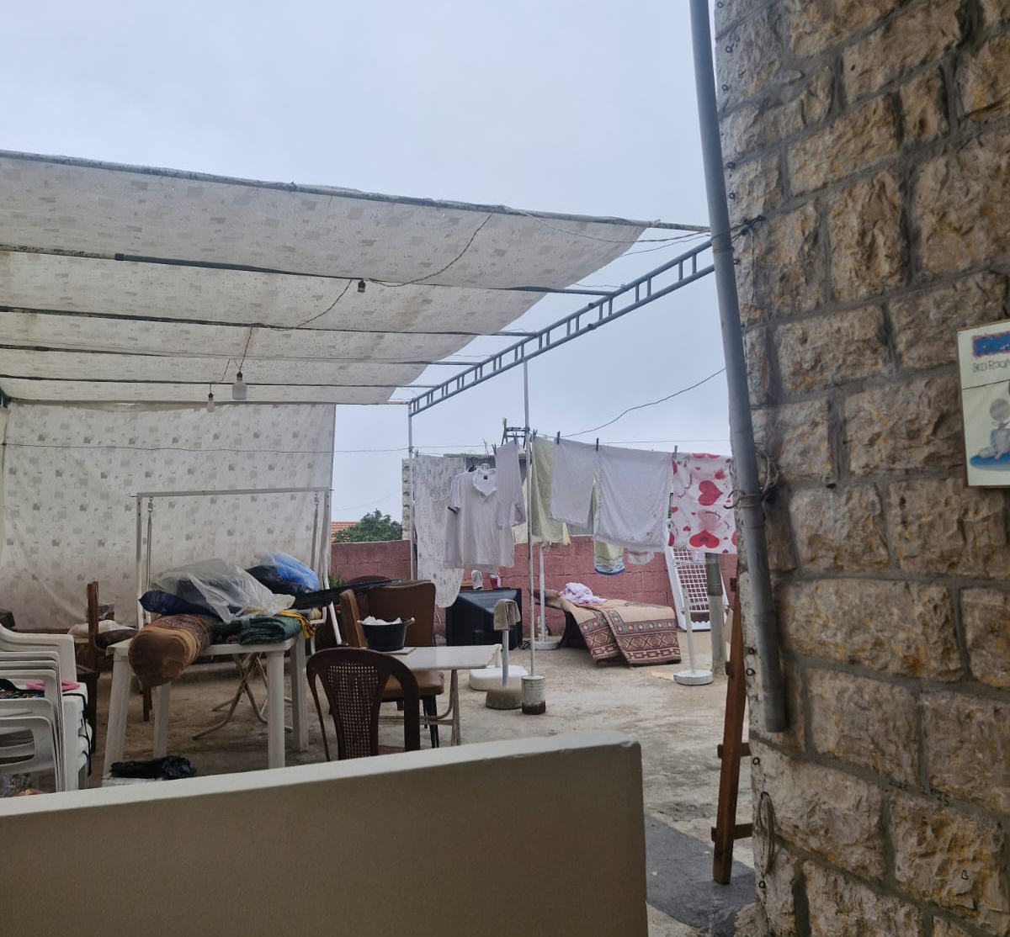
MAPPING RECIPIENT JOURNEY
Notes:
This section presents a synthesis of individual and household-level experiences with social assistance programmes in Lebanon, drawing on detailed user journeys collected through in-depth interviews and focus group discussions. These journeys offer a person-centred lens into how intersectional factors; such as gender, health status, geographic location, political affiliation, and social identity, shape access to aid, emotional responses, and perceptions of fairness. Rather than treating these cases as isolated narratives, the chapter groups them thematically to highlight recurring patterns and systemic challenges.

Slide 23
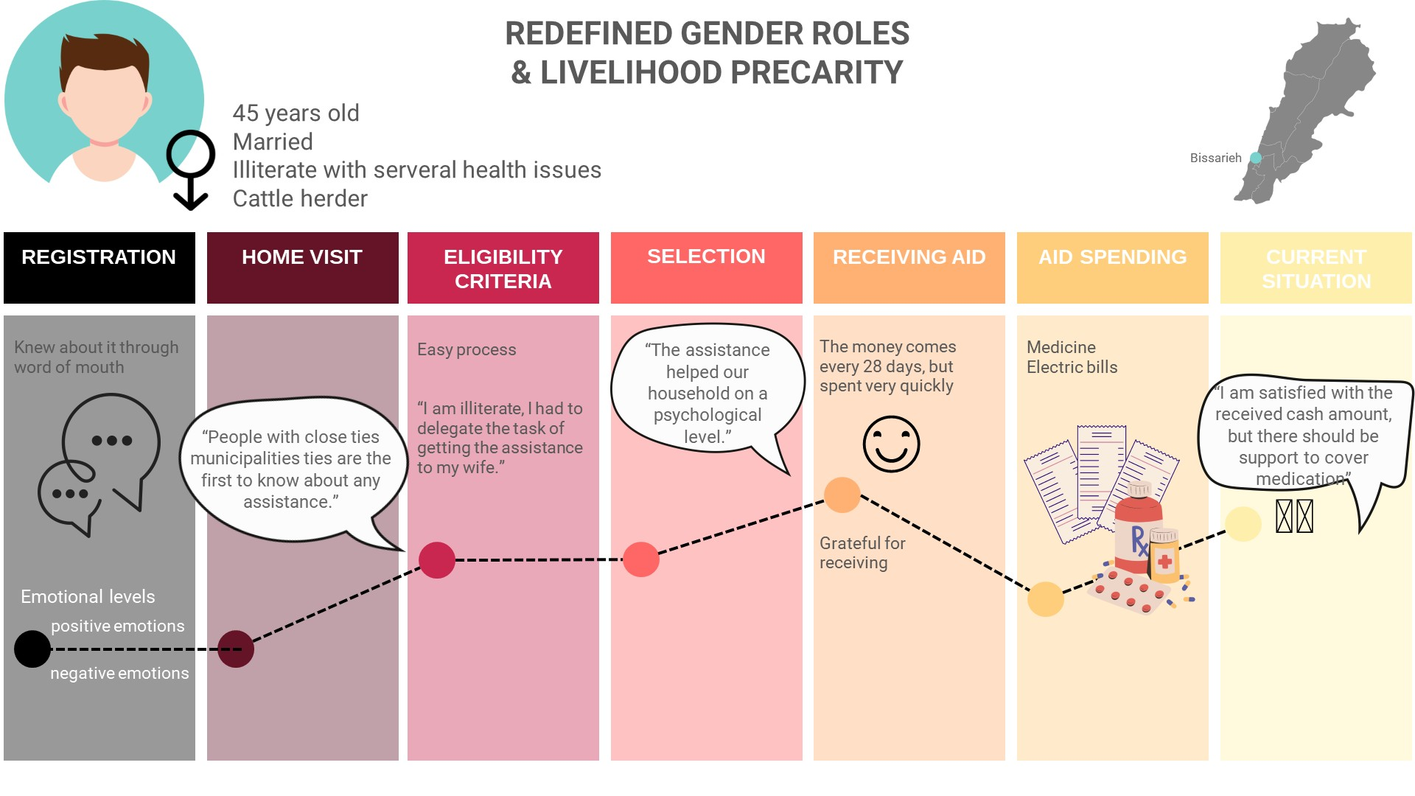
USER JOURNEYS
Notes:
Redefined Gender Roles and Livelihood Precarity (Journey 1)
Several journeys illustrate how gender roles have been redefined under conditions of economic collapse and aid dependency. In Bissariyeh, a 45-year-old male cattle herder (Journey 1) suffering from chronic illness and illiteracy delegated the application process to his wife. Despite receiving assistance, he expressed anxiety about the adequacy of the cash transfer, which was quickly spent on medicine and electricity. His case reflects the psychological relief provided by aid, but also the limitations of cash-only support in addressing complex health and livelihood needs

Slide 24
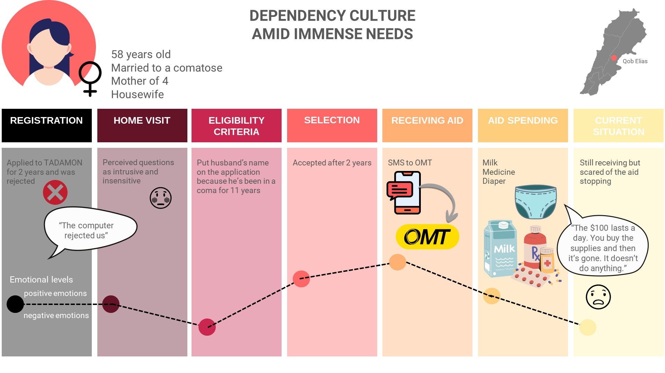
USER JOURNEYS
Notes:
Dependency Culture and Immense Needs (Journey 2)
In Qob Elias, a 58-year-old woman caring for a comatose husband and grandchildren (Journey 2) described her experience with repeated rejection from the TADAMON programme before eventually receiving AMAN support. Her journey underscores the emotional toll of navigating opaque systems and the fear of losing assistance, especially when caregiving responsibilities are intense and continuous.

Slide 25
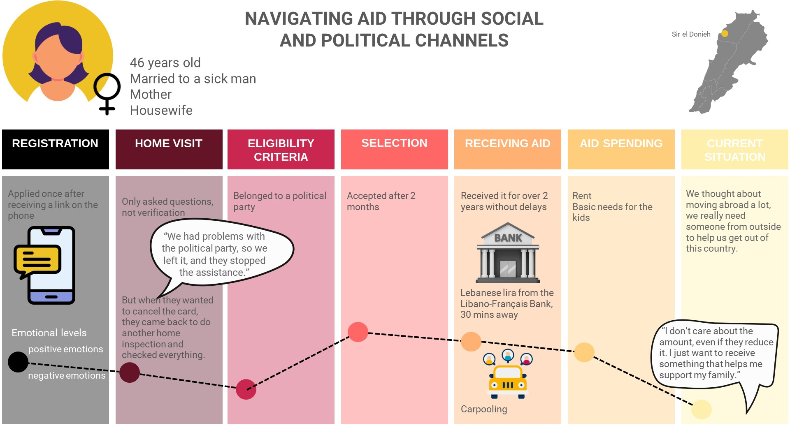
USER JOURNEYS
Notes:
Navigating aid through social and political channels (Journey 3)
Political affiliation and local governance structures emerge as critical mediators of aid access. In Sir el Donniyeh, a woman (Journey 3) believed her husband’s withdrawal from a political party led to the discontinuation of their aid. Although she was later reinstated, the experience left her disillusioned and eager to leave the country. Her case exemplifies how political dynamics could influence programme inclusion and reinforce perceptions of favouritism.

Slide 26
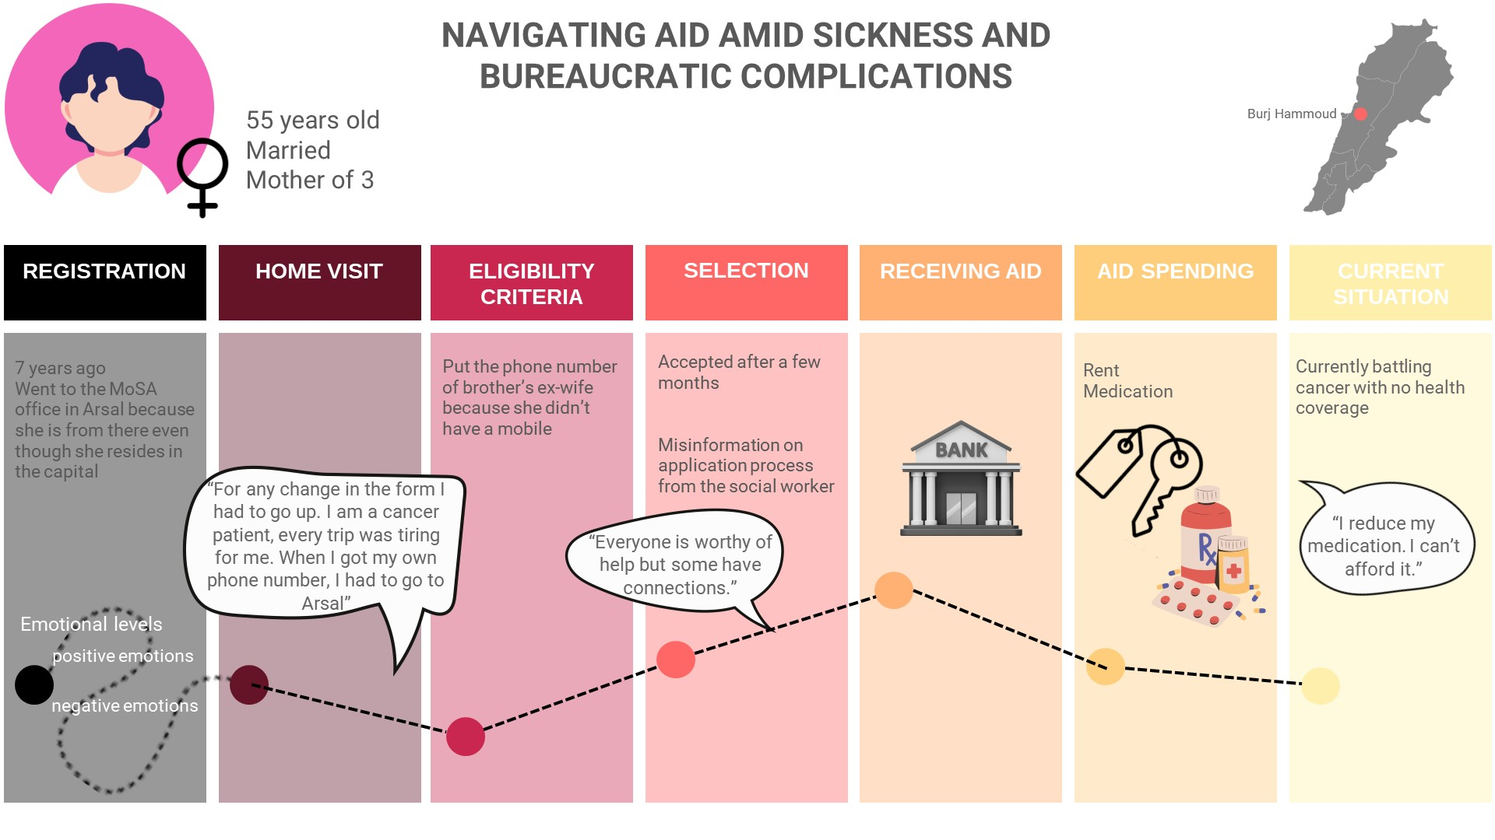
USER JOURNEYS

Slide 27
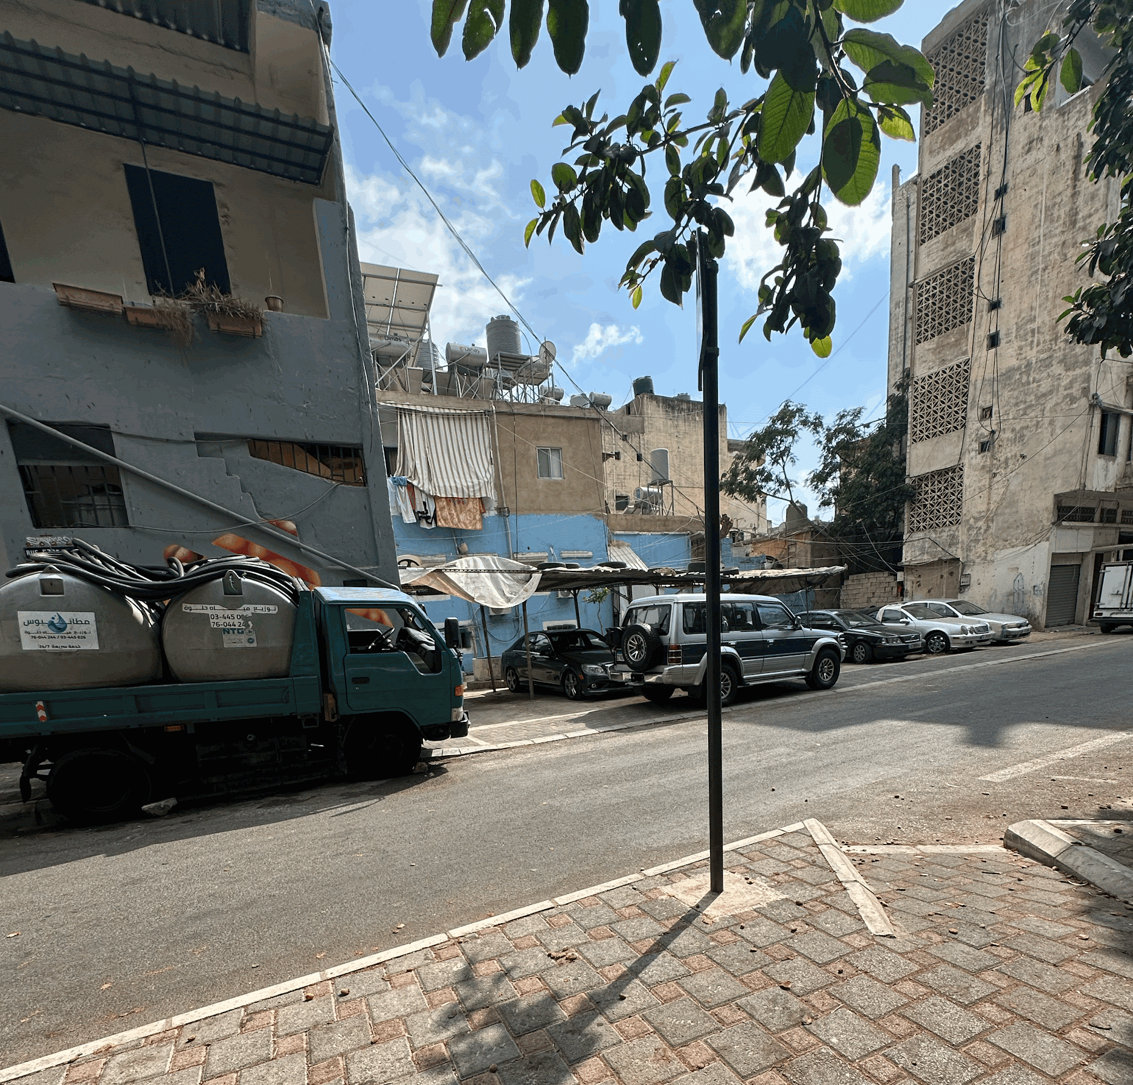
RECOMMENDATIONS

Slide 28
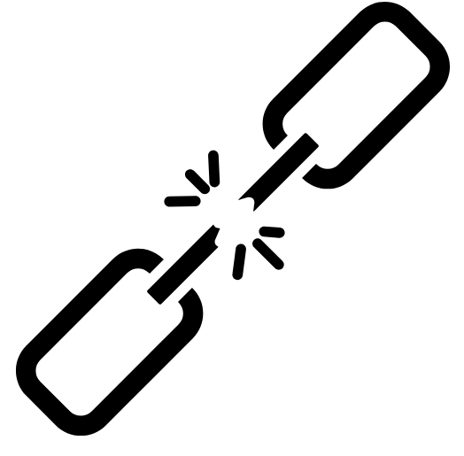


RECOMMENDATIONS (1/2)
Strengthen crisis-responsive social assistance programmes and aid continuity
Improve communication and information pathways
Reduce barriers to access and enhance feedback mechanisms
Mitigate emotional and psychological toll
Promote equity in aid distribution
Notes:
The report has nine recommendations aimed at improving the inclusiveness, transparency, and responsiveness of social assistance programmes in Lebanon. These include Strengthen crisis-responsive social assistance programmes and aid continuity, Improve communication and information pathways, Reduce barriers to access and enhance feedback mechanisms, Mitigate emotional and psychological toll, promote equity in aid distribution.

Slide 29


RECOMMENDATIONS (2/2)
Integrate gender-
sensitive approaches
Enhance transparency and targeting fairness
Link social assistance to livelihoods
Institutionalise accountability and monitoring
Long-term policy reform
Notes:
Continued: Integrate gender sensitive apporaches, enhance transparency and targeiting fairness, link social assistance to livelihoods, institutionalise accountability and monitoring, and lastly long term policy reform. Findings reveal that assistance recipients often faced sudden disruptions during crises, with poor communication or unclear information on whether aid would continue. This unpredictability eroded trust and caused emotional and financial stress. Although shock-responsive mechanisms exist, their implementation remains disjointed and inadequately communicated. Improving institutional coordination and maintaining aid during emergencies are crucial for developing a more resilient and responsive social assistance system that prevents the most vulnerable populations from relying on harmful coping mechanisms.

Slide 30
RECOMMENDATIONS - Strengthen Crisis-Responsive Social Assistance Programmes & Aid Continuity
Shock-
Responsive Measures
Actor: MoSA & DRM
Method: Publish public guidance on crisis-
triggered programme adjustments.
Explain Different Aid Programmes
Actor: MoSA + INGOs
Method: Use clear visuals, infographics, and communication tools in arabic
Secure Funding
Actor: MoSA + INGOs + local partners
Method: Establish multi-year funding frameworks and allocate emergency specific funds prior to crisis.
Notes:
Findings reveal that assistance recipients often faced sudden disruptions during crises, with poor communication or unclear information on whether aid would continue. This unpredictability eroded trust and caused emotional and financial stress. Although shock-responsive mechanisms exist, their implementation remains disjointed and inadequately communicated. Improving institutional coordination and maintaining aid during emergencies are crucial for developing a more resilient and responsive social assistance system that prevents the most vulnerable populations from relying on harmful coping mechanisms.

Slide 31
RECOMMENDATIONS- Improve Communication and Information Pathways
Standardise Messaging
Actor: MoSA
Method: Multilingual, low-literacy-infographic, friendly material
Multi-Channel Communication
Actor: MOSA, NGOs and media partners
Method: Dissemination of programme information and updates via social media, TV, radio, and print
Engage Local Actors in Training
Actor: Municipalities + SDC Staff
Method: Enhance program understanding for local leaders
Engage Local Actors in Outreach
Actor: SDCs, municipalities and local authorities
Method: Coordinate and ensure availability of media
Notes:
Participants across all regions reported confusion about programme eligibility, application procedures, and aid status. These issues were worsened by functional illiteracy, digital exclusion, and inconsistent messaging. While some beneficiaries relied on social media or word of mouth, older adults and rural residents, in particular, remained uninformed. Clear, accessible and standardised communication ensures fair access to information and minimising misinformation and frustration.
There is a need to create standardised multilingual, low-literacy-infographic, friendly material to be used by all dissemination outlets, websites, and platforms to ensure inclusion of information on how to access programs and get more information.
Enhance the dissemination of programme information and updates via social media, TV, radio, and print; ensure traditional local channels are updated monitor success and effectiveness of outreach to targeted public.
Enhance program understanding for local leaders/authorities/SDC staff regarding what programs are available when and for whom.
Coordinate outreach through municipal networks
Ensure brochures are available at all SDC centres
Enhance the area-based approach (ABA) that aims to align social services with local need and leverage municipalities and SDCs (MoSA Strategy 2026 – 2030)

Slide 32
RECOMMENDATIONS- Reduce Barriers to Access and Enhance Feedback Mechanisms (1/2)
Application Process
Actor: MoSA
Method: Disseminate content via traditional and non traditional media
Community Registration
Actor: MoSA, SDCs, social workers
Method: Engage and support (by SDC social workers) social networks to assist older persons
Mobile Money
Actor: MoSA, donors, and transfer payment providers
Method: Establish streamlined and secure payment including pilot mobile money
Notes:
The findings underscore how digital illiteracy, transportation costs, and lack of feedback mechanisms systematically exclude the most vulnerable. These recommendations aim to dismantle these barriers through inclusive design and responsive service delivery.
Action: Disseminate the application process clearly
By whom: MoSA
How:
Use multiple communication channels: Facebook, Instagram, TikTok.
Include traditional media: TV commercials, radio, newspaper ads.
Partner with local organizations for word-of-mouth outreach.
Action: Establish community registration hubs with social worker support
By whom: MoSA, SDCs, social workers
How:
Engage social networks to assist older persons and persons with disabilities (PWDs).
Expand outreach to peripheral areas through SDC social workers.
Action: Enhance mobile money and decentralized payment systems
By whom: MoSA, donors, transfer payment providers (OMT, Whish Money, etc.)
How:
Pilot mobile money services via licensed providers.
Open new payment locations in rural hubs.
Streamline and secure payment procedures to reduce crowding and improve access.
Action: Ensure assistance for older persons, PWDs, and digitally illiterate individuals
By whom: MoSA, Municipalities, SDC
How:
Consult communities on preferred communication channels (e.g., comment boxes, trusted community groups).
Organize town hall meetings to engage communities on social assistance processes.
Action: Improve grievance and appeal systems
By whom: DRM, MoSA, SDCs
How:
Upgrade the 1714 hotline to be toll-free.
Develop a secure digital portal for tracking applications, viewing rejection reasons, submitting complaints, and receiving feedback.
Disseminate information through brochures, posters, info sessions, ads, and videos streamed on SDC digital screens.
Action: Build capacity of social workers
By whom: MoSA, SDCs
How:
Deliver training on empathetic communication, gender sensitivity, disability inclusion, and trauma-informed approaches.
Develop and update Standard Operating Procedures (SoPs) for grievance and appeals mechanisms.
Implement special follow-up and case management for older persons, PWDs, and residents in remote areas.

Slide 33
RECOMMENDATIONS- Reduce Barriers to Access and Enhance Feedback Mechanisms (2/2)
Community Consultation
Actor: MOSA, Municipalities, SDC
Method: Setup town hall meetings at municipalities to engage with the community
Grievance Process
Actor: DRM, MoSA, and SDCs
Method: Upgrade the 1714 hotline to be toll-free and develop a secure digital portal
Notes:
Consult with Communities on Preferred Communication Channels
By whom: MoSA, Municipalities, SDC
How:
Organize town hall meetings at municipalities to engage communities.
Use participatory methods like comment boxes and community groups approved through voting.
Discuss which channels (digital, physical, social) are most trusted and accessible.
Improve Grievance and Appeal Systems
By whom: DRM, MoSA, SDCs
How:
Upgrade the 1714 hotline to be toll-free for better accessibility.
Develop a secure digital portal for applicants to:
Track application status
View reasons for rejection
Submit complaints
Receive feedback
Ensure transparency and user empowerment through these tools.

Slide 34
RECOMMENDATIONS- Mitigate Emotional and Psychological Toll
Trauma Informed Approaches
Actor: MoSA & Humanitarian NGOs
Method: Mental health training modules targeting municipalities, MoSA and SDC staff
Eliminate Humiliation and Distress
Actor: MoSA & Humanitarian NGOs
Method: Adjust delivery protocols to ensure privacy and no-harm to beneficiaries
Notes:
Action: Train social workers in trauma-informed approaches
By whom: MoSA and Humanitarian INGOs
How:
Develop training modules with mental health experts.
Target municipalities and SDC staff, especially those conducting or accompanying assessment and verification home visits.
Include hotline workers and staff from money transfer providers.
Action: Eliminate or reduce factors that generate feelings of humiliation and distress
By whom: MoSA, NGOs, and training institutions
How:
Review and revise aid delivery protocols to minimize public visibility during distribution.
Shift to discreet systems such as appointment-based aid delivery, digital transfers, or home delivery options.
Limit public relations activities during aid distribution.
Avoid photographing beneficiaries to protect privacy and uphold dignity.

Slide 35
RECOMMENDATIONS- Promote Equity in Aid Distribution
Unified Registry
Actor: MoSA
Method: Managing, updating, and securing beneficiary records to build and accurate and reliable unified; registry
Harmonised SOPs
Actor: CMU, MoSA, UN agencies, INGOs, donors
Method: Establish data-sharing framework among ministries and partners
Regular Data Updates
Actor: CMU and third-party data audit
Method: Assign strict quality control measures to ensure data quality and reliability
Address Perceived Inequalities
Actor: MoSA, Humanitarian INGOs, local authorities, and other local actors
Method: Design and implement inclusive livelihood projects
Notes:
The findings exposed widespread perceptions of unfairness in aid distribution, especially among Lebanese citizens who felt sidelined compared to refugees. To regain trust and promote fairness, Action: Finalize the Unified Social Registry (including non-Lebanese residents and refugees)
By whom: MoSA and CMU (Central Management Unit of PCM hosting AMAN registry)
How:
Develop SOPs for managing, updating, and securing beneficiary records.
Build an accurate and reliable unified registry.
Partially link refugees and migrant workers to Lebanese social protection systems.
Include administrative procedures: registration, referral systems, monitoring humanitarian aid provision.
Action: Formulate Harmonized SOPs and Referral Systems
By whom: CMU, MoSA, UN agencies, INGOs, donors
How:
Establish a coordinated data-sharing framework among ministries and partners.
Draft formal MoUs to enable secure, standardized use of vulnerability and beneficiary data.
Create and activate unique identification numbers for households or individuals.
Action: Ensure Data Update, Security, and Protection
By whom: CMU and third-party data audit
How:
Design strict quality control measures for data reliability.
Conduct periodic third-party audits to monitor security and confidentiality.
Action: Address Perceived Inequities in Aid Provision
By whom: MoSA, Humanitarian INGOs, local authorities, and other actors
How:
Design inclusive livelihood projects serving both host and refugee populations.
Base interventions on joint needs assessments and community consultations.
Promote shared economic resilience and social cohesion to reduce tensions.

Slide 36
RECOMMENDATIONS- Integrate Gender-Sensitive Approaches
Prioritise Female-headed Households
Actor: MoSA
Method: Integrate female-headed households into targeting criteria and train social workers on gender-sensitive outreach and registration practices
Childcare Support and Flexible Access (SDCs)
Actor: MoSA, SDCs
Method: Enhance and increase childcare facilities within or near SDCs that offer flexible service hours
Transparent and Fair Targeting/ Representation of Gender
Actor: MoSA
Method: Use gender-
disaggregated data in beneficiary databases and regularly audit targeting outcomes
Notes:
The findings of this study highlight the need for gender-sensitive approaches within Lebanon’s social assistance framework. Action: Ensure female-headed households are prioritized
By whom: MoSA
How:
Integrate female-headed households into targeting criteria for social assistance programs.
Train field staff on gender-sensitive outreach and registration practices.
Ensure equitable access and respectful engagement with vulnerable women.
Action: Provide childcare support and flexible access options through SDCs
By whom: MoSA, SDCs
How:
Enhance and increase childcare facilities within or near SDCs.
Offer flexible service hours (including evenings and weekends) to accommodate working caregivers.
Action: Enhance transparency and fair targeting with attention to gender representation
By whom: MoSA
How:
Use gender-disaggregated data in beneficiary databases.
Regularly audit targeting outcomes to ensure fairness and representation.

Slide 37
RECOMMENDATIONS- Enhance Transparency and Targeting Fairness
Revisit Selection Criteria
Actor: MoSA +INGOS+SDCs+Local providers
Method: Multi-stakeholder workshops to assess and update vulnerability metrics and beneficiary selection using disaggregated data and first hand insights
Participatory Approach to Review criteria
Actor: MoSA +UN agencies+INGOS+SDCs
Method: Multi-stakeholder workshops to review, validate, and update vulnerability metrics and beneficiary selection criteria
Communicate Updated Criteria
Actor: MoSA +UN agencies+INGOS+SDCs+Local providers
Method: Disseminate outcomes through policy briefs, workshops, and digital platforms
Notes:
Action: Revisit Selection Criteria and Communicate Broader Criteria
By whom: MoSA, INGOs, local providers, SDCs
How:
Organize inclusive workshops at national, regional, and local levels.
Include key stakeholders: government agencies, NGOs, municipal representatives, and community leaders.
Review, assess, and update vulnerability metrics and beneficiary selection criteria using disaggregated data and lived experience insights.
Action: Communicate and Disseminate Updates to Selection and Eligibility Criteria
By whom: MoSA (with technical advice and funding from UN agencies and international organizations)
How:
Clearly explain the integration of intersectional vulnerability indicators and categorical targeting alongside PMT poverty indicators.
Disseminate outcomes through policy briefs, workshops, and digital platforms to ensure shared understanding and coordinated implementation.
Action: Apply Participatory Approach to Reassessment of Vulnerability Metrics
By whom: MoSA, SDCs (with technical advice and funding from UN agencies and international organizations)
How:
Organize multi-level stakeholder workshops to collaboratively review, validate, and update vulnerability metrics and beneficiary selection criteria.
Use region- and gender-disaggregated data and lived experience insights.

Slide 38
RECOMMENDATIONS- Link Social Assistance to Livelihoods
Link with Vocational Training
& Micro-grants
Actor: MoSA (new economic inclusion unit)+Donors+MoL
Method: Develop a referral System between MoSA and MoL to provide jobs and build on existing experience of enhancing micro grants for start up kits
Transform SDCs into Referral Hubs
Actor: SDCs
Method: Develop livelihood referral hubs within SDCs and network with the private sector and NGOs.
Notes:
It is important to connect cash assistance to livelihood pathways to reduce reliance on social support programmes as partial safety nets and to promote long-term self-reliance. However, this recommendation involves a long-term aspect whereby the comprehensive social protection system, as outlined in the NSPS and the social inclusion pillar of MoSA’s strategy 2026 -2030, should be integrated with other sectoral policies and undergo significant reforms.
Bridge social assistance to vocational training programmes, supporting small business initiatives through grants, or SMEs (including agriculture, urban farming, mouneh production, tailoring, electronic repairs.)
Use Maison de L’artisan as a platform to train and employ individuals from the bottom poor category, particularly women and persons with disabilities.
Offer vocational training in crafts, design, and marketing, combined with micro-grants for start-up kits

Slide 39
RECOMMENDATIONS- Institutionalise Accountability and Monitoring
Organise Community Accountability Sessions
Actor: MoSA
Method: Sessions (in SDCs), offering a space for beneficiaries and discontinued participants to discuss and monitor their application status.
Publish Simplified Social Assistance briefs
Actor: MoSA
Method: Communicate the impact, achievements, and challenges of AMAN.
Third-party monitoring
Actor: Universities/consultancies
Method: Publish third-party monitoring and assessment reports, programme design, outreach, and outcomes.
Standardise Assessment, Verification and Feedback
Actor: MoSA
Method: clear SOPs, speaking notes, scheduled assessment and verification units, and post visit follow-up communication including rejections.
Notes:
Action: Organise community accountability sessions
By whom: MoSA
How:
MoSA could organise community accountability sessions (in SDCs).
Offer a space for beneficiaries and discontinued participants to discuss and monitor their application status.
Action: Publish simplified social assistance briefs
By whom: MoSA
How:
MoSA needs to publish its own policy briefs (beyond press conferences).
Communicate the impact, achievements, and challenges of AMAN.
Action: Leverage third-party monitoring/external assessment
By whom: Universities/consultancies (external assessments, reports)
How:
The PCM/CMU should transparently publish third-party monitoring and assessment reports.
Include programme design, outreach, and outcomes.
Action: Improve and standardise the assessment, verification and feedback process
By whom: MoSA
How:
MoSA should standardise household visits with clear SOPs and speaking notes.
Schedule assessment and verification units.
Ensure post-visit follow-up communication including rejections.

Slide 40
RECOMMENDATIONS-Advocacy Recommendation for Long-Term Structural Reform (1)
Progressive Taxation-based funding
Actor: GoL + WB+WFP +ILO +MoF
Method: Technical assessments on improved revenue collection, progressive taxation, banking sector reform, fiscal analysis, and policy simulations to evaluate viability and design options
From Poverty Targeting to Lifecycle Approach
Actor: oL + WB+WFP +ILO +MoF
Method: Design eligibility and benefit structures to cover all life stages (childhood, working age, old age)
Rights Based
Financed System
Actor: Parliament, Council of Ministers, MoSA, MoF
Method: Enact legal and policy reforms including to reduce reliance on external aid
Equitable Distribution of Aid
Actor: MoSA, SDCs, civil society organizations
Method: Use gender and region-disaggregated data; monitor and adjust targeting mechanisms; engage communities in oversight
Notes:
Action: Advocate for feasibility studies on taxation-based funding for social protection
To Whom: Government of Lebanon (GoL), World Bank (WB), WFP, ILO
How:
Collaborate on technical assessments of improved revenue collection, banking sector reform, fiscal analysis, and policy simulations.
Evaluate viability and design options for sustainable social protection financing.
Action: Advocate for the design and adoption of progressive taxation models
To Whom: Ministry of Finance (MoF), GoL, with support from WB and ILO
How:
Develop tax policy proposals targeting wealth and luxury consumption.
Consult stakeholders and ensure gender and equity considerations.
Action: Promote a shift from poverty-targeting to a life-cycle approach in social protection programming
To Whom: MoSA, GoL, supported by ILO and UN agencies
How:
Redesign eligibility and benefit structures to cover all life stages (childhood, working age, old age).
Action: Support the establishment of a rights-based and nationally financed social protection system
To Whom: Parliament, Council of Ministers, MoSA, Ministry of Finance
How:
Enact legal and policy reforms including improved revenue taxation, progressive tax, and transparent banking policy.
Allocate national budget resources and reduce reliance on external aid.
Action: Encourage policy actions to reduce disparities in aid provision
To Whom: MoSA, SDCs, civil society organizations
How:
Use gender- and region-disaggregated data to monitor and adjust targeting mechanisms.
Engage communities in oversight to promote equitable distribution of social assistance.

