Slide 1



CAMEALEON & LCAT
LEVERAGING EVIDENCE FOR EFFECTIVE CASH PROGRAMMING: INSIGHTS, GAPS, AND OPPORTUNITIES

Slide 2

Table of
CONTENTS
01
About CAMEAELEON
02
CAMEALEON’s Objectives & Pillars in the 3rd phase
03
Previous, Ongoing & Upcoming Work
Presenting CAMEALEON’s Cash Advocacy Paper
04
05
Q & A

Slide 3


ABOUT:
The Cash Monitoring Evaluation Accountability and Learning Organizational Network (CAMEALEON) is a research and learning initiative in support of humanitarian and social assistance for Syrian refugees and Lebanese.
In its third phase, CAMEALEON produces research on the relevance, effectiveness and accountability of cash and voucher assistance and social assistance programs and supports dissemination through learning events, multi-media material and knowledge-sharing activities.

Slide 4

Board Members
Stakeholders
Donors
MoSA
NRC
Oxfam
SI
BAWG, CALP Network, CWG, PWG
CVA & SP Actors, Local Actors
Consortium Management Unit (CMU)
THE CAMEALEON MODEL
Technical Reference Group (TRG)
Generate findings and recommendations, with focus on accountability to affected populations, as well as enhancing the link between social protection and humanitarian CVA
CAMEALEON Partners
Consultants, Independent Experts, Academic / Research / Policy Institutes, Cash Learning Academic Institutions, Civil Society Actors
Research Reports, Learning & Policy Briefs, Technical Guidance Notes, Case Studies, Evidence Syntheses / Literature Review, Advocacy Papers

Slide 5


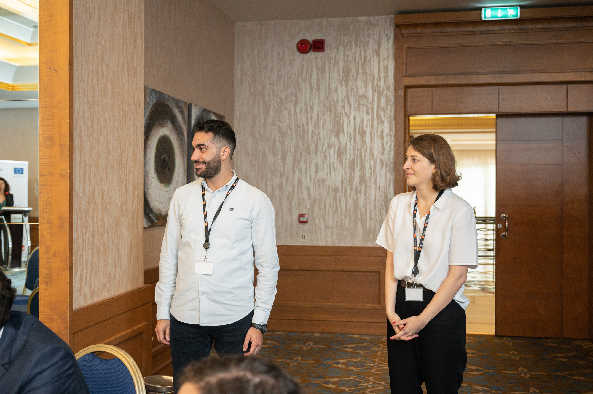




MEET THE TEAM
CONSORTIUM MANAGER
POLICY ADVISER
RESEARCH ADVISER
CONSORTIUM ASSISTANT
STRATEGIC CONSULTANT
JEAN PAUL EL KHOURY
CYNTHIA SAGHIR
MARWAN ALAWIEH
MONA MOUNZER
INGRID BETZLER

Slide 6
CAMEALEON Objectives & Pillars
Objectives
The evidence on the effectiveness of large-scale social assistance response for extremely poor and vulnerable Syrian refugees and Lebanese
The evidence on the accountability systems of the large-scale social assistance response for extremely poor and vulnerable Syrian refugees and Lebanese is increased.
Learning on the large-scale social assistance response for extremely poor and vulnerable Syrian refugees and Lebanese is improved.
EFFECTIVENESS
ACCOUNTABILITY TO AFFECTED POPULATIONS
LEARNING
Research Pieces
Bottom Poor
Links Between CVA and Social Protection
Long Term Impact of Cash Plus
Misinformation
Learning Events
Effect of Debt
Inclusion of PwDs
Multi-Media Learning Material
Cash Coordination in Lebanon
Adaptive Capacities of Vulnerable Households and Communities in Lebanon
Knowledge Sharing Activities
Role of Local Actors
Elderly

Slide 7
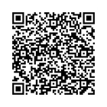

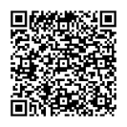

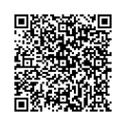
Previous Works
Implementing Consultants
The Role of Misinformation on Cash and Voucher Assistance for Social Cohesion in Lebanon
The study explored how misinformation on cash assistance affected Lebanese and Syrian communities and contributed to social tensions. It identified misinformation channels and helped inform targeted communication, user-friendly program design, and improved monitoring tools. Findings were shared through coordination platforms to support more transparent and accountable CVA programming.
Lebanon's Social Protection System Suffers Amidst the Current War: Urgent Action Needed!
This policy paper evaluates Lebanon’s fragmented and underfunded social protection response to the ongoing war and proposes urgent and long-term reforms. It highlights the limited reach of current cash-based and in-kind assistance, and calls for better integration between humanitarian aid and national systems. Key recommendations include expanding coverage, improving coordination, leveraging domestic funding, and implementing universal social protection schemes to strengthen the system’s shock-responsiveness and long-term resilience.
Safety net and humanitarian cash in the Emergency Response in Lebanon – what can we learn?
This paper assessed the recent scale-up of cash assistance in Lebanon, focusing on the interaction between emergency humanitarian aid and government-led safety nets. Centered on the Lebanese population, the study examined how these systems complemented each other, identified key challenges, and highlighted opportunities for improved coordination. It concluded with recommendations to strengthen the design and delivery of cash responses in future crises.

Slide 8
Research Piece | Added Value
The Role of Misinformation on Cash and Voucher Assistance for Social Cohesion in Lebanon | The findings helped agencies enhance social stability in their analyses by generating insights and recommendation for developing targeted communication plans, designing easily communicable cash programs, and monitoring cash-related indicators in communal relations surveys.
Lebanon's Social Protection System Suffers Amidst the Current War: Urgent Action Needed! South Paper | The study offers evidence-based guidance to strengthen Lebanon’s social protection system amid conflict. It identifies key reform areas, promotes better alignment between humanitarian aid and social protection, and provides actionable recommendations to enhance system responsiveness, coordination, and sustainability.
Safety net and humanitarian cash in the Emergency Response in Lebanon – what can we learn? CAMEALEON’s Cash Advocacy Paper | The policy paper sought to enhance the humanitarian response and provide recommendations to support the development and implementation of novel policies and practices to improve the cash response in Lebanon.

Slide 9

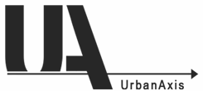

Current Works
Implementing Consultants
Opportunities and Barriers for PWDs in Accessing Social Protection and CVA Programs in Lebanon
The objective is to identify the barriers People with Disabilities (PWDs) face in accessing CVA and social assistance programs (NPTP and NDA) from their own perspective, assess the appropriateness, relevance, accessibility, and sustainability of these programs, and explore how PWDs intersect with specific sub-groups such as the elderly, women, children, and caretakers within these systems
The Bottom Poor and Social Assistance programs in Lebanon
The research explores the perspectives of users and non-users of social assistance programs in Lebanon (e.g., NPTP, ESSN), considering gender, age, disability, and geography. It examines how program inclusion or exclusion affects households across areas like health, education, food security, employment, and social stability. It also identifies access barriers—informational, structural, and social—and provides recommendations to improve the inclusiveness and effectiveness of social protection systems.
Assessing the Link Between Cash Assistance and Debt Among Vulnerable Households in Lebanon
The research aims to identify the sources and types of debt, including their characteristics (formal or informal), scale, duration, and interest type, with disaggregation by area of residence, age, and gender of the debtor. It also evaluates the impact of different types of debt on the overall well-being of the target population.
Impact and Effectiveness of Cash Plus Livelihood Programming for Lebanese Host Communities in Lebanon
This study examines the effectiveness of cash and cash-plus interventions in addressing the urgent needs of internally displaced persons (IDPs) and host communities. It aims to understand how these approaches support basic needs, enhance coping capacity, and contribute to resilience in a context of prolonged instability.

Slide 10
Research Piece | Added Value
Opportunities and Barriers for PWDs in Accessing Social Protection and CVA Programs in Lebanon | This study gives voice to people with disabilities, revealing the hidden barriers they face in accessing aid — and offers actionable recommendations to improve inclusive design, targeting, and delivery of social protection assistance.
The Bottom Poor and Social Assistance programs in Lebanon | The research will develop key recommendations to improve the inclusiveness and effectiveness of social protection programs, identifying best practices for addressing information and coverage gaps to better reach the poorest and most vulnerable households from a bottom-up perspective.
Assessing the Link Between Cash Assistance and Debt Among Vulnerable Households in Lebanon | This research is expected to provide crucial insights to enhance the design and implementation of cash programs by identifying prominent trends in protection threats correlated with high debt levels, ensuring they align with the overarching goal of mitigating vulnerabilities within the refugee and host communities.
Impact and Effectiveness of Cash Plus Livelihood Programming for Lebanese Host Communities in Lebanon | The study will inform the design of Cash Plus interventions by exploring the effectiveness of the cash plus approach in achieving intended outcomes, share lessons learnt and recommendations and provide a roadmap on the needed considerations when designing and reviewing such interventions in Lebanon.

Slide 11

New Research Pieces
Status
Participatory Approach to Assessing the Access to CVA and the Social Protection Systems for the Elderly Population in Lebanon
The study will explore the perspectives of vulnerable elderly Lebanese on CVA and social assistance programs to support more inclusive and accessible programming. It identifies access barriers, addresses information gaps, and offers bottom-up policy recommendations to improve targeting. A gendered lens is applied to better understand their specific challenges and experiences.
Upcoming
advertisement
Streamlining Cash Coordination in Lebanon
The study will investigate the initial response to the September 2024 conflict in southern Lebanon, focusing on key non-formal actors involved in supporting displaced communities during the early stages. It will examine how these actors provided assistance before formal aid mechanisms were activated and the extent of their interaction with official responses. Findings will be used to identify opportunities for leveraging civil society in future anticipatory action
Advertised
Partnership Initiative
The Role of Civil Society as Local First Responders in the Lebanese Emergency Response
This study examines the effectiveness of cash and cash-plus interventions in addressing the urgent needs of internally displaced persons (IDPs) and host communities. It aims to understand how these approaches support basic needs, enhance coping capacity, and contribute to resilience in a context of prolonged instability.

Slide 12
Research Piece | Added Value
Participatory Approach to Assessing the Access to CVA and the Social Protection Systems for the Elderly Population in Lebanon | This study aims to understand the perspectives of the most vulnerable elderly Lebanese regarding CVA programs and social assistance schemes, in order to inform effective, inclusive, and accessible programming.
Streamlining Cash Coordination in Lebanon | This research offers actionable insights to streamline cash coordination in Lebanon, helping maximize impact and efficiency in a resource-constrained humanitarian environment.
The Role of Civil Society as Local First Responders in the Lebanese Emergency Response | This study highlights the vital, often under looked role of civil society as first responders in crisis, offering insights on how to better integrate local actors into future anticipatory and formal response systems.

Slide 13



Organizers
BASIC Paper / Conference - The Link Between Humanitarian Assistance and Social Protection in Lebanon: A Bottom-Up Perspective
CAMEALEON’s team will develop a policy paper for BASIC’s upcoming event as part of its knowledge-sharing and learning agenda. The paper will (1) highlight key research findings, (2) offer concrete policy recommendations to improve the accountability and effectiveness of social assistance and humanitarian cash programs, and (3) contribute to global discussions on strengthening the link between social protection and humanitarian aid in crisis settings from a bottom-up perspective.
Research Visibility & Policy Influence
Adaptive Capacities of Vulnerable Households and Communities in Lebanon
This study explores how vulnerable households in Lebanon are responding to overlapping crises and financial hardship by relying on local strategies and community-based solutions. It highlights homegrown resilience in the face of shrinking international aid and aims to inform future research by identifying both effective coping mechanisms and areas of continued vulnerability.
Foresight Paper - CAMEALEON EVENT
In 2025, CAMEALEON will produce a comprehensive Foresight Policy Paper that consolidates key findings from its research portfolio, providing a forward-looking analysis of trends, gaps, and opportunities related to CVA and Social Protection in Lebanon. This paper will synthesize insights across multiple studies to inform future program and policy decisions. To amplify its impact, CAMEALEON will also host an event to present the Foresight Paper and showcase its broader body of work, fostering dialogue among policymakers, practitioners, and stakeholders.

Slide 14
Research Piece | Added Value
BASIC Paper / Conference - The Link Between Humanitarian Assistance and Social Protection in Lebanon: A Bottom-Up Perspective | This policy paper intends to contribute to the global conversation and learning activities surrounding the enhancement of the link between social protection and humanitarian assistance and accountability to affected populations in crises from a bottom-up perspective.
Adaptive Capacities of Vulnerable Households and Communities in Lebanon | The study will uncover community-led and household-level strategies that have emerged in response to Lebanon’s crises—offering rarely documented, homegrown models of resilience that can guide future programming, fill evidence gaps, and strengthen locally anchored social protection responses.
Foresight Paper - CAMEALEON EVENT | By compiling data and outcomes across multiple research projects, the Foresight Summary aims to present a coherent narrative highlighting critical gaps from the research, emerging challenges, and potential intervention opportunities. This paper will serve as a valuable resource for policymakers, practitioners, and stakeholders, informing future program designs and policy decisions.

