Slide 1
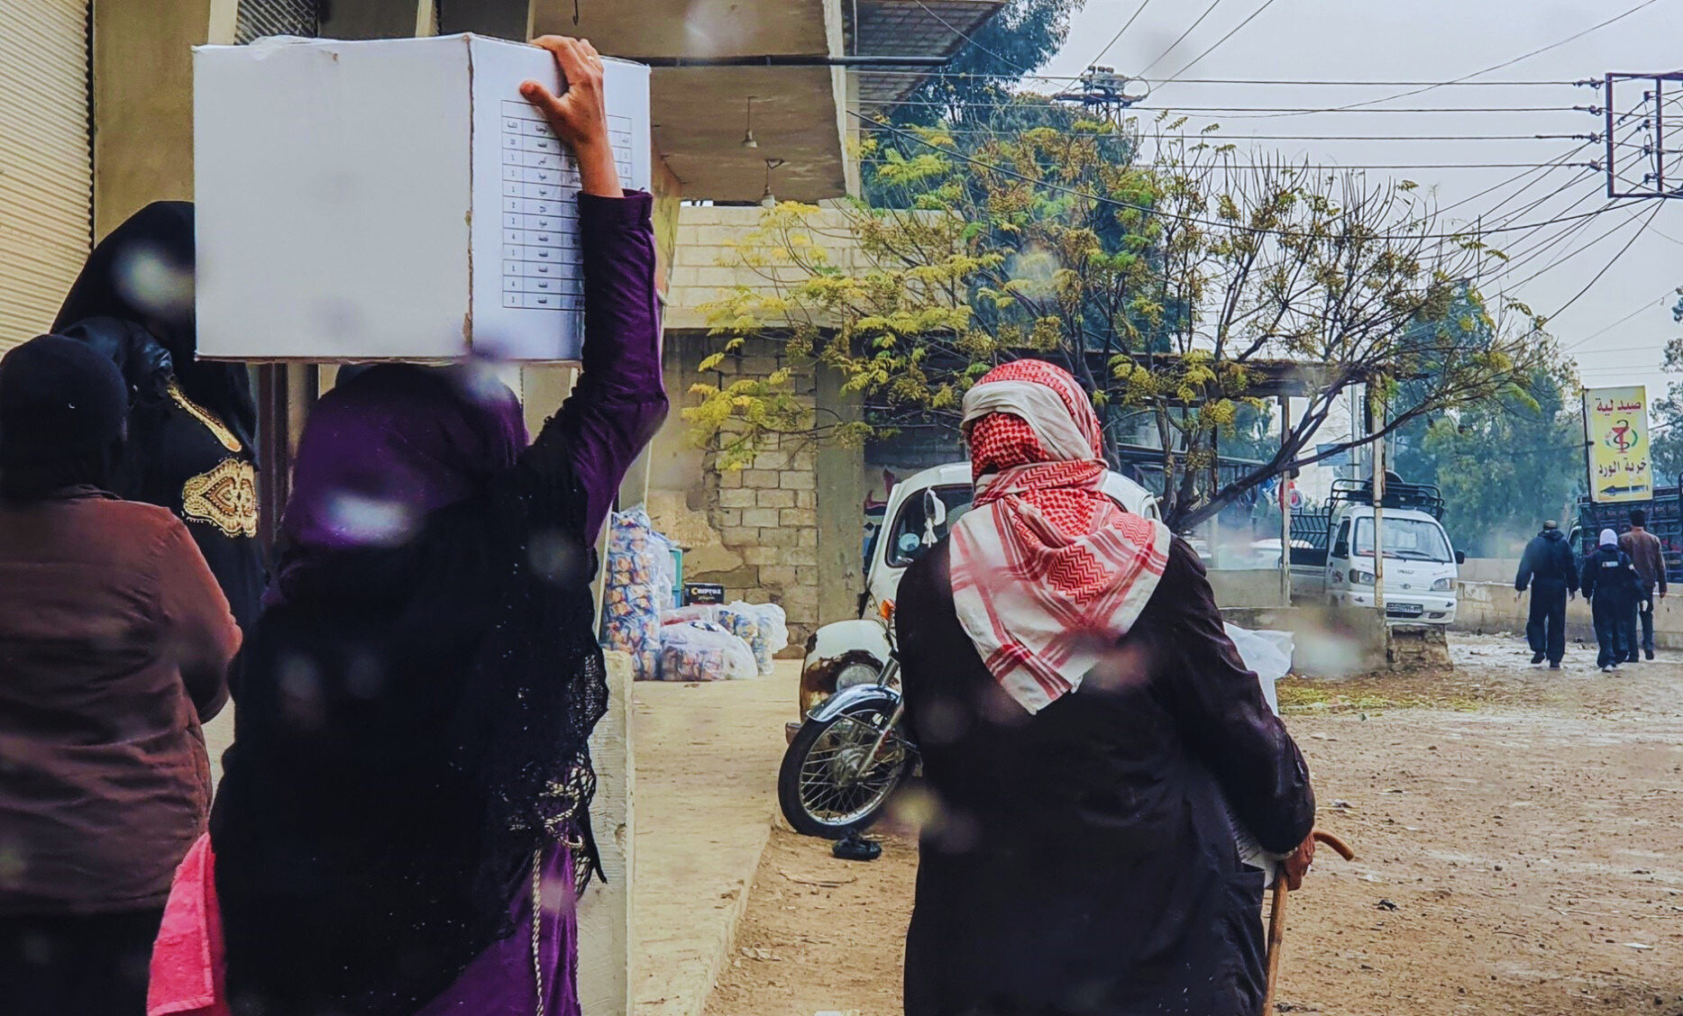



SAFETY NET AND HUMANITARIAN CASH IN THE EMERGENCY RESPONSE IN LEBANON – WHAT CAN WE LEARN?
Cash Advocacy Paper
12 March 2025

Slide 2


AIM OF ADVOCACY PAPER
01
02
Deliver a nuanced conversation surrounding humanitarian cash and its links with government-led social safety net.
Provide novel policy recommendations to enhance the humanitarian cash response in Lebanon.

Slide 3
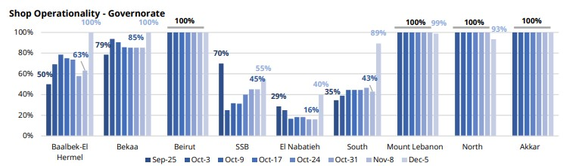
WHY USE CASH
CASH IS CHEAPER: CVA OFFERS MORE VALUE FOR MONEY
02
CASH IS PREFERRED AS IT GIVES AFFECTED POPULATIONS CHOICE AND DIGNITY
01
03
CASH BOOSTS LOCAL MARKETS WITH A MULTIPLIER EFFECT OF $2.13
CASH HAS REMAINED POSSIBLE.
04

Slide 4
Landscape of Cash in Lebanon
SOCIAL ASSISTANCE
HUMANITARIAN CVA
EMERGENCY SOCIAL SAFETY NET (ESSN) targeting households affected by the economic crisis
SHOCK-RESPONSIVE SOCIAL SAFETY NET (SRSSN) benefitted 58,000 targeted Lebanese households between Nov and Dec 2024
UNHCR and WFP’s Multi-Purpose Cash Assistance (MPCA) targeting
MPCA of other cash actors, including Oxfam, NRC, Mercy Corps, Save the Children etc.
Sectoral cash-based interventions
Programs target Syrian and Lebanese but mostly Syrians

Slide 5





Lebanon Cash Situational Summary
(September 23 – January 2025)
Dec 9, 2024: MoSA issues letter on the deduplication process of humanitarian cash programs from ESSN
Dec 2024 – Jan 2025: following three-month delay in the humanitarian cash response, emergency cash was disbursed
Oct 2024: Flash Appeal includes use of cash wherever feasible in several sectors
Sept 23, 2024: outbreak of war
Response to the war mostly consisted of in-kind assistance
Nov 21, 2024: MoSA requested reduction of disbursement of cash till registration process of IDPs is completed
Dec 29, 2024: BAWG and FSAC issued a joint geo-split coordinated guidelines on the transfer of cash

Slide 6
Recommendations: Part 1
RETURN TO A CASH FIRST APPROACH
A COLLABORATIVE AND TECHNICAL CASH WORKING GROUP
EMERGENCY CASH AND SAFETY NETS SHOULD NOT BE DEDUPLICATED
CWG facilitate harmonization and coordination around targeting, transfer values and data protocols, etc.
The absence of a CWG can adversely affect humanitarian responses.
SSNs and humanitarian cash serve different purposes with different criteria.
Coordination is key to ease implementation and impact, making sure households are able to meet their needs.
Deliver in-kind only when cash is no appropriate.
Cash should be a default approach for a more effective and efficient response.

Slide 7




Scenario 1
Displaced household of 5
Household DOES NOT receive displacement related humanitarian cash
Deduplicated from humanitarian assistance
Receiving ESSN
Use humanitarian cash to complement ESSN with a top up
ESSN targets the poorest and most vulnerable affected by economic crises

Slide 8
Recommendations: Part 2
POSITIVE DEVELOPMENTS, BUT WHAT ELSE?
ESTABLISH STRATEGY FOR CROSS-REFERRAL
LEARNING EXERCISE
MoSA’s registration system is a positive development for coordination, but building new systems take time.
Use existing systems to expand shock-responsive SSNs or allow actors expand reach and establish parallel systems.
Between humanitarian organizations and SP systems with guidelines
It should consider poverty and needs associated with displacement and conflict, as well as disability, old-age and GBV.
Include a focus on cash response from implementation, to reach and coordination in upcoming learning exercise of emergency response.

Slide 9
Scenario 2
Displaced household of 5
Eligible to receive displacement-related humanitarian cash
Deduplicated from
ESSN
NOT receiving ESSN
Establish referral systems to link humanitarian cash assistance with social protection or temporarily add households
Household could also be eligible for the ESSN

Slide 10
Q&A

Slide 11
Thank you for listening!

Slide 12


