Slide 1







Making Cash More Inclusive:
Improving Access to Cash Assistance for People Living with Disabilities in Lebanon
Presented by: Dr Cory Rodgers, LAU

Slide 2
Disclaimer
This publication was co-funded by the European Union and the Norwegian Ministry of Foreign Affairs (NMFA). Its contents are the sole responsibility of the author Dr Cory Rodgers, and do not necessarily reflect the views of the European Union or the NMFA.

Slide 3


The Cash Monitoring Evaluation Accountability and Learning Organizational Network (CAMEALEON) is a collaborative research and learning initiative that supports the strengthening of humanitarian and social assistance for crisis-affected populations in Lebanon.
In its third phase, CAMEALEON continues to generate evidence on the relevance, effectiveness, and accountability of cash and voucher assistance (CVA) and social assistance programs. Through research and advocacy, we provide policy recommendations that support stakeholders in strengthening accountability, transparency, coordination, and communication.

Slide 4


Table of
CONTENTS
01
Objectives and Rationale
02
Methodology
03
Findings (Disability-Associated)
Findings (Not Specific to Disability)
04
Recommendations
05
06
Questions and Insights from WG

Slide 5
Study Objectives
Provide a qualitative, “bottom-up” assessment of the accessibility, appropriateness and relevance of cash programs (including humanitarian CVA as well as social assistance) for people with disabilities.
Identity barriers and facilitative factors that influence access,
Describe how program design influences effectiveness,
Examine how experiences vary according to nationality, gender, age, location, and disability type.

Slide 6
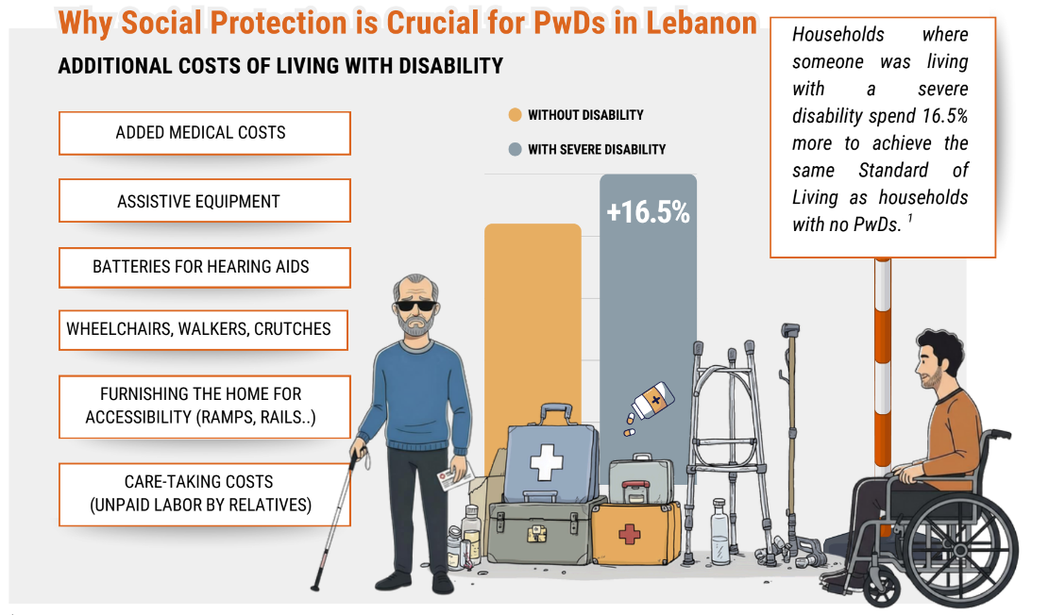
Rationale

Slide 7
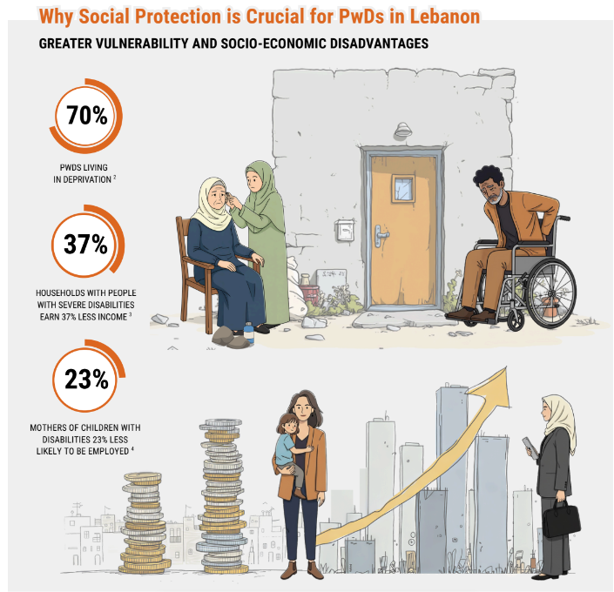
Rationale
‘Living with Disabilities in Lebanon’ Study (ILO 2023)
  based on 2019 survey data (before Oct)
  Point 1: PwDs have more need for SP
  Point 2: PwDs tend to have less access to SP
Since this study…
  Protracted economic crisis
  Israel’s aggressions since 2023
  New SP opportunities
    NPTP absorbed into ESSN (2022)
    NDA launched in 2023

Slide 8
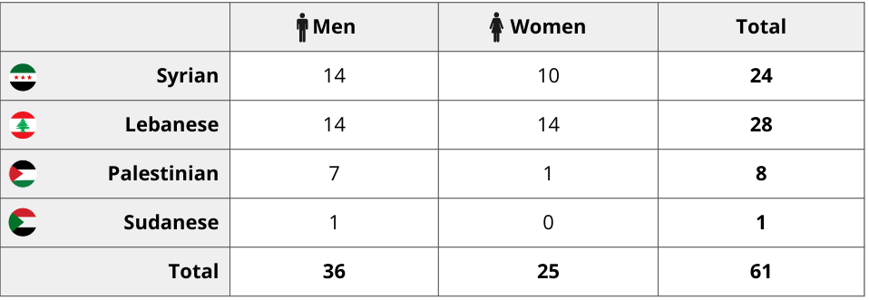
Methodology
61 In-depth Interviews
Sampling for inclusivity:
  Nationality
  Gender
  Age
  Location of Residence
  Disability-type
Journey-mapping approach

Slide 9
National Disability Allowance
Emergency Social Safety Net Program
Multi-purpose Cash Assistance Program
Food e-Cards
Eligibility
People with disabilities aged 15-29 (all nationalities) and children 0-14 (Lebanese)
Vulnerable Lebanese
Vulnerable Syrians
Vulnerable Refugees
Targeting
Disability Determination
(varies by nationality)
Proxy means testing (PMT) + Categorical
Proxy means testing (PMT)
Proxy means testing (PMT)
(Previously universal for refugees)
Launch Year
2023
2022
(absorbed the earlier NPTP)
2013
2013
Main Cash Programs of Interest
$40 USD per person with a one-off $100 USD top
up for households affected by displacement and conflict in late 2024
Maximum of $145 USD ($20 for a household and
$25 per person up to 5 people; some top ups for
education)
Max of $145 USD ($20 per individual up to 5 individuals, plus an additional $45 per household)
$20 per individual, capped at 5 individuals
(restricted cash voucher)
Benefit
Implementers
MoSA
ILO
UNICEF
MoSA
PCM
WFP
UNHCR
WFP
WFP
Redemption
LOUISE Card;
Redeemed as a food voucher at participating shops
MTOs
MTOs
LOUISE Card, via ATM
(some MTOs

Slide 10
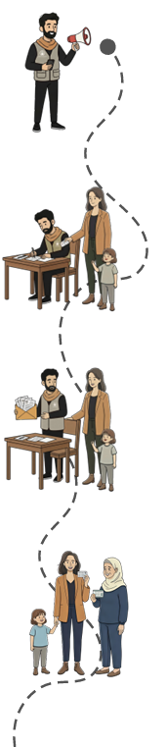
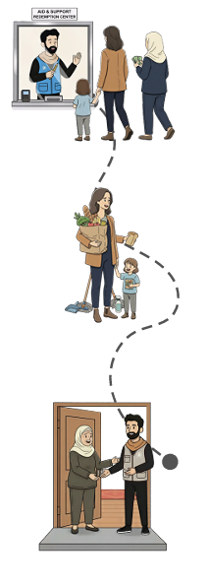
Findings (Disability-Associated)
Outreach
Enrolment
Redemption
Use
Upkeep
Barriers / Pain Points
Pervasive Transportation Barriers
Restrictive requirements [Lebanese + Migrants]
Queues and long-waiting times [displaced]
Lack of support for invisible disabilities
Discrimination: esp. parents of children with disabilities
Technology: a double-edged sword [older persons]
Facilitative Factors
Intra-familial support and proxies
Remote enrolment and home visits
Helpful staff at redemption points
Notes:
Some findings were specific to PwDs, and I’ll start with these
Transportation (across all phases, especially for people mobility and physical disabilities), but also visual and hearing impairments, because they may want to be accompanied
Restrictive disability criteria for Lebanese (medical definition)
Queues and long waiting times (physically difficult for those with physical impairments), but also sometimes intimidating for people with other disability types due to tensions that emerge. Especially during the war due to overcrowding in areas where displaced people moved
Facilitative Factors
use of proxies, although some – especially older persons – reported they are fairly alone. Children have their own lives/responsibilities, and they don’t want to be a burden

Slide 11
Findings (Not Specific to Disability)
Appropriateness of Program Design
Most regular transfers are small but impactful
Challenges to autonomy and decision-making about use [Women]
Difficulty acquiring necessary documentation [Migrant Workers]
Trust and Accountability
Lack of information and some misinformation about eligibility [Syrians and Palestinians]
Distrust about targeting methods for safety nets
Frustration with non-responsive call centers or help lines.
Program interruptions and discontinuation created uncertainty
Notes:
Misinformation – especially for Syrians and Palestinians who were under the impression they were not eligble for certain programs, including NDA.
Trust – an issue of opaqueness, also pmt is widely known for being faulty

Slide 12
Recommendations
Training for staff at provider organizations and partners (e.g. MTOs, banks)
  Appropriate support and prioritization to anyone with disabilities
  Discretion for women receiving transfers
Optionality in redemption methods
  Mobile wallet as an options to remove redemption stage
  Lump sums rather than monthly disbursements
  Unrestricted cash is usually preferred, but some exceptions
Transparency and Trust
  Updated eligibility and application information on websites and social media
  Support OPDs to monitor informal dissemination of information through informal community channels
  Well staffed help-lines and call centers
  Gradual shift from humanitarian social safety nets to rights-based social protection
Notes:
Trust – an issue of opaqueness, also pmt is widely known for being faulty

Slide 13
Questions & Feedback

Slide 14

THANK YOU

