Slide 1








From war to war: what have we learnt from Social Protection and Humanitarian Cash Assistance in Lebanon in times of peace?
CAMEALEON final presentation and workshop
28.04.2026

Slide 2
Disclaimer
This publication was co-funded by the European Union and Norway. Its contents are the sole responsibility of CAMEALEON and do not necessarily reflect the views of the European Union and Norway.

Slide 3
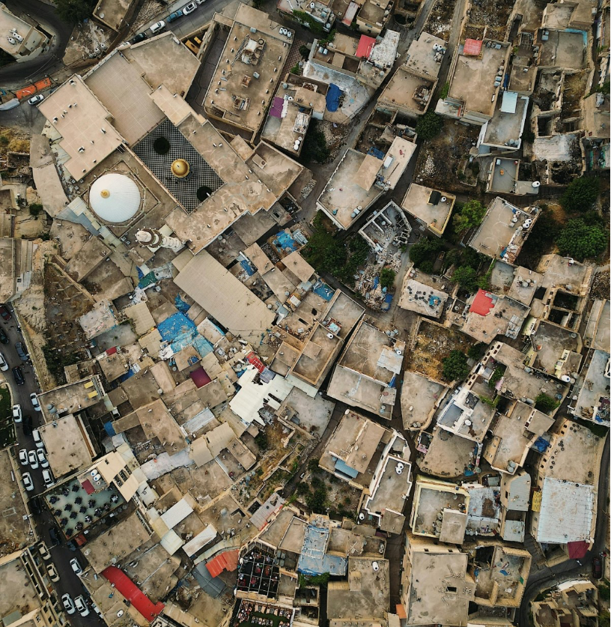
Agenda
Opening remarks.
Presentation: objective, research questions, summary findings and recommendations.
Gorup work: collective reflection and refinement of recommendations.
Wrap-Up and Next Steps.

Slide 4
Objective
Current ongoing humanitarian action can benefit from learning that CAMEALEON has generated after the 2024/2025 escalation of hostilities and subsequent large-scale displacement.
The lessons learnt from CAMEALEON’s work to date are even more important considering the volatile context in Lebanon, marked by recurrent humanitarian crises, protracted displacement, and limited recovery opportunities.
CAMEALEON focused mostly on qualitative research, driven by the initial planning of several impact evaluations for NPTP and AMAN and through consultations with multiple stakeholders.
The central focus of this paper is to synthesize the major insights and findings from CAMEALEON’s research to date on CVA and social protection in Lebanon and to provide recommendations based on lessons that can be drawn from past.

Slide 5
Overview of CAMEALEON research in 2024/2025
CAMEALEON’s focus on four thematic areas:
Social protection - documenting access barriers for the most vulnerable population groups (older persons, persons with disabilities, and poor/vulnerable HHs); and two policy papers on the expansion of SP systems at the onset of the war and documenting lessons learnt from the SP and humanitarian CVA response.
Humanitarian CVA – reviewing the cash coordination architecture in Lebanon, analyzing the cash for rent modality, and providing innovative research into the role of misinformation around CVA on social cohesion.
Resilience and self-reliance – documenting the role of debt as a coping mechanism, evaluating cash plus approaches and their effectiveness, and building an argument for a self-reliance approach to humanitarian programming in Lebanon.
Informal networks and civil society - documenting the role of civil society as first responders and structural challenges, and the role of informal networks on self-reliance.

Slide 6
Key research questions
What are some of the access barriers of the most vulnerable groups, including older persons, people with disabilities, and the poorest segments of the population to SP and formal aid programs? Will these patterns of exclusion intensify in the context of a full‑scale crisis?
What is the role of cash coordination in driving an effective and timely humanitarian cash response?
What is the role of civil society and informal networks in filling the gaps and to compensate for the shortcomings of an unequal system?
Can CVA programmes also become an avenue for self-reliance and resilience building?
What can we learn from past research on these interlinked systems (SP, humanitarian, civil society) that can inform the emergency response today, as well as recovery and planning tomorrow?

Slide 7
1. Social protection and SRSN

Slide 8
1. Social protection – Key findings across the studies
Systematic exclusion: Across CAMEALEON studies, Lebanon’s social protection system consistently fails to reach those facing the highest levels of vulnerability.
Structural access barriers: Digital exclusion, high transport costs, inaccessible registration and payment mechanisms, rigid eligibility criteria, and opaque targeting processes drive widespread exclusion and self‑exclusion.
Weak outreach and trust deficits: Poor communication, misinformation, and short‑term outreach are compounded by deep mistrust in state and humanitarian actors, linked to perceptions of politicization, unfairness, and reliance on wasta rather than need.
Narrow targeting approach: The focus on poverty targeting—rather than lifecycle and intersecting vulnerabilities—leaves children, older persons, people with disabilities, women, and newly impoverished households inadequately protected.
Inadequate assistance: Even when accessed, support is widely perceived as insufficient, short‑term, and unreliable.
Harmful outcomes: These limitations contribute to negative coping strategies and long‑term risks to dignity, wellbeing, and human capital development.
Crisis amplification risk: In a full‑scale crisis, existing social protection programmes risk further entrenching and amplifying patterns of exclusion.
SRSN: The rollout of the SRSN during the 2024–2025 crisis generated critical lessons, including that system building approaches may not be appropriate during an emergency response.

Slide 9
Recommendations- SRSN
Preparedness plan: Need of an overall preparedness plan and strategy that clarifies roles and responsibilities and sets state-led interventions strategies, in partnership with international and national humanitarian actors and civil society.
Clarify purpose: In crises, SRSN must prioritize rapid cash delivery, not registry development and system‑building objectives.
Speed over procedures: In‑person verification, multiple datasets reconciliation, and a lack of deduplication protocols delayed assistance—shift to rolling enrolment and ongoing payments, common in humanitarian cash programs.
Expand fast: Urgent horizontal and vertical expansion needed for both SRSN and AMAN; during crises, dedicated registration pathways for newly displaced people and higher transfer values are required.
Reach the excluded: Online registration must be paired with active outreach, especially for digitally excluded groups.
Fix data flows: Enable two‑way, interoperable data sharing between MoSA and humanitarian actors as opposed to one way distribution of lists from MoSA.
Explore collaborative models: Collaborative approaches (MoSA, UN, NGOs, local civil society) are more effective at delivering assistance faster and at scale compared to single actor delivery systems.
State leadership: SRSN must evolve from a donor financed delivery channel into a state‑led mechanism, with growing domestic financing as ODA declines.
MoSA’s role: Shift from humanitarian cash coordination to long‑term social protection system development under the NSPS and SRSN system building.

Slide 10
Recommendations- Social Protection reform
Shift
Shift to universal, rights‑based SP: Move beyond poverty‑targeted programmes toward a universal social protection system, aligned with the NSPS and pension law.
Address
Address exclusion: Current systems exclude some of the most vulnerable due to access barriers and program design; a rights‑based approach can reach vulnerable people beyond a single registry, using a life cycle approach.
Transition
From emergency to recovery: After the crisis, transition from short‑term humanitarian aid to a broad, state‑led social safety net supporting recovery, livelihoods, and resilience.
Strengthen
Strengthen national ownership: Increase government leadership and domestic financing to rebuild trust, strengthen the social contract, and reduce reliance on aid and informal patronage systems.
Universal SP is not feasible under the current fiscal and growth constraints, but neither is the full coverage of the AMAN program from state budget.
Finance SP sustainably: Adopt a phased reform over 10–15 years; prioritize affordable measures (e.g. disability allowance expansion, child grants) funded through the state budget. The use of loans and grants for the provision of benefits beyond system design is unsustainable.
Improve communication and outreach: Ensure clear, trusted, multi‑channel communication and proactive outreach to those most at risk of exclusion.
Simplify access: Reduce administrative and physical barriers through remote delivery, mobile wallets, and accessible helplines is particularly important for people with mobility constraints, care responsibilities, and lack of financial means.
Prioritize older persons: Advance toward a non‑contributory social pension and implement existing national strategies. Older people face distinct risks and barriers that require more systematic recognition within policy and programme design.

Slide 11
Group work – 15min.
What should be the priority reccomendations for the SRSN and for Social Protection? Cast your vote.
For the priority reccomendations, what could be concrete steps to take for their implementation? Write your ideas on post it notes.
If feasibility is questioned, what are the barriers and how can we address them? Write your ideas on post it notes.
Plenary – 5 minutes.

Slide 12
2. Humanitarian CVA: coordination, self-reliance, cash plus, debt.

Slide 13
2. CAMEALEON research on CVA
Lessons from the 2024/2025 CVA response and cash coordination:
Previous cash coordination model unable to deliver an effective and timely CVA response.
Consistently described as ineffective and deeply fragmented both during and after the escalations.
Absence of CWG as a central factor.
National systems have progressed, but remain insuficiently equipped for large scale crisis and disaster response.
Lack of shared protocols and governance mechanisms significantly delayed humanitarian cash operations for the majority of Lebanese HHs.
Refugee response operates through a separate more technically advanced system.
Need of a stronger governnace coordination through a CWG aligned with IASC international standards, with a cross population mandate.
Mandate driven coordination, but expectation that all groups are treated equally during shocks. In practice this equity has not materialized.
Resilience and self-reliance:
Self reliance requires access to basic services, safety, legal rights, and the ability to meet essential needs—conditions that remain largely unmet in Lebanon.
For Syrians in particular, regularization and protection remain an obstacle towards self-reliance.
Extensive investments over a period of 15 years – poverty indicators have worsened due to recurrent crises and programs designed only to meet basic needs.
Current humanitarian cash programs do not promote self reliance by design and due to lack of access to rights.
HHs rely on low-margin informal work and multiple jobs per HHs; rising protection concerns including child labour and ilicit activities in certain areas.
Growing isolation reported by older persons, women and Syrian nationals.
Requires an intentional shift toward self-reliance outcomes.

Slide 14
CAMEALEON research on CVA
Cash Plus (financial literacy, nutrition&hygiene, agriculture support):
Cash plus is defined too broadly and needs a clearer concept definition.
Cash plus programs delivered imporant short-term benefits across food security, income, and access to services.
However, most of these gains quickly dissapeared when the assistance stopped – meal skipping, debt reliance re-emerged.
Transfer values widely perceived as insufficient; the Plus component added value only when HHs already owned assets (eg: land).
Syrians and women generlaly faced structural barriers (landlessness, caregiving responsibilities, legal constraints) that limited their abilities to convert skills into durable livelihoods.
Overall, Cash Plus interventions were highly relevant and operationally effective for meeting urgent needs, but their contribution to long‑term resilience was limited.
Role of CVA in debt management:
Borrowing and debt are widely used coping strategies, with debt stress highly prominent and aid interruptions are linked to deeper indebtedness.
Borrowing mainly for essentials like food, rent, and healthcare.
Borrowing is informal, trust‑based, and interest‑free, but repayment is enforced through social pressure and sometimes harassment.
Indebted households—especially women, refugees, and migrants—face increased risks of exploitation, eviction, abuse, and social stigma.
CVA largely insufficient to reduce debt or support sustainable livelihoods.
Assistance only partially meets needs and lasts less than two weeks, with debts quickly reaccumulating once transfers end.
Impact of cash assistance on debt depends on its design, duration, and adequacy; flexible, predictable, and longer‑term transfers are more effective.

Slide 15
Reccomendations – cash coordination
Mandate of CWGs: Lebanon’s experience shows that CWGs are central to a healthy and effective cash ecosystem. The CWG upholds quality standards beyond individual organisational mandates, strengthens resilience to shocks, and enables cash scale‑up beyond the capacity of a few strong actors.
Role of the CWG during the 2026 escalation of hostilities:
Platform for high‑quality humanitarian cash: Lebanon presents an opportunity to coordinate a nationality‑ and mandate‑agnostic cash response through the newly established CWG.
Mandate‑neutral coordination: Coordination should not be driven by existing systems or mandates, which risk excluding migrants, unregistered refugees, and Lebanese unwilling to register with state authorities. The CWG must prioritise technical standards over mandate driven approaches in a fragmented cash response.
Cross‑population technical leadership on quality and effectiveness: Empower the CWG with a cross‑population technical mandate so that “equal assistance for all populations” is meaningfully reflected in technical guidance and implementation. Host mandate‑neutral technical discussions on cash effectiveness and MPCA design in emergencies.
MPCA coordination across all nationalities: Reinforce the CWG as the technical lead for all cash and CVA matters, fully coordinating MPCA through population‑agnostic technical guidance.
Promote a collaborative model: Given the scale of needs, the CWG should leverage the contributions of all 68 cash actors. Centralised coordination and de‑duplication, combined with decentralised implementation, is essential to reach populations invisible to existing systems in a timely manner.
Balancing efficiency, speed, and inclusion: Humanitarian principles may require prioritising speed and inclusion over efficiency gained through single delivery platforms such as the SRSN. The CWG should guide analysis of trade‑offs between delivery modalities.
Centrality of MPCA: Reinforce MPCA as the default emergency response for basic needs, with sectoral top‑ups used when technically justified and needs driven.
Transfer values: TVs should reflect real needs during emergencies, which could mean a misalignment with SP programs. Emergency top-ups should be allowed if the TV remains unchanged.
Sustained backing: Donors and the HCT should ensure senior‑level backing and align funding with agreed cash standards.
Inclusive platform: The CWG should be an inclusive coordination platform and share information beyond the regular cash actors, including having a proactive outreach to non-traditional actors and donors.

Slide 16
Reccomendations – resilience and self-reliance
Current CVA model: Ongoing discussion is primarily framed around emergency humanitarian assistance, however in the recovery phase, the current CVA-for-basic-needs model will not be adequate to support self‑reliance, enable recovery, or build resilience.
The current model of cash assistance is unlikely to deliver self-reliance on its own.
Rights-based approach: Needs to be positioned within a broader protection and rights-based response, to ensure a more sustainable pathway to self-reliance.
Different CVA models: As contexts stabilize, affected populations require more appropriate CVA designs that go beyond recurring basic needs transfers.
For ex, lumpsums have been used more successfully to generate better results when it comes to longer-term livelihoods outcomes.
Cash Plus should be designed as a modular approach and support packages should be tailored to household profiles and local economic realities, with stronger attention to the quality and relevance of the plus component, since cash alone is often insufficient where transfers are inadequate.
Requires also a rights-based approach, strong integration with protection.
Defining Cash Plus: Cash plus is defined too broadly and there is a need for a clear concept definition. Need of a clearer definition of what is an impactful and meaningfull cash plus intervention.
Debt management: Debt should be treated as a core programming and protection issue.
CVA programmes should include debt related risks in targeting, link cash more closely with protection case management and referrals, monitor debt outcomes over time, and allow adaptive responses, including mediation support in severe cases.

Slide 17
Group work – 15min.
What should be the priority reccomendations for cash coordination, and role of CVA in self reliance, cash plus and debt? Cast your vote.
For the priority reccomendations, what could be concrete steps to take for their implementation? Write your ideas on post it notes.
If feasibility is questioned, what are the barriers and how can we address them? Write your ideas on post it notes.
Plenary – 5 minutes.

Slide 18
3. Role of civil society and informal networks

Slide 19
Informal networks and local civil society
First responders:
Communities are often their own first responders, mobilizing resources through trust-based systems.
During the early escalation of the 2024 war, refugee‑led organizations, CSOs, and informal networks emerged as key first responders and they are once again center stage in the 2026 humanitarian crisis.
Research shows that civil society actors played a dual role as both first responders and system‑builders.
They delivered immediate assistance but also created informal coordination networks that relied on personal ties, community trust, and platforms to overcome administrative, geographic, and security barriers.
Proliferation of civil society and grassroot initiatives in response to the war represents a major asset, yet there remains a significant disconnect between the formal aid sector and local community-led efforts; lack of accessible direct funding channels.
Informal support networks:
Behind a weak state, there are vibrant informal support networks.
More than 13 types of community based support: family support, food sharing, hosting displaced relatives or neighbors.
Mutual aid, food sharing, borrowing, and social solidarity are common practices, while debt is widely used as a coping strategy.
However, access to informal support is highly unequal and shaped by nationality, age, sectarian affiliation, and political connections - older people and Syrian nationals report the highest levels of exclusion and isolation.
Unequal access to formal aid is perceived as being linked wasta and party‑ or sect‑based networks, with municipalities, local leaders, and mukhtars acting as gatekeepers through politicized or list‑based systems.

Slide 20
3. Role of informal networks and local civil society
Impact on community cohesion:
Evidence across several of the CAMEALEON studies points to growing grievances associated with the formal aid system and rising distrust.
Limited information and poor understanding of registration processes, targeting criteria, and beneficiary selection have generated widespread frustration and tension.
This has contributed to a loss of trust at the community level and with aid providers.
Insufficient transparency and weak communication around international assistance can inadvertently erode social trust, exacerbate social tensions and weaken the social fabric.
Misinformation:
Even before the 2024 escalation of hostilities, there was widespread misinformation surrounding CVA in Lebanon.
Common beliefs about aid bias, unfair competition, unequal access to services, manipulation of assistance, and politically driven aid allocation.
The impact of misinformation on social cohesion has been severe.
It has contributed to rising hostility, hate speech, evictions, protests, and occasional violence, with Syrian refugees frequently scapegoated for economic hardship.

Slide 21
Reccomendations
Role of local civil society: The local civil society should be recognized as an essential actor, but within a coherent national framework that treats it as a genuine partner rather than a parallel substitute or gap filler.
Collaborative national emergency framework: Establish a unified national emergency framework with clearer coordination and preparedness systems.
Financing arrangements: Shift to more predictable and flexible financing arrangement for local civil society.
Support grassroot initiatives: directly resource existing grassroots initiatives—such as food sharing, community kitchens, and mutual aid groups.
Group cash transfers: Use group cash transfers to bridge formal aid and local action, strengthening mutual aid networks without undermining existing coping systems.
Do no harm to social cohesion: Address grievances linked to formal aid systems that fuel distrust and misinformation.
Implement clear, proactive, and inclusive communication reaching the entire community, including non‑recipients.
Increase transparency around targeting, eligibility, and programme objectives. Clarify how assistance is allocated, why certain groups are prioritized, and what support is available.

Slide 22
Group work – 10min.
What should be the priority reccomendations for the role of civil society and informal networks? Cast your vote.
For the priority reccomendations, what could be concrete steps to take for their implementation? Write your ideas on post it notes.
If feasibility is questioned, what are the barriers and how can we address them? Write your ideas on post it notes.
Plenary – 5 minutes.

Slide 23
Thank you!
Notes:
Acknowledgements
This report was authored by Diana Tonea, who is an independent consultant. It was produced under the guidance of Ingrid Betzler, Cynthia Saghir, Jean Paul El Khoury and Mona Mounzer from the CAMEALEON Consortium, Lebanon. The opinions expressed are those of the author and do not necessarily reflect the views of CAMEALEON. Responsibility for the opinions expressed in this report rests solely with the author.
Disclaimer
This publication was co-funded by the European Union and Norway. Its contents are the sole responsibility of CAMEALEON and do not necessarily reflect the views of the European Union and Norway.
Citation
This report should be cited as: Tonea, D. (2026). From war to war, what have we learnt from Social Protection and Humanitarian Cash Assistance in Lebanon in times of peace? CAMEALEON.

