Slide 1
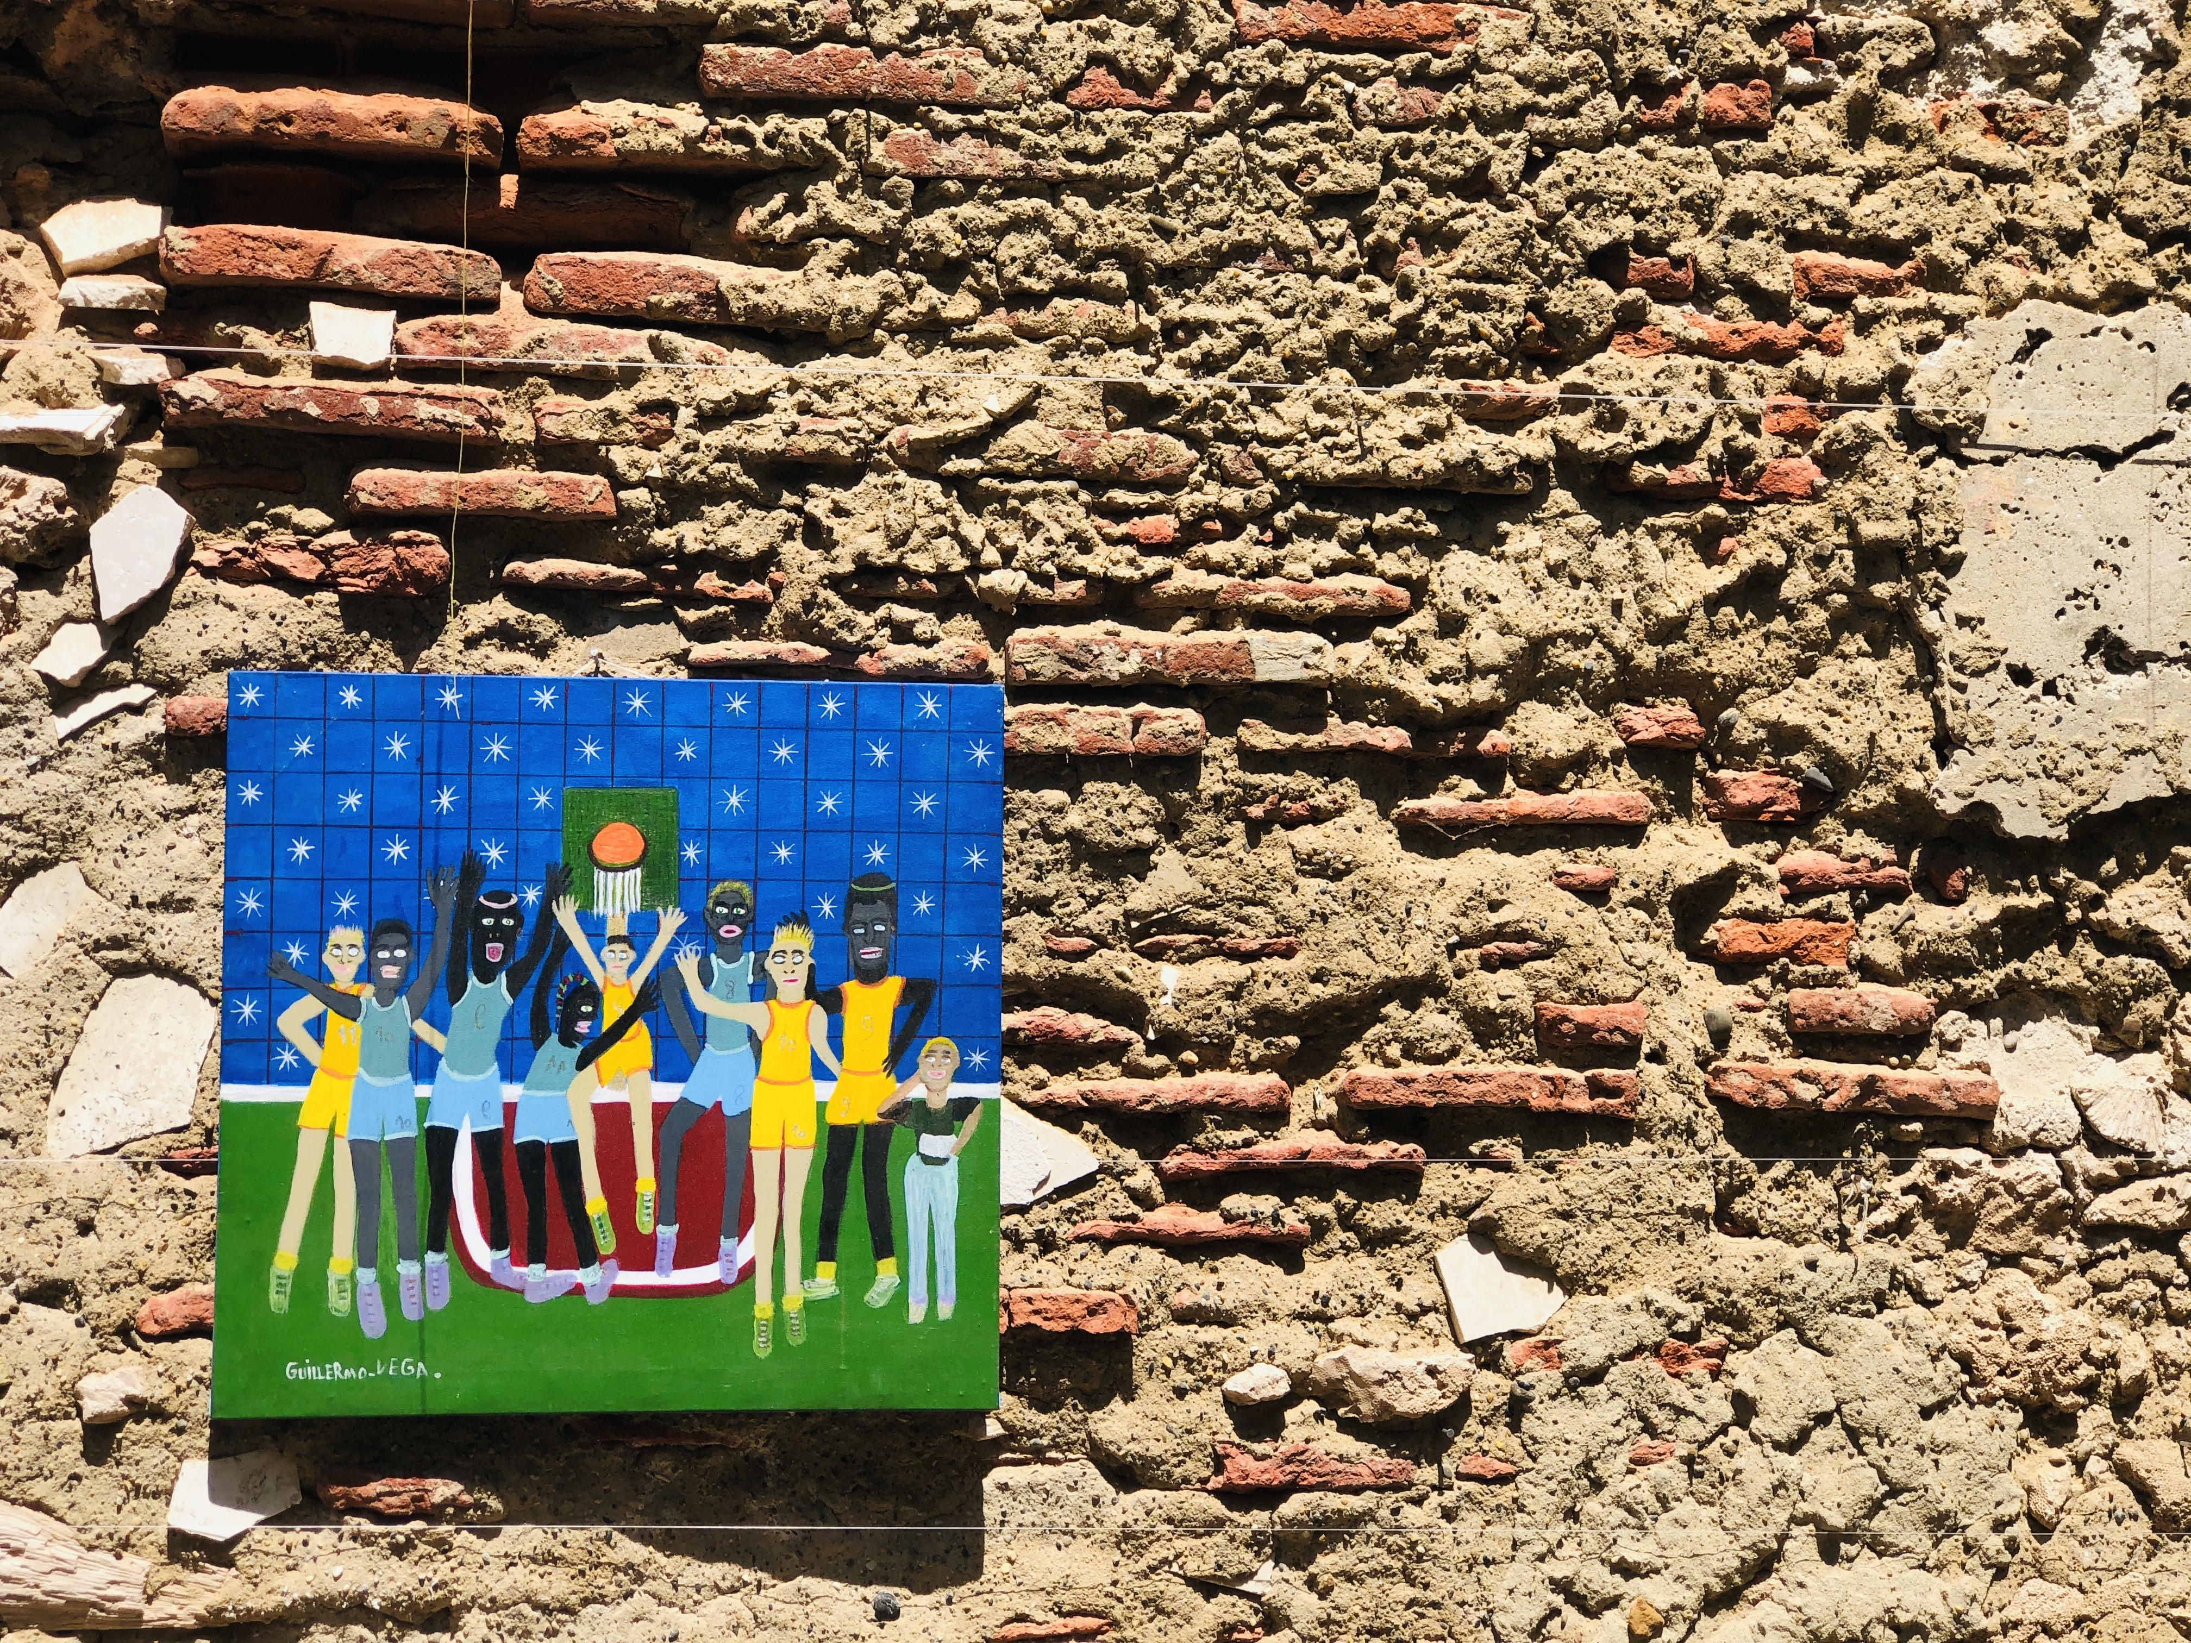
“The Poor”: a fictional construct
Implications for targeting
Stephen Kidd
30th May 2023

Slide 2
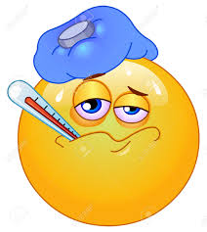

What happens when households cross the poverty line?
?
?
0℃
37℃
PPP$ 1.90 a day
Water temperature
Body temperature
Poverty line
?
?
WATER TURNS INTO ICE
YOU DEVELOP A FEVER

Slide 3
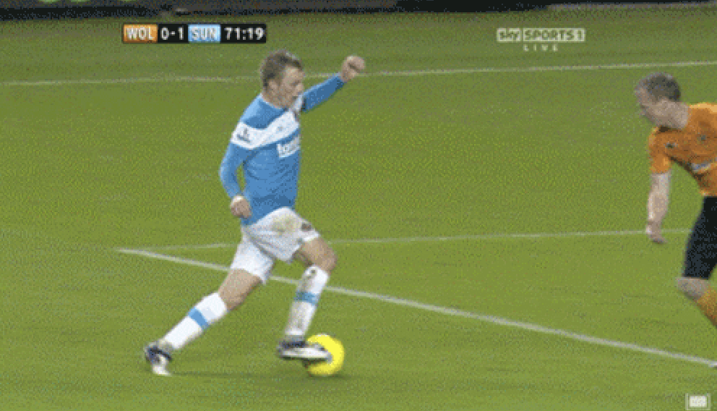
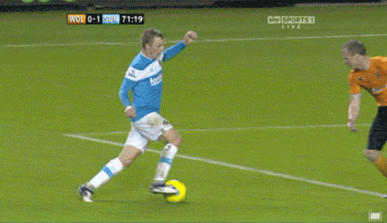
Cross-sectional data
Longitudinal data

Slide 4
Household consumption and incomes vary considerably over short periods of time
Uganda
Indonesia
Uganda: 46 per cent of households that were in the poorest quintile in 2013 had not been in the poorest quintile in 2011
Indonesia: 48 per cent of households with children that were in the poorest quintile in 2015 had not been there in 2014

Slide 5
Poverty transitions in panel surveys with three rounds in selected countries
Number of periods that people were in the bottom quintile (poorest 20%)

Slide 6
Comparison of income distribution in Jordan and United States
91%
91% of Jordanians live under the poverty line in the USA
12%
Source: PovcalNet API (accessed in Jan 2022).

Slide 7
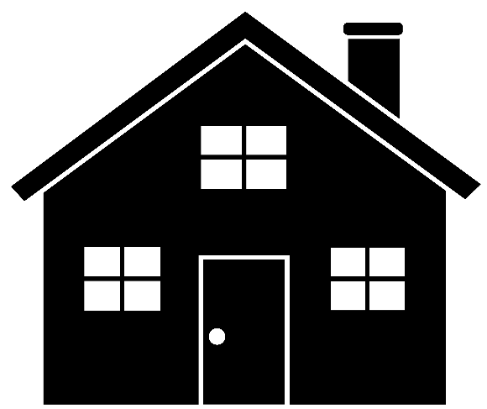



Assumptions in poverty analysis
Poverty line set at US$0.88 per day
Is this household living in poverty?
$3.50/day
3 Adults
2 Children

Slide 8













It depends on your assumptions!
Scale 1: Equal consumption
Scale 3: and if we count the children as 0.5?
Five equally weighted household members (1.0 x 5):
USD$3.50 ÷ 5 = US$0.70 / day = poor
Three adults (1.0 x 3) and two children (0.5 x 2):
USD$3.50 ÷ 4 = US$ 0.88 / day = poor
Scale 2: and if we count the children as 0.3?
Scale 4: and if we recognise economies of scale?
Three adults (1.0 x 3) and two children (0.3 x 2):
USD$3.50 ÷ 3.6 = US$0.98 / day = not poor
First adult (1.0), two additional adults (0.5), two children (0.3 x 2): USD$3.50 ÷ 2.6 = USD$ 1.35 / day = not poor

Slide 9
Implications for targeting

Slide 10
Poverty-targeted schemes always have high exclusion errors
Guatemala
96%
Indonesia
82%
Pakistan
73%
Philippines
48%

Slide 11
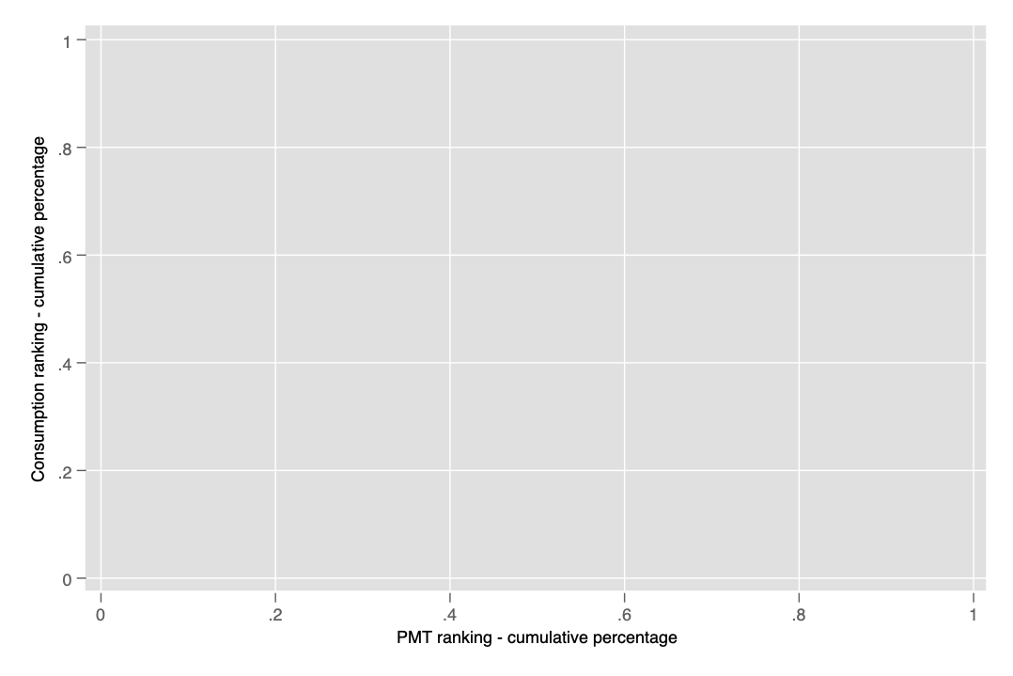
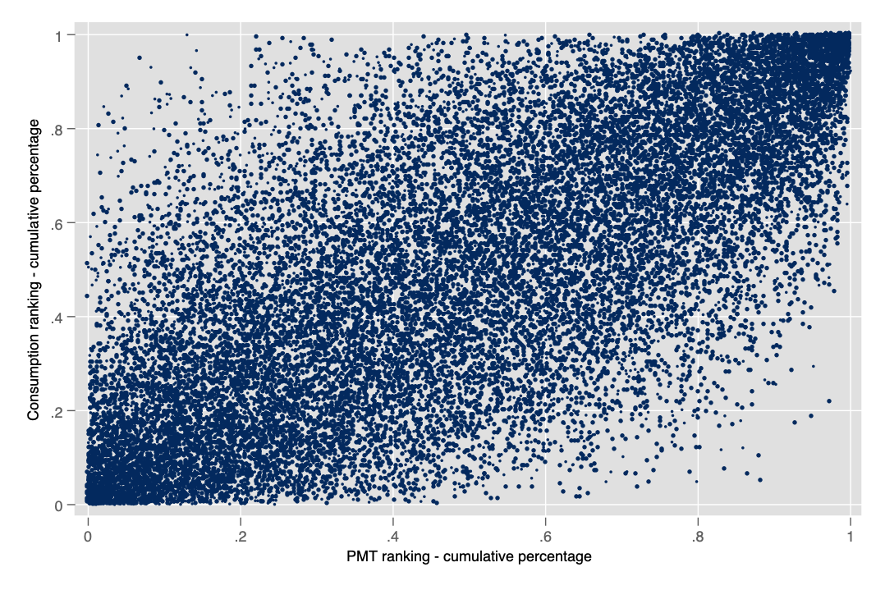
Arbitrariness of PMT: example of Bangladesh
Inclusion errors
Actual consumption from poorest to richest
Correctly targeted
Exclusion errors
PMT’s prediction of household consumption, from poorest to richest

Slide 12
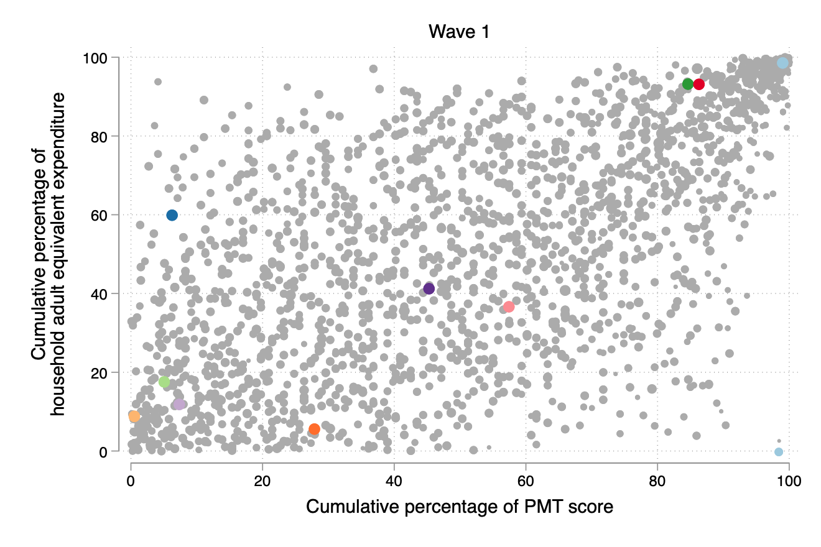
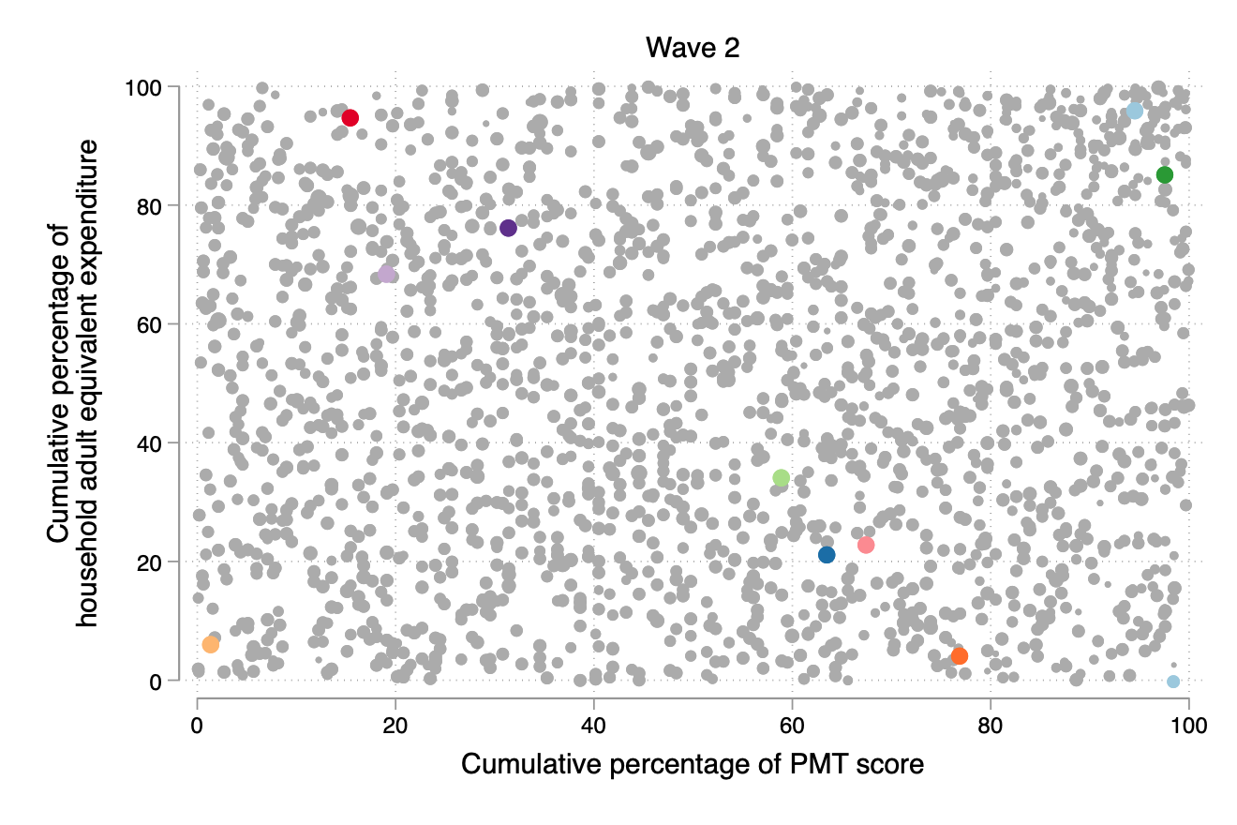
Comparing PMT effectiveness in Rwanda
Assessment against household survey that PMT was derived from
Assessment against household survey 3 years later (better mimics reality)
Source: own calculations using EICV III and EICV IV panel data. PMT score was developed and trained using the first wave

Slide 13
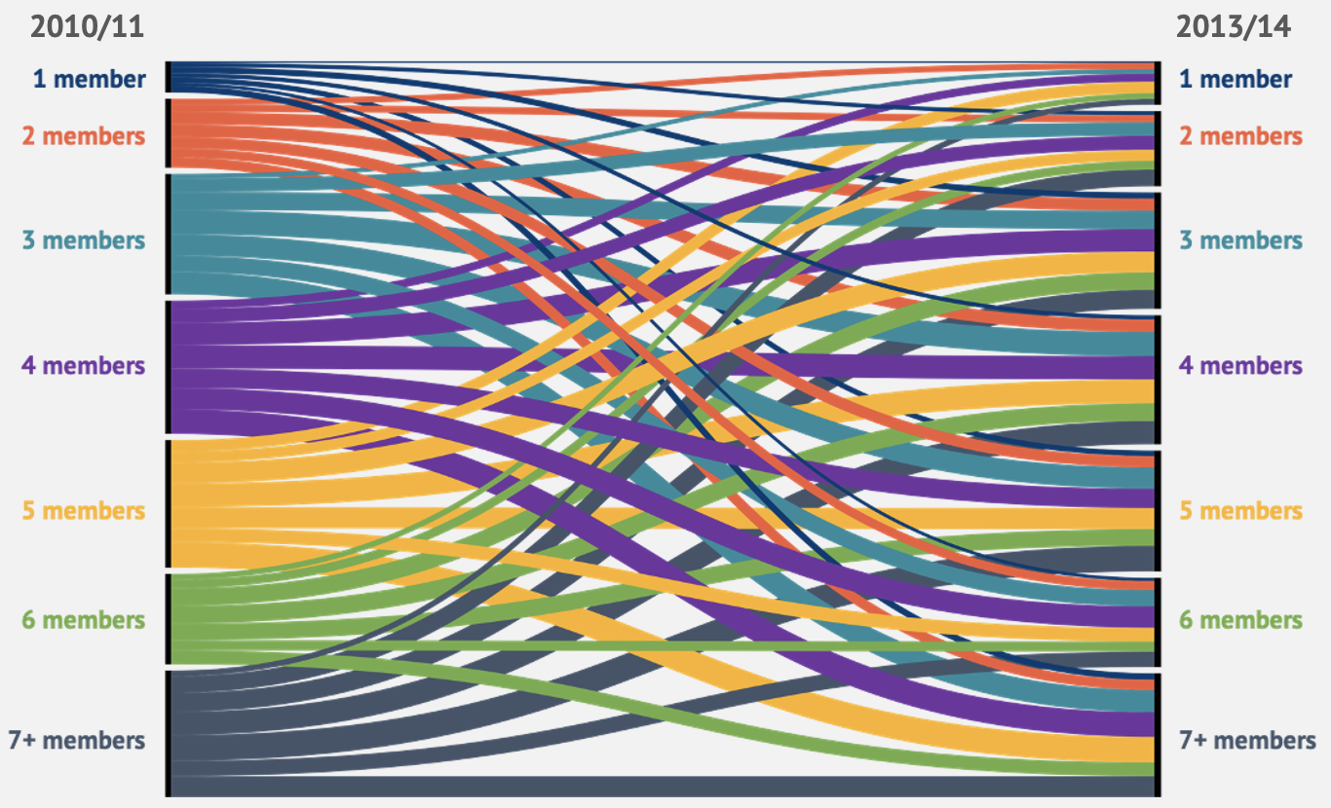
Proxy means tests imagine a static world
Changes in household size in Rwanda over 3 years
87% of households in Rwanda are a different size after 3 years

Slide 14
The best PMT: Peru’s Juntos programme

Slide 15
Pakistan: Benazir Income Support Programme (BISP)

Slide 16
Indonesia: PKH programme

Slide 17
Guatemala: Mi Bono Seguro programme

Slide 18
Targeting the poor is like hitting a moving target
Targeting in the context of income dynamics
Income dynamics mean that the “poor” are a moving target.
If someone is targeted a point A, they will be accepted onto a programme.
However, if they are targeted at point, a short while later, they will be excluded.
In reality, their incomes have not changed much.
Not eligible
Income
B
Eligibility threshold
A
Eligible
Time

Slide 19
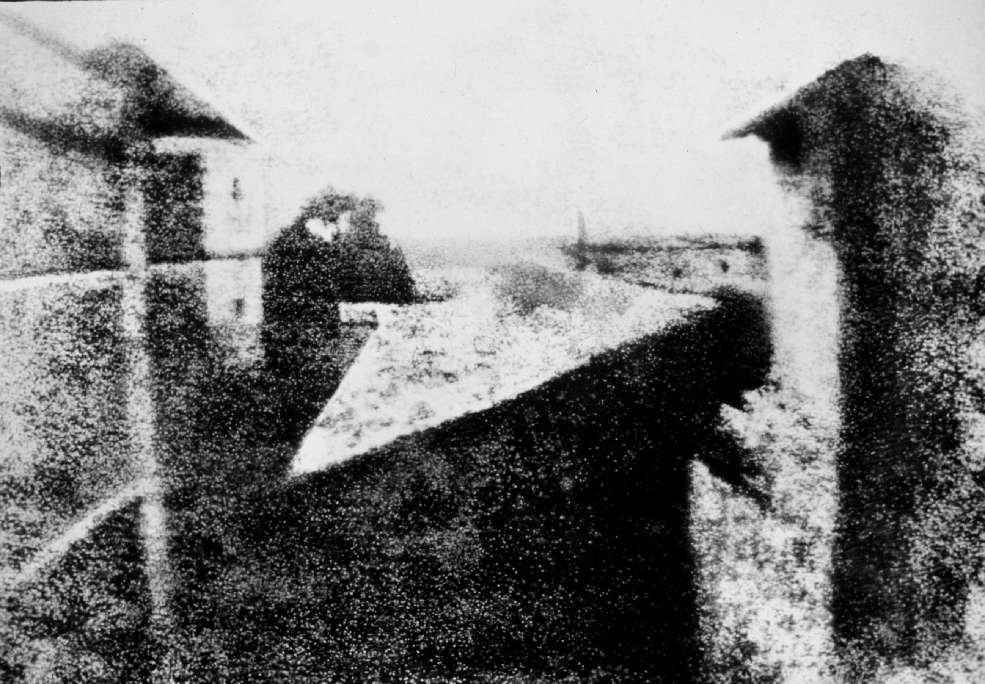
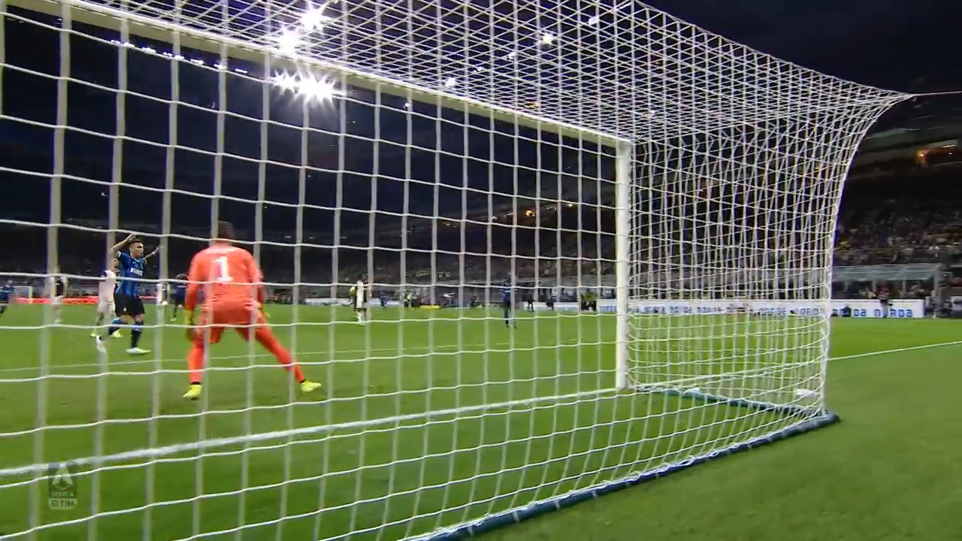
Poverty targeting is similar to the first photo ever taken, when we really need high-resolution video

Slide 20
Poverty targeted social security can provoke social conflict, protests and a breakdown in trust between citizens and government
Social unrest following poverty targeting of a social protection programme using a proxy means test in Indonesia
A key trigger for the civil war in Syria was the replacement of a universal fuel subsidy with a poverty targeted cash transfer that used a proxy means test

Slide 21
Targeting logic of an inclusive lifecycle system
Option 1
Option 2
Universal child benefit
0-4 years
0-11 years
Universal disability benefit
0-69 years
0-64 years
Universal old age pension
70+ years
65+ years

Slide 22
Comparison of an inclusive lifecycle system with the current Pakistan system
Again, inclusive lifecycle system is much more effective than BISP

Slide 23
Key distinction to remember
Reaching the poor
Targeting the poor
This is an objective
This is a means to an end
Universal schemes are very effective in reaching the poor
Targeted schemes usually exclude majority of the poor
Universal schemes are more expensive
Targeted schemes are much cheaper

Slide 24
Some final quotes
Martin Ravallion
“Social-protection policy advocacy turned ‘targeting’ (avoiding leakage to the ‘non-poor’) into a fetish—oddly confusing the ends and means of social protection.”
Amartya Sen
“Benefits targeted at the poorest tend to be poor benefits”

Slide 25




